Slide 1
Welcome to the final CIF of the year
West Suffolk House
Wednesday 26th June 2024

Slide 2
Welcome to our ‘free stuff’ CIF!
Samson and Ofsted: A tail of hope
Dr Jill Griffiths DBV updates
The Autism CHIME project by Teams 4:30pm
Immersive reader – new and existing features Kate Gregory and Rebecca Moran
Rebecca from HNF by Teams at 5pm
Catherine Fraser-Andrews Free stuff and funding
AOB and priorities for next time

Slide 3
Welcome Liz and Samson Bonnelykke from Stanton Primary School

Slide 5
Delivering Better Value
Contact DBV@suffolk.gov.uk for any further information.
Evidence-based Interventions Available on DBV Programme | Suitable for
Essex Educational Psychology Service (EPS) Maths Intervention | KS1 Number based learning sessions. This is for Year 2 pupils who are not yet at ARE for Maths. It is for children who can count 1-9 but have very few other maths skills. Specific assessment available to determine pupils’ suitability for this intervention.
Paired Reading | KS1-KS2 Reading accuracy and fluency. This is ideal for any child in Years 1-4 who is ‘working towards’ ARE
Precision Teaching | EYFS – KS2 Measures the development of key basic skills to fluency. This can be high frequency word spelling, letter formation, number bonds, reading high-frequency words.
Reciprocal Teaching | KS2 Reading comprehension. This is for pupils who have good decoding skills but whose comprehension skills are below ARE.
Self-Regulated Strategy Development | KS2 Writing composition and metacognition skills. This is for Year 5 and 6 pupils who are not at ARE for Writing composition.
Speech and Language Link | EYFS/KS1/KS2 (part-funded by DBV).
Emotion Coaching Hamish and Milo | KS3/KS4 (in mainstream secondary schools and alternative provision). EYFS/KS1/KS2 (part-funded by DBV).

Slide 6
Welcome ARC
For more information about the CHIME project contact:
Samuel Williams
sw2145@cam.ac.uk
Research Assistant | Autism CHIME study
Autism Research Centre | University of Cambridge
Douglas House | 18B Trumpington Road | CAMBRIDGE CB2 8AH
www.autismresearchcentre.com

Slide 7
Welcome Kate Gregory and Rebecca Moran
Immersive reader

Slide 8
Welcome Rebecca Piotrowski High Needs Funding Moderation Lead
rebecca.piotrowski@suffolk.gov.uk

Slide 9
Free Stuff
tescostrongerstarts.org.uk
projects that provide food and support to young people
https://www.coop.co.uk/membership/local-causes
Aviva Community Fund - Supporting Your Community – Aviva
also offer volunteers’ time
Apply for funding | EEF (educationendowmentfoundation.org.uk)
Funding for secondary schools and sixth form colleges (wolfson.org.uk)
Funding for secondary schools to improve the teaching at GCSE and A-Level of subjects that need specialist spaces and equipment.
Senior mental health lead training - GOV.UK (www.gov.uk)

Slide 10
Free Stuff
https://www.internationaltreefoundation.org/uk-grants and Young Tree Champions: Apply now for free trees, tech and support at your school - The Tree Council
Receiving applications now for tree planting projects.
Apply for a grant: Wooden Spoon, the children's charity of rugby | Wooden Spoon.
Funding for projects or initiatives that benefit disadvantaged and disabled children.
Local School Nature Grants - Learning through Landscapes (ltl.org.uk)
£500 of outdoor equipment chosen from a catalogue of over 100 items, and an outdoor learning training course for your staff.
www.awardsforall.org.uk
Offers grants of between £300 and £10,000 for projects that improve communities, and the lives of people within them. It is for voluntary and community groups, schools and health organisations, parish and town councils.

Slide 11
Next Year
The CIFs will be in the afternoon
Venue?
Focus?
Next one?
The format?

Slide 13
.
Mainstream
A termly panel is held in Endeavour House – one week after the application deadline.
The panel is made up of colleagues from settings and colleagues from SES.
Moderators work in pairs and have access to all EHCPs.
The lead moderators and funding manager oversee the panel.

Slide 15
Inclusion Funding Hub - HNF
HEAD OF SEND
FUNDING & Provider
Services
SEND
Policy & Funding manager
High needs funding
Moderation leadS
Joy Settle
&
Rebecca
Piotrowski
Gemma Morgan
April Oliver
Jen Makin – Business Support Officer

Slide 16
Element 1
Element 2
Element 3

Slide 17
Element 1 Funding
Element 1 - £4,000/£5,000
Place Funding
Mainstream – AWPU (Age Weighted Pupil Unit)
Leadership/Teachers/Premises/Resources
SENDCo (mainstream)
Local Authority School – LA
Academy/FE – Education and Skills Funding Agency

Slide 18
Element 2 Funding
Element 2 - £6,000
First funding for SEND provision
Specials – Data from Census
FE – Individual Learning Plan
Mainstream – Notional Funding
Proxy Indicators
*Prior Low Attainment/Deprivation/EAL/Mobility
Local Authority School – LA
Academy/FE – Education and Skills Funding Agency

Slide 19
Element 3
Top Up Funding
High Needs Funding
The Local Authority controls how it is passed on to settings.
Banding system

Slide 20
SEND National Average – 15% of all learners HNF National Average – 25% of all SEND 400 learners – 60 SEND – 15 High NEED
SEND Profile

Slide 21
www.suffolklearning.com/inclusion/high-needs-funding

Slide 23
C
Mild to moderate needs
Some 1:1 support for learning and may need shared support in social time*
Monitored by SENDCo
Generic outside agency advice
Mild/moderate speech and language disorder or delay
Frequent support for socio-communication needs
Low cognitive range (>3 years below ARE)
Regular support for SEMH needs
Regular support for physical/medical needs
Regular support for sensory needs
D
Moderate to significant needs
Most learning requires 1:1 support and may need shared support in social time*
Advice from SENDCo
Specific outside agency advice/support
Moderate speech and language disorder or delay
Significant support for socio-communication needs
Very low cognitive range
Frequent support for SEMH needs
Frequent support for physical/medical needs
Frequent support for sensory needs
E
Significant to severe needs
All learning requires 1:1 support and some 1:1 may be required in social time*
Interventions overseen by SENDCo
Outside agency assessment has been carried out and some contact with learner is ongoing
Moderate/severe speech and language disorder or delay
Constant support for socio-communication needs
Extremely low cognitive range
Significant SEMH needs and daily support
Significant support for physical/medical needs
Significant support for sensory needs
*Support levels for the lower bands are there as a guide and can vary, depending on the primary area of need. There will be variations on an individual basis and provision for some learners will be more resource/intervention based.
F
Severe to complex needs
All learning/all social time requires 1:1 support**
Regular, detailed planning/target setting by SENDCo and outside agencies
Outside agency contact with learner is ongoing or caseload work is completed
Severe speech and language disorder or delay
Constant interventions for socio-communication needs
Cognitive range is around 1st percentile
Personalised interventions required for SEMH needs and constant support for regulation
Constant support for physical/medical needs
Severe sensory needs that are significantly affecting access to learning and daily life
G
Complex and profound needs
Some 2:1 support is required for personal care/interventions**
Multi-agency and specialist support
Ongoing advice from multi agencies and/or therapeutic services
Complex speech and language disorder and delay
Obsessional/ritualistic socio-communication needs affecting most aspects of daily life
Significant cognitive impairment
Complex SEMH needs requiring extensive
multi-agency support
Severe/complex physical/medical needs
Severe/profound sensory needs that are affecting most aspects of daily life
H
Profound and multiple needs
A high level of 2:1 support is required**
Support described as highly specialised
Specialist multi-agency interventions
Ongoing input from multi agencies and/or therapeutic services
Complex/profound speech and language disorder and delay
Obsessional/ritualistic socio-communication needs affecting all aspects of daily life
Extreme delays across cognitive range
Complex/severe SEMH needs requiring
extensive multi-agency interventions
Profound/multiple physical/medical needs
Profound/multiple sensory needs that are affecting all aspects of daily life
**Support levels for the higher bands are as stated for a mainstream or FE settings and will be interpreted on an individual learner basis for specialist settings.

Slide 25
Diagnosis/es
EHCP
Accessing
Alternative
Provision
Attend a
Suffolk Setting

Slide 26
Perspective Lite/ Broadcast +
Angel Solutions
Perspective Lite is a new platform for us to send and receive Spreadsheets and Evidence form data, rather than relying on the secure email thread
Every school has an account already and you can allocate someone to be an HNF Lead, who can receive your data. This does not need to be SENCo or Headteacher necessarily and you can sign more than one person up to this role.
When you send in your evidence forms to Perspective Lite, please either send them on the one excel document, or create a zip file so that only one ‘document’ is uploaded
When you are sent your results this will be in the format of a new spreadsheet, listing your learners with a band. This will then be ready for next term’s submission, unless you are requesting changes/new bands.

Slide 27
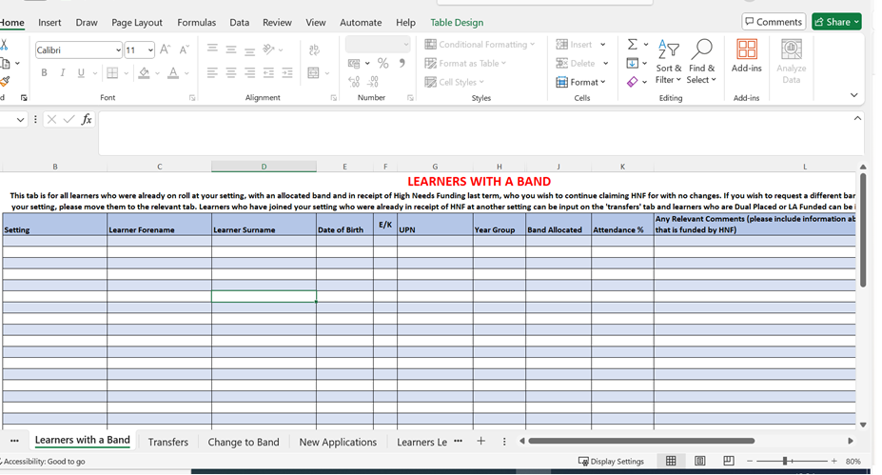
Spreadsheet Updates

Slide 28
Spreadsheet
A spreadsheet is required every term – even if there are no changes.
This is your declaration that the learners remain in the setting and the bands are accurate.
Bands are retained by a learner unless you indicate that a change is needed.
It is possible for a learner to retain a band from age 5 to 25 (with an EHCP).
Band change requests can be for increases or decreases.
Learners moving into your setting from another setting, may have bands and these band can transfer in with the learners.
You must let us know if a learner leaves your setting or goes into alternative provision.
You must let us know the attendance of your HNF learners on your spreadsheets please.
You must let us know if your learners have Suffolk EHCP’s or an EHCP from a different county

Slide 29
Evidence form Updates and Guidance
Evidence form has been updated and changed into an Excel document, so that all moderation can be completed within one document
Please do not remove sections from the document
Please only send in the evidence form as we can look up the EHCP if required
Please put the same Band request on the spreadsheet and Evidence form
Use the banding descriptor terms to define the learner’s level of need
Please do not give a diagnosis that cannot evidence level of need, e.g., diagnosis of ASD could be Band C or Band H, so we need further details
Please ensure you include element 2 funding (£6,000) in your provision mapping.
Ratio costings on your provision map if there is a group intervention with other children present (1:2, 1:3, 1:4 etc)
Do not include: cost of teacher time, cost of hardware, software that will largely benefit others, cost of carrying out annual review,

Slide 30
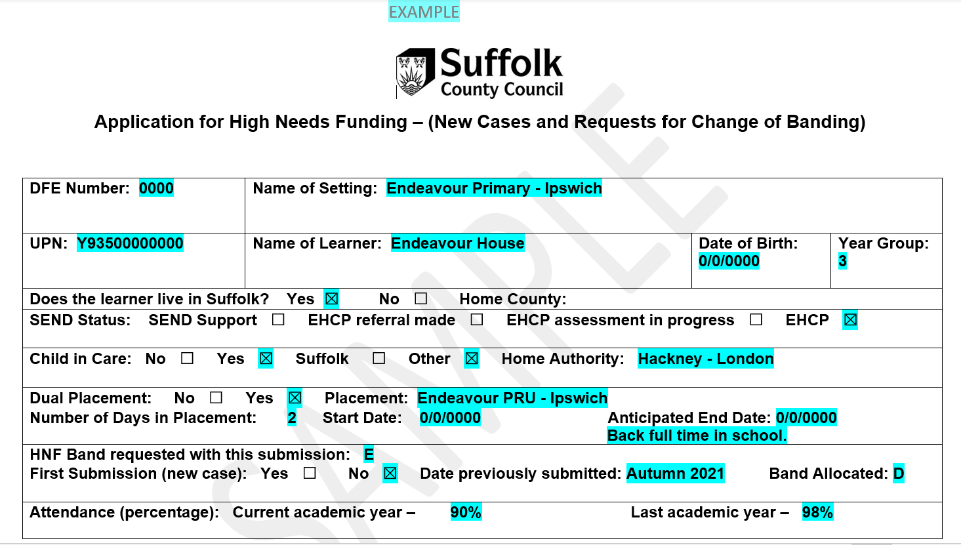
Evidence Form

Slide 31
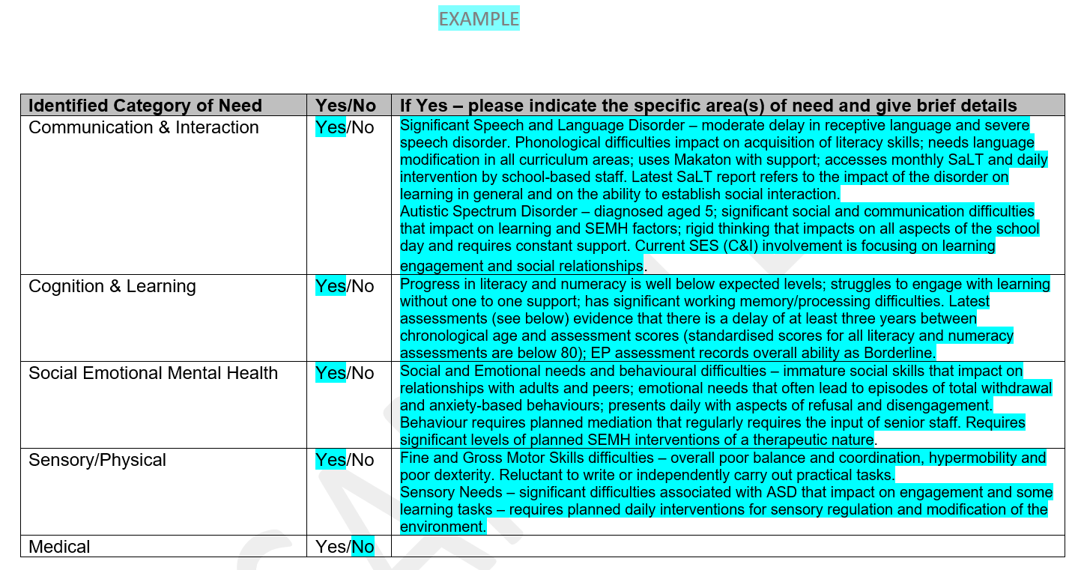
Evidence Form

Slide 32
Evidence Form

Slide 33
Evidence Form

Slide 34
Evidence Form

Slide 35
Evidence Form

Slide 36
Evidence Form

Slide 37
.
Mainstream
A termly panel is held in Endeavour House – one week after the application deadline.
The panel is made up of colleagues from settings and colleagues from SES.
Moderators work in pairs and have access to all EHCPs.
The lead moderators and funding manager oversee the panel.

