Slide 1
Community Inclusion Forums
A partnership to explore approaches to inclusive practice

Slide 2
The Purpose Of Our Community Inclusion Forums:
To promote the inclusion, and achievement of best possible outcomes, for children and young people with SEND and additional needs
To empower staff across the sector to be able to meet these needs, through the sharing of effective practice and providing peer support, and awareness of emerging research
Through the collaboration of stakeholders, we intend to enable access and knowledge and development of the Local Offer
To understand and meet the needs of the local community in Bury & Central Suffolk
To increase community capacity, facilitate co-creation, and raise parental confidence
To improve our wellbeing and reclaim our professional identity

Slide 4
Agenda
Feedback from previous meeting
Transition Pledge update
ARC CHIME research project.
An introduction to developing a calming menu/strategy to support self-regulation.
An introduction to Emotional based school avoidance (EBSA)
Next meeting – agenda and location

Slide 6
An Introduction to Developing a Calming Menu and Strategies to Support Self-Regulation
Jenny Baskett and Jane Albery
C&I Specialist Teachers
Community Inclusion Forum
Notes:
JG

Slide 7
Definition of Self-Regulation
“Self-Regulation is the ability to attain, change or maintain an appropriate level of alertness for a task or situation”.
(Williams and Shellenburger 1996)
“Self-regulation is the ability to flexibly regulate internal states such as emotions or cognition as well as outwardly noticeable states such as behaviour in response to situational or contextual
demands” (Nigg 2017)
“Self-regulation is important for paying attention in class, adapting to the demands of different activities, and keeping emotions in a balanced state” (Blair & Raver 2015)
Notes:
The development of self-regulation and executive function is consistently linked with successful learning, including pre-reading skills, early mathematics and problem solving

Slide 8
Self-Regulation
We self-regulate constantly- think about how you keep alert as the driver on a long motorway journey…
In classrooms, children are confronted with a variety of situations that might systematically elicit varying levels of self-regulation
Notes:
Emotional self-regulation: includes a child’s ability to identify, label and communicate their feelings as well as understanding and managing their emotional responses
Cognitive self-regulation: includes a child’s impulse control, such as waiting their turn and following instructions to stop, sustaining attention, and ignoring distractions, problem-solving, working memory and decision making (executive function skills)

Slide 9
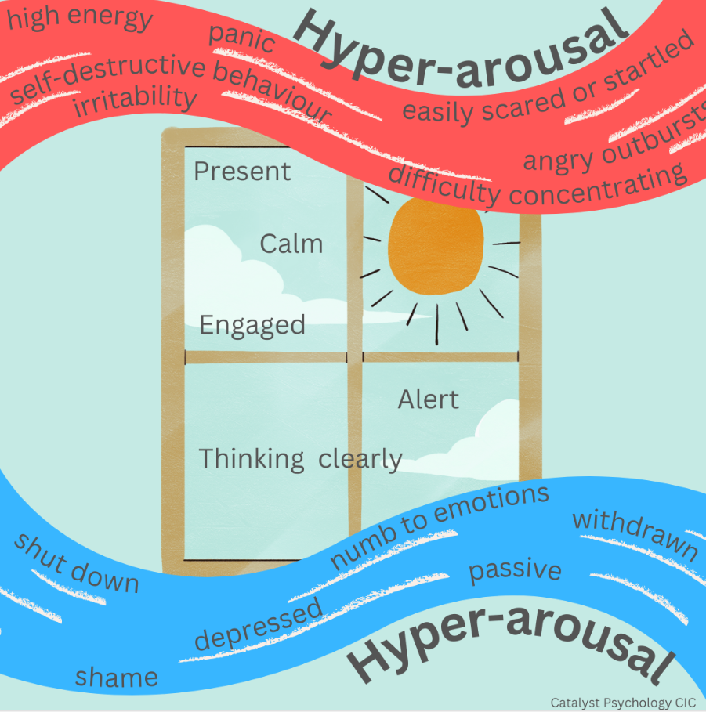
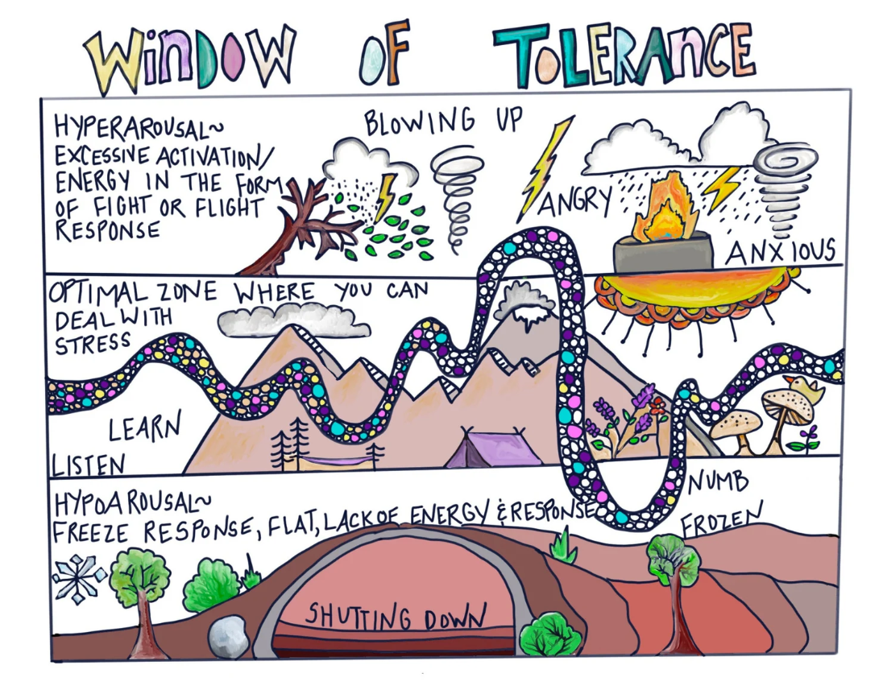
Emotional Regulation
Window of Tolerance
Notes:
Not to watch now but as a reference https://www.youtube.com/watch?v=ZVEDueyZ2C4 – Panda window of tolerance.
Click image for Beaconhouse film footage.

Slide 10
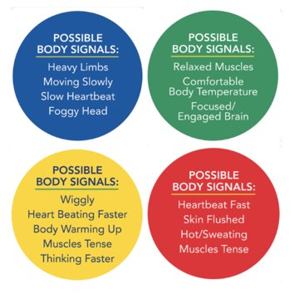
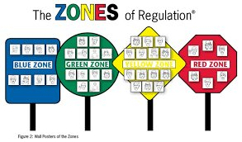
The Zones of Regulation
JA
Notes:
Support that look at regulation zones e.g. Zones of Regulation or Sensory Ladders
Jenny to describe resources and share book – recap – most familiar with Zones of Regulation

Slide 11
Interoception and Self-Regulation
Interoception is an internal sensory system in which the internal physical and emotional states of the body are noticed, recognised/identified and responded to
Interoception skills are required for a range of basic needs, such as knowing when to go to the toilet, and more advanced emotions, like being aware that you are becoming angry or upset and managing these feelings proactively
When children and young people have not yet developed interoception skills they may struggle with their emotions and social interactions
When it comes to emotional self-regulation, interoception is essential- it allows us to notice and connect bodily sensations with emotions
Notes:
Interoception is sometimes referred to as mindful body awareness or somatic awareness.
It's colloquially known as the eighth sense, with the other seven being sight, hearing, taste, smell, touch, proprioception and vestibular (Lynch and Simpson, 2004)
Awareness of both these internal body cues is impacted in individuals who are affected by trauma, including intergenerational trauma, and neurodevelopmental disabilities including the autism spectrum (Schauder, Mash, Bryant and Cascio, 2015; Mahler, 2015).

Slide 12
Interoception and Self-Regulation
Children who experience difficulties with interoception, may need higher levels of co-regulation by their teachers, as they become dysregulated far more quickly than their peers
Once a child or young person can recognise and understand their internal body signals for uncomfortable emotions, they can begin to work out what distresses or stresses them and then how to respond to these stressors
Teaching interoception using activities can help children connect to and learn to understand their own bodies and emotions
This develops the prerequisite skills for self-regulation
Notes:
Interoception is sometimes referred to as mindful body awareness or somatic awareness.
It's colloquially known as the eighth sense, with the other seven being sight, hearing, taste, smell, touch, proprioception and vestibular (Lynch and Simpson, 2004)
Awareness of both these internal body cues is impacted in individuals who are affected by trauma, including intergenerational trauma, and neurodevelopmental disabilities including the autism spectrum (Schauder, Mash, Bryant and Cascio, 2015; Mahler, 2015).
Interoception is sometimes referred to as mindful body awareness or somatic awareness.
It's colloquially known as the eighth sense, with the other seven being sight, hearing, taste, smell, touch, proprioception and vestibular (Lynch and Simpson, 2004)
Awareness of both these internal body cues is impacted in individuals who are affected by trauma, including intergenerational trauma, and neurodevelopmental disabilities including the autism spectrum (Schauder, Mash, Bryant and Cascio, 2015; Mahler, 2015).
In Australia, to improve self-regulation in the classroom effectively, activities to be taught 2-3 times a day. Each activity takes 1-5 minutes
Students observe and label the movement and part of the body involved (for example, toes - stretch and curl up or curl under)
They are then encouraged to identify a change in their body state (for example, hot-cold, soft-hard, stretch-relax) and where they felt that change (arch or ball of foot, on top)
The change in body state is always repeated a second time, and the whole class is asked to focus on noticing what they feel in a very specific part of their body

Slide 13
Interoception Activities
Research in South Australian school has confirmed research from the USA undertaken with adults- interoception activities have both immediate and longer term benefits (Goodall 2019)
Over a period of 8-10 weeks, with regular implementation of interoception activities, individuals were more able to self-regulate their emotions, exhibit less off-task behaviours and engage in more kind and considerate behaviours
There appears to be less on this in the literature and practice in the UK, but it is now being discussed more e.g. in this recent lecture (online) - Events – CRAE (ioe.ac.uk) Considering the impact of Alexythmia alongside Autism (Geoff Bird UCL)
In doing interoception activities, we activate the mindfulness part of the brain which help us calm and focus
Notes:
Interoception activities focus on a particular part of the body for at least 30 seconds.
You might ask the class to sit with their hands clenched tight for 30 seconds.
After the 30 seconds, tell them they are going to do that again, and that you want them to notice the differences in their bodies between now, when they are relaxed, and when they clench their fists again. Name the parts of their bodies where they might notice a change. Do they feel their nails digging into their palm? Do they feel the skin go tight across their knuckles? Do they feel a change in their biceps too?
Get them to repeat the activity for another 30 seconds and try to really notice where they feel a change. When the 30 seconds is up, ask them what they felt.

Slide 14
Interoception Activities
Over time, interoception activities help us to develop the level of interoception required to be able to self-regulate
Ready to Learn - Interoception Kit or Interoception Activity Guide 301 – see resources page for links (free resource)
These activities can be used in any order, though it is reportedly preferable to start at the beginning and work through them
Also see SES Heavy Work Activities overview – this can be shared with staff
Notes:
Interoception is sometimes referred to as mindful body awareness or somatic awareness.
It's colloquially known as the eighth sense, with the other seven being sight, hearing, taste, smell, touch, proprioception and vestibular (Lynch and Simpson, 2004)
Awareness of both these internal body cues is impacted in individuals who are affected by trauma, including intergenerational trauma, and neurodevelopmental disabilities including the autism spectrum (Schauder, Mash, Bryant and Cascio, 2015; Mahler, 2015).

Slide 15
Interoception Activities
Notes:
Example Slide 2: This slide has been set up as an example to show layout and house style. Please follow the ‘less is more’ rule so slides are uncluttered, visually appealing and you don’t add to cognitive overload!
Please use suggested layout as a guide.
Teachers can amend as necessary but maintain background colour, SCC logo, font, size and colour. If you need technical assistance to add images, please speak to Nickie Roberts, SES BSC.

Slide 16
The Zones of Regulation
Notes:
JG

Slide 17
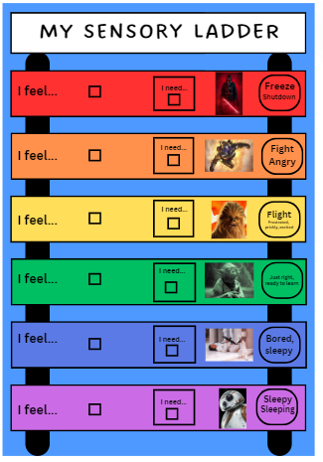
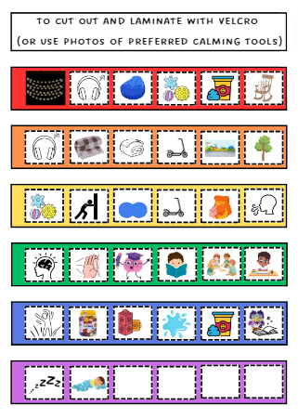
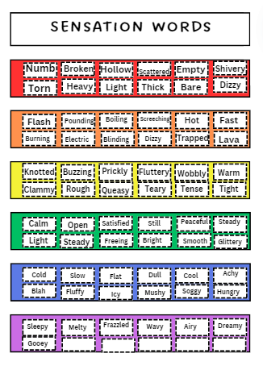
Questions?
Notes:
Example Slide 3: This slide has been set up as an example to show layout and house style. Please follow the ‘less is more’ rule so slides are uncluttered, visually appealing and you don’t add to cognitive overload!
Please use suggested layout as a guide.
Teachers can amend as necessary but maintain background colour, SCC logo, font, size and colour. If you need technical assistance to add images, please speak to Nickie Roberts, SES BSC.

Slide 18
Resources- signposting
Success with Sensory Supports: The ultimate guide to using sensory diets, movement breaks, and sensory circuits at school 2023 Kim Griffin
The Kids' Guide to Staying Awesome and In Control: Simple Stuff to Help Children Regulate their Emotions and Senses Lauren Brukner
Sensory break videos (created by an OT) Sensory Diet Movement Brain Breaks – YouTube
Sensory activity cards (register to download – free) Join Our Community - GriffinOT
Interoception resources – Kelly Mahler www.Kelly-Mahler.com
Sensory Ladders website Sensory Ladders – Sensory integration education about self regulation | free for anyone | anywhere | anytime
series of animal stretches early years interoception (youtube.com)

Slide 19
Resources- signposting
Positive Partnerships | Interoception (videos and resources)
education.sa.gov.au/docs/support-and-inclusion/engagement-and-wellbeing/ready-to-learn-interoception-kit.pdf (interoception toolkit-free)
Interoception 301 Activity Guide (education.sa.gov.au) (further ideas)
Applying interoception skills in the classroom (education.sa.gov.au)
The Window of Tolerance – YouTube (Beacon House video)
Considering the impact of Alexythmia alongside Autism (free lecture Geoff Bird UCL) Events – CRAE (ioe.ac.uk)
Panda's Island of Regulation (youtube.com) (Window of Tolerance- shorter)
Brainstem Soothers (beaconhouse.org.uk) (Information about brain science and a regulating toolkit)

Slide 20
Emotionally-based school avoidance (EBSA)
Dr Rachel Sawyer (Educational Psychologist)
Kelly Francis (Experienced Senior Inclusion Facilitator)
11th and 12th June 2024
Notes:
Rachel to introduce

Slide 21
Aims for session
To understand what we mean by EBSA and contributing factors.
To understand what we mean by an individualised approach and what this looks like.
To share what we can do to support children, carers and staff with responding to EBSA.
Signposting to resources and support services.
Notes:
Rachel
Approx 1 hours
Will be opportunities for discussion/feedback, so plan to go ahead without a break. Layout of building etc.

Slide 22
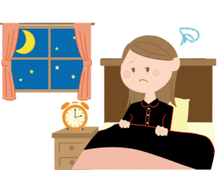
What is EBSA?
‘Emotionally-based school avoidance’: difficulty attending or engaging with school due to experience of negative emotions (e.g. anxiety/ distress). *
Previously/also known as ‘school refusal’, ‘anxiety based avoidance’, ‘emotionally based barriers to attendance’…
10% of CYP currently understood to be ‘persistently absent’. Previous estimates suggested that 1-2% of CYP experience EBSA, likely to be much higher.
Important to view EBSA as a symptom, rather than the difficulty itself. Often complex, long-lasting and multi-faceted.
Notes:
KELLY *Berg 1969- reasonable endeavours from parents to secure attendance (2002). Best known criteria and is still relevant today
Behaviours might include anything from not attending, inconsistent attendance, avoidance or certain lessons/ parts of the school building. Attending but not engaging. Difficulty coming into school in morning, headaches, stomach aches etc.
Signposting to information around EBSA:
Suffolk, West Sussex, Herts etc. Jerricah/
Acknowledge impact of covid on waiting lists- recognition that non-attendance is changing, importance of unmet needs, knock on effect, services stretched more than ever.

Slide 23
What causes EBSA?
Research suggests that there are a range of factors and circumstances that can contribute to attendance difficulties. These are best understood in terms of a ‘push and pull’ model.
School factors
Home factors
Within-child factors
Notes:
Kelly
These factors can be in isolation or overlapping/working together. Usually presence of all three.
Both risk and protective factors (things that encourage or increase risk)
Pull factors (towards school)- friendships, good staff relationships, motivation to learn (towards home)- concern for a parent, don't have to face the difficulty.
Push factors (towards home)- unmet need, high anxiety
Unique to each young person

Slide 24
EBSA – The anxiety cycle that can maintain difficulties
The Anxiety Cycle
Notes:
KAY

Slide 25
The need for an individualised approach
EBSA is hugely individual and varies between schools and families
EBSA impacts the wider family and not just the individual CYP
A multi-agency and systems approach to support is needed
CYP voice should be at the centre of this support.
This makes your job, and implementing a universal offer of support, difficult!
Notes:
Rachel
Berg 2002

Slide 26
SPIRAL Principles (Sawyer, 2022)
Thesis research into parental experience of EBSA, with a focus on ‘what works’ to support successful reintegration.
Implications for a range of professionals in supporting families, CYP and schools, and the need for early intervention and support.
Consideration of parent experience, including presence of blame and not feeling listened to, aligning with previous research: Not Fine in School: Not-Fine-in-School-march-2020-survey (wsimg.com)
Highlights importance of language and approach (supportive, collaborative and curious).
Notes:
Rachel
Print overview to take with me and put on tables, maybe print recommendations table also?

Slide 27
Supporting Parents & Carers
Promoting Sense of Belonging
Including and Informing Parents &Carers
Raising awareness of EBSA
Accessing external professionals
Lessons learnt from Covid
Parent Carers, Schools,
Local Authority, Health
working collaboratively
Notes:
Rachel

Slide 28
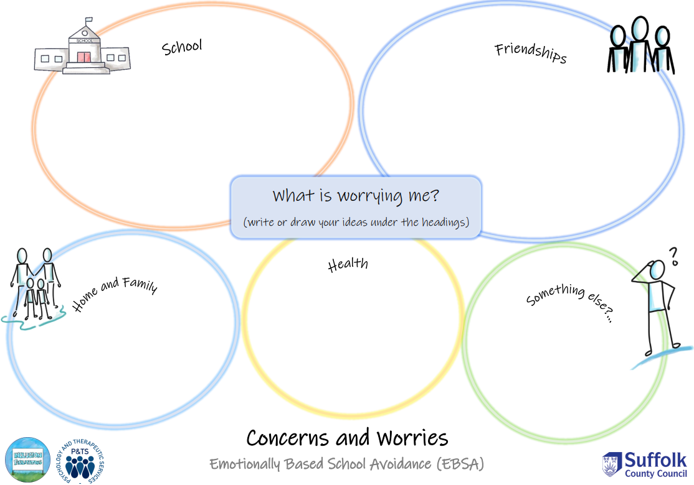
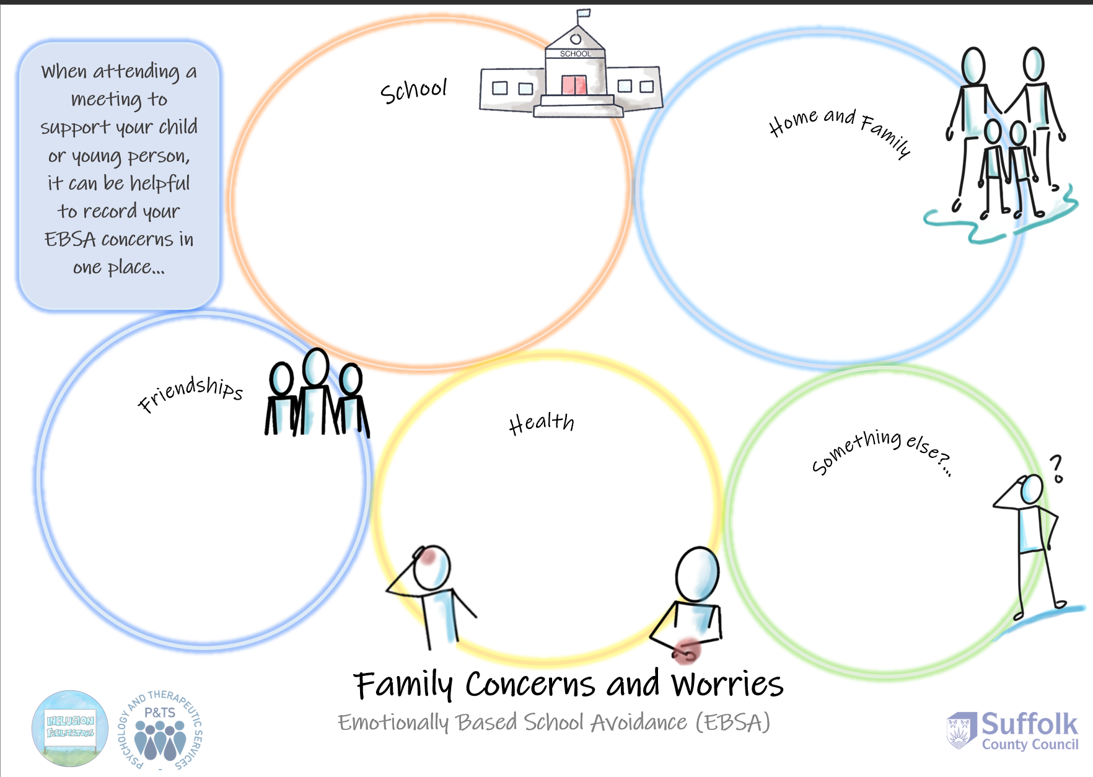
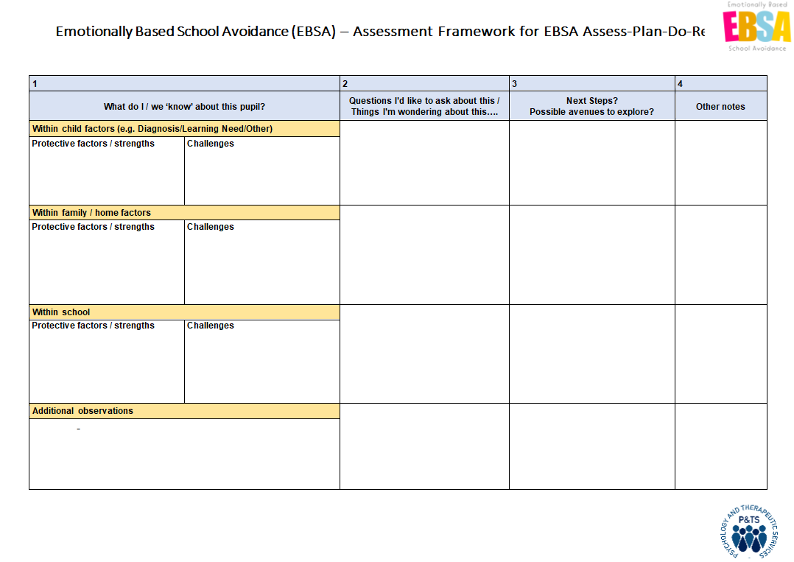
Gathering the Voices
Have efforts been made to gather the Child’s voice? Does the school/ family/carers need support to gather Child views? Does the school have an ELSA who could help with this?
Have the parent/carer views been gathered and represented? Is professional support needed to provide further information or input these into an action plan?
These are an important step towards establishing reasons behind attendance difficulties.
Child Voice
Home Voice
School Voice
Notes:
Kelly
In line with IF role.
Sometimes need to challenge schools and promote accountability. Varies between settings and individuals.
Remember: Not your role to do this, but to support schools to do so and to utilise this effectively.
Rachel- Note with ELSA: Not a long term solution, or necessarily appropriate in all cases, but good skill set that can support with gathering views that many schools have available.

Slide 29
When the child is not consistently attending...
Lessons learnt from Covid: Is there more that the school can de doing to maintain relationships? To support feelings of anxiety and develop coping skills? Can work be sent home?
This can make implementing school-based support more challenging, meaning that a multi-systems approach is often needed.
However, schools can take steps to support CYP remotely...
Need to maintain and build relationships remotely: Maintaining Connections
Consider psychological safety: Feelings of safety
Notes:
Rachel.
Refer back to SPIRAL and Lessons Learnt from Covid plus RAAC.
Relief and reduced pressure, able to engage, maintained relationships- wellbeing phone calls etc.
Capacity of each school will differ, also policies. EWOs well placed to challenge this- sending work home, virtual catch ups, offers of remote support, Family support practitioners. How do you feel about this? Do you feel confident to do this? Do you consider this part of your role? Reducing emphasis on the family.
Some CYP will find this hard (caveat)- has this been a reasonable attempt? Think about consistency and trust. Not just tried once- similar to key adults. Has this been done with them, not to them? Are parents involved? Etc.

Slide 30
EBSA and Special Educational Needs (Disability)
Research has consistently found a relationship between EBSA and SEND, with attendance difficulties a symptom of a wider need.
Has the school identified any additional unmet needs? Is support for SEND in place?
Remember: Social, Emotional and Mental Health difficulties are also SEND.
Ensuring that SEND concerns are explored
Signposting resources and support to families
Helping to identify appropriate teams/ professionals
School SENCO/DT
Notes:
Rachel
Note on Covid.
SEND- may not necessarily approach this differently, still need an individualised approach, however greater range of risk factors that may make school overwhelming. Think back to contributing and maintaining factors (impact oon home).
SEMH (mental health needs, attachment, social difficulties etc.) Dismissive approach to anxiety can delay effective support. Do schools actually have this in hand? Promote quick discussion about if this is something they're seeing.
Importance of your role in helping schools to reframe it and take it seriously.
Attendance difficulties as a symptom of wider needs- is there a more appropriate team?

Slide 31
Supporting parent/carers
Research highlights the importance of supporting parents both practically and emotionally, although this will differ between families.
These might be:
Support networks and access to mental health support/ peer support groups which can be valuable to families
Consideration of other unmet needs or difficult circumstances that need supporting within the home environment
Access to psychoeducation approaches
Important that support for parent/carers takes place alongside school support
Notes:
Kelly and Rachel
Often focus on schools. Really interested in understanding what else is recommended- post it notes on tables- what would you be signposting parents to? What can they access?
Post it notes.
Parents often a source of difficulty within their role (understandabley), but within our work often say they don't feel listened to by schools. Often defenses up. Building relationships, ensuring they have support and capacity. Shae example from research.
What else might they not have?
Blurred line between services- not your role always to support, but to help them find it. Service anecdotal parent support (IFs)

Slide 32
So, what can schools be doing?
Assess, Plan, Do, Review (typical SEND support involving the SENCO and SLT)
Use of the whole-school audit tool and/or Suffolk EBSA Resources to consider universal provision and school culture
Would school staff benefit from further training, information or ways to connect Pastoral, SEND and Attendance support? Who could provide this?
Could an external professional help school staff to unpick the CYP's difficulties further? Have they accessed a Solution Circle? Or an AANT?
Develop EBSA Action Plans with use of the CYP/Parent voice
Notes:
Rachel
First, ensure that typical SEND offer been implemented (including pastoral and learning). What has been tried already?
From Jan 2024- link SES teacher to discuss whole school issues. Has this been raised? Hoping EPs will follow in future but TBC. Other ways to access support. ISMs?
EWO role to have these conversations with school and determine if they have taken these steps.

Slide 33
EBSA Plan Example
Notes:
Anonymised versions from Kelly.
Could be useful to help frame EWO conversations with schools and families, be a supportive role, gives a framework. Currently used by Ifs and ensures a joined up approach.
When schools are trying to support reintegration, often talk about lessons, but need to think about relationships and safety (THINK SPIRAL)
Including parents and child in plan
Multi systems approach
Creating back up plans

Slide 34
Helpful links and resources
Going back to school | Childline
Suffolk EBSA Resources (for professionals, families and young people): EBSA (Emotionally Based School Avoidance) - Suffolk County Council
EBSA Horizons School Training: EdPsychEd | EBSA Horizons School Training
Not Fine in School/ Square Peg Groups
Parent workshops | Norfolk and Suffolk NHS (nsft.nhs.uk)
Psychology and Therapeutic Services - Suffolk County Council
Please talk to/ email me! Rachel.sawyer@suffolk.gov.uk
Notes:
Add

Slide 35
Anything else?
What would you like to see happen?
Any thoughts/ feedback on our EBSA resources?
What support or collaboration would you like from/with our service going forwards?
Any questions?
Notes:
Rachel
Email our line managers!

Slide 36
Transition pledge update.

Slide 37
Questions & Dates for next year
Wednesday 9th October
Wednesday 27th November
Wednesday 29th January
Wednesday 26th March
Wednesday 21st May
Wednesday 27th June

