Slide 1
Considering staff wellbeing
Presentation for Community Inclusion Forum
January 2024
What an educational setting can do to facilitate staff wellbeing.
The systems around the individuals
What an individual staff member can do to facilitate their own wellbeing.
The individual (s)

Slide 2
Points covered:
Why are we talking about staff wellbeing?
Ways we conceptualise wellbeing; stress and resilience
What can I do? What can the system do?
Wellbeing audit
Resources to consider wellbeing in education

Slide 3
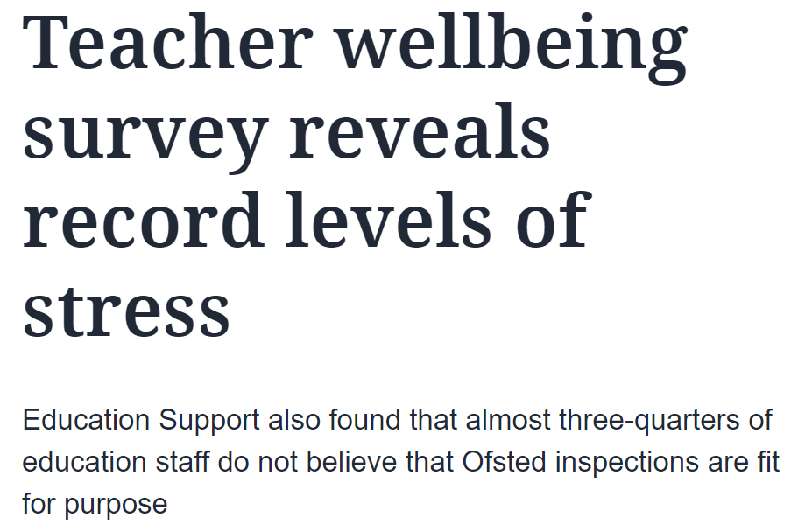
“According to the UK’s Health and Safety Executive, teaching staff and education professionals report the highest rates of work-related stress, depression and anxiety in Britain”. (Gov.uk)
“Work-related stress is extremely prevalent within the teaching profession” (National Education Union)
In 2023 78% of teachers described themselves as stressed.

Slide 4
Wellbeing and stress
Notes:
Toxic stress leads to changes in our brain, hormonal and immune systems. These changes, in turn, are associated with behavioral and general health.

Slide 5
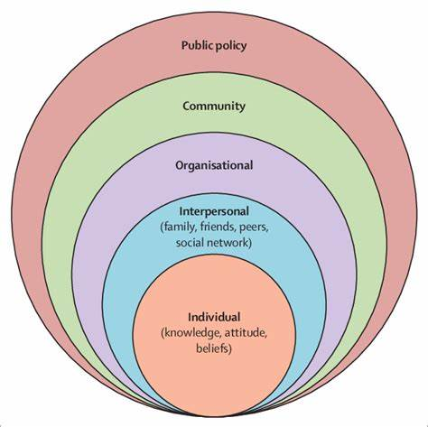
Protective factor models of resilience
____________________gov initiatives/drive to support wellbeing, guidance/charters
The Education Staff Wellbeing Charter - November 2021 (publishing.service.gov.uk)
________________connection to community, helping others, acts of kindness
________________workplace supervision, support, role-models
Supporting staff wellbeing in schools | Anna Freud
DS79597 - PDF eBook - 10 ways to create a culture of positive staff wellbeing v10.pdf (tes.com)
________________co-regulation, connectedness to family, peers, groups
___________self-regulation, impulse control, goal setting, empathy, coping skills
5 Ways to Wellbeing | Mind - Mind
Interactive stress container tool for staff : Mentally Healthy Schools

Slide 6
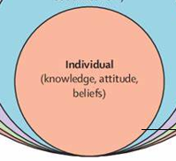
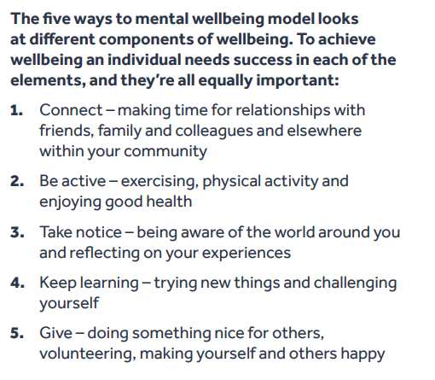
https://www.mind.org.uk/workplace/mental-health-at-work/taking-care-of-yourself/five-ways-to-wellbeing/

Slide 7
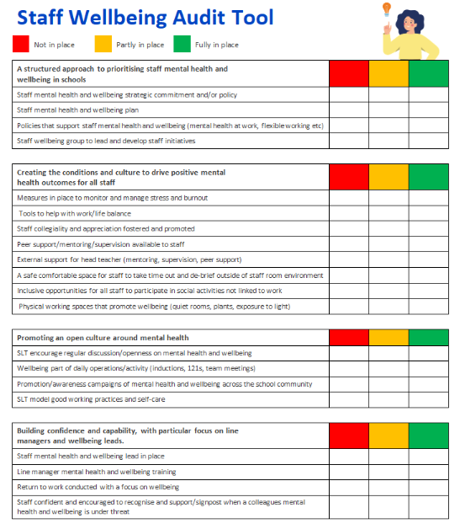
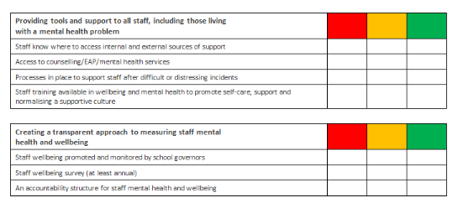
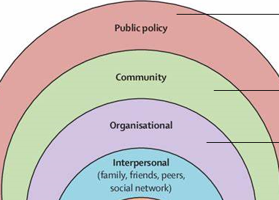
staff-wellbeing-audit.docx (live.com)
Notes:
Offer as activity

Slide 9
NOVEMBER 2023
SOPHIE BOETTCHER
Education Support:
Mental Health and Wellbeing Support for the entire education workforce

Slide 10
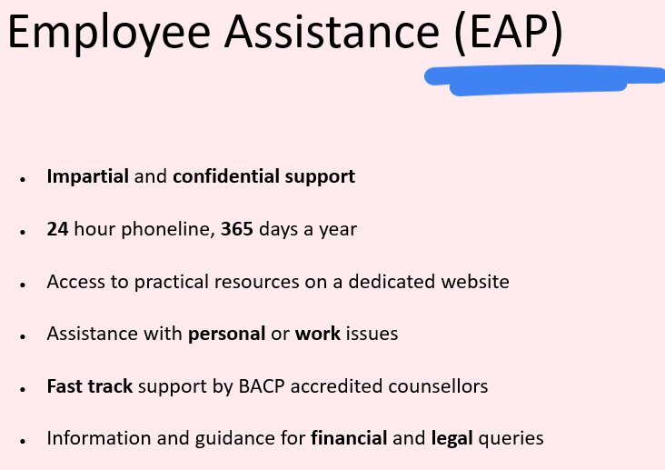
Our Support
We support individuals and help schools, colleges and universities to improve the mental health and wellbeing of their staff – All teachers and education staff!
Helpline – 08000 562 561
Grants
Wellbeing Service (School Leaders Service)
Resources Mental health & wellbeing resources for teachers, education staff & schools (educationsupport.org.uk)
Research
Employee Assistance Programme
Education Support, supporting teachers and education staff (https://www.educationsupport.org.uk/)
Notes:
Free!
Available 24/7 365
Staffed by counsellors
Personal and work related issues
In the moment support
Completely confidential

Slide 11
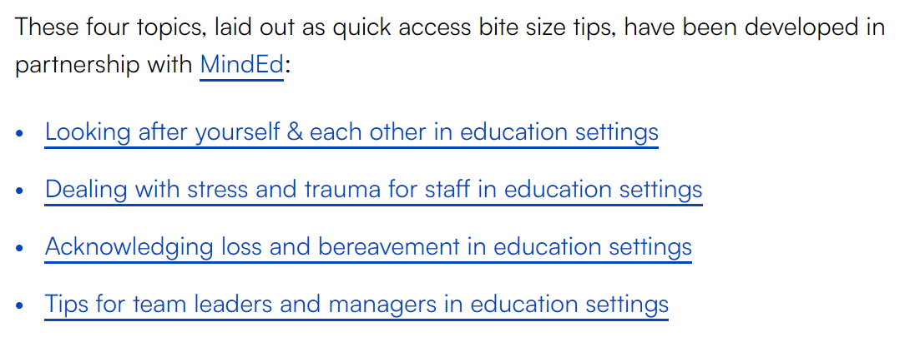
Measuring wellbeing
The staff well-being charter encourages the measuring of staff wellbeing so you can monitor and respond to any changes. Some resources to help this include:
What Works Centre for Wellbeing’s guide on improving staff wellbeing in schools and colleges (see next slide)
Education Support’s staff wellbeing audit tool
Department for Work and Pensions’ workplace wellbeing tool that helps employers work out the costs of poor employee health (see slide 10)
the Thriving Places Index which identifies the local conditions for wellbeing and measures whether these are being delivered fairly and sustainably
The Measures of National Well-being Dashboard monitors and reports on wellbeing of the UK.
Supporting staff wellbeing and mental health
Some resources to help support your staff’s mental wellbeing include:
guidance on promoting and supporting mental health and wellbeing in schools and colleges (gov.uk document; includes reference to the 8 key principles of a whole school approach – principle / chapter 5 focuses on staff wellbeing)
Education Support’s resources to help your organisation with mental health and wellbeing including free 24 hour helpline for education staff
Mentally Healthy Schools which is a directory of resources for schools
Anna Freud’s guidance on supporting staff wellbeing in schools (see downloaded copy)
Mental Health at Work resources for schools
mindfulness and meditation sessions through Headspace for Educators
the NEOST staff wellbeing guide for schools and trusts
the local mental health support database from the Hub of Hope
Education Support’s wellbeing tips for teachers

Slide 12
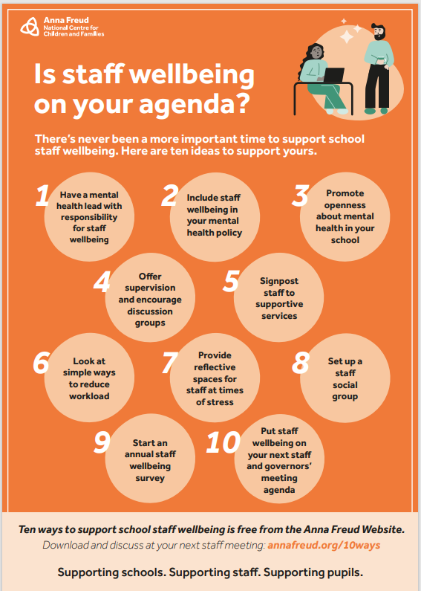
Useful resources
Interactive stress container tool for staff : Mentally Healthy Schools
This interactive online tool will lead staff through steps to help them:
think about their individual capacity for stress
identify sources of stress in their lives
recognise how stress presents to them
helpful and unhelpful coping strategies for stress
Ten ways to support school staff wellbeing | Anna Freud (there is a poster, a booklet and a report to download)
5 Steps to Mental Health and wellbeing - Tips for staff from the Anna Freud website. - A really helpful starting point for considering staff wellbeing within an education setting. It is free to use but you have to register with them to be able to use their action planning tool.

Slide 13
Training and Webinars
Supporting Your Staff Group or Team YouTube Webinar - A 52 minute webinar that addresses challenges that school leaders face, helping them to:
Understand the needs of vulnerable staff,
Develop knowledge about core beliefs/behaviours that build resilient organisations,
Support leaders to consider how they can support the wellbeing of their team, and individuals,
The importance of looking after your own wellbeing.
Supporting Wellbeing Across the School Webinar Part 1
Supporting Wellbeing Across the School Webinar Part 2
These two 31 minute webinars focus on:
Looking after your own wellbeing, the wellbeing of others
Supporting the wellbeing of young people.
For access to lots of free webinars on topics such as stress & anxiety management, mindfulness, relationship break-ups, managing worry, bereavement: Online Workshops and Courses - Wellbeing Suffolk (wellbeingnands.co.uk)

