Slide 1
Considering staff wellbeing
Presentation for Community Inclusion Forum
January 2024
What an educational setting can do to facilitate staff wellbeing.
The systems around the individuals
What an individual staff member can do to facilitate their own wellbeing.
The individual (s)

Slide 2
https://www.mind.org.uk/workplace/mental-health-at-work/taking-care-of-yourself/five-ways-to-wellbeing/
Connect
There is strong evidence that indicates that feeling close to, and valued by, other people is a fundamental human need and one that contributes to functioning well in the world.
It’s clear that social relationships are critical for promoting wellbeing and for acting as a buffer against mental ill health for people of all ages.
With this in mind, try to do something different today and make a connection.
Be active
Regular physical activity is associated with lower rates of depression and anxiety across all age groups.
Exercise is essential for slowing age-related cognitive decline and for promoting well-being.
But it doesn’t need to be particularly intense for you to feel good - slower-paced activities, such as walking, can have the benefit of encouraging social interactions as well providing some level of exercise.
Notes:
Five Ways to Wellbeing are evidence-based actions that people can do in their daily lives, or can be designed into policies and services, that should improve wellbeing: Connect, Give, Learn, Take notice; Be Active. They were developed in 2008 based on a Government Office for Science Foresight Report into Mental Capital and wellbeing.

Slide 3
Take notice
Reminding yourself to ‘take notice’ can strengthen and broaden awareness.
Studies have shown that being aware of what is taking place in the present directly enhances your well-being and savouring ‘the moment’ can help to reaffirm your life priorities.
Heightened awareness also enhances your self-understanding and allows you to make positive choices based on your own values and motivations.
Learn
Continued learning through life enhances self-esteem and encourages social interaction and a more active life.
Anecdotal evidence suggests that the opportunity to engage in work or educational activities particularly helps to lift older people out of depression.
The practice of setting goals, which is related to adult learning in particular, has been strongly associated with higher levels of wellbeing.
Give
Participation in social and community life has attracted a lot of attention in the field of wellbeing research.
Individuals who report a greater interest in helping others are more likely to rate themselves as happy.
Research into actions for promoting happiness has shown that committing an act of kindness once a week over a six-week period is associated with an increase in wellbeing.

Slide 4
Emotional connection
Meaning and purpose
Status and respect
community
achievement
movement
privacy
attention
control
security
Food and drink
sleep
Suffolk Mind use an ‘organising idea’ that we all have physical and emotional needs and a set of skills and resources that we’re born with to meet those needs. This is referred to as the Emotional Needs & Resources Model. There is more explanation here: Emotional Needs & Resources - Suffolk Mind. There is a proforma people could use to aid reflection here: The Emotional Needs Audit (hgi.org.uk)

Slide 5
NourishingDepleting.pdf (getselfhelp.co.uk)
A typical work day / week consists of:
Does this tend to nourish or deplete me:
So my next step will be:

Slide 6
Education staff wellbeing charter - GOV.UK (www.gov.uk)
The charter:
was created by the education sector to highlight staff wellbeing in the education sector
is a tool for schools and colleges to create and publicly commit to their own wellbeing strategies
is a declaration to protect, promote and enhance the wellbeing and mental health of everyone working in state education
Use the charter to:
show staff that you take their wellbeing seriously
open a conversation with staff about their wellbeing and mental health
create a staff wellbeing strategy
create a wellbeing-focused culture
The Education Staff Wellbeing Charter - November 2021 (publishing.service.gov.uk)

Slide 7
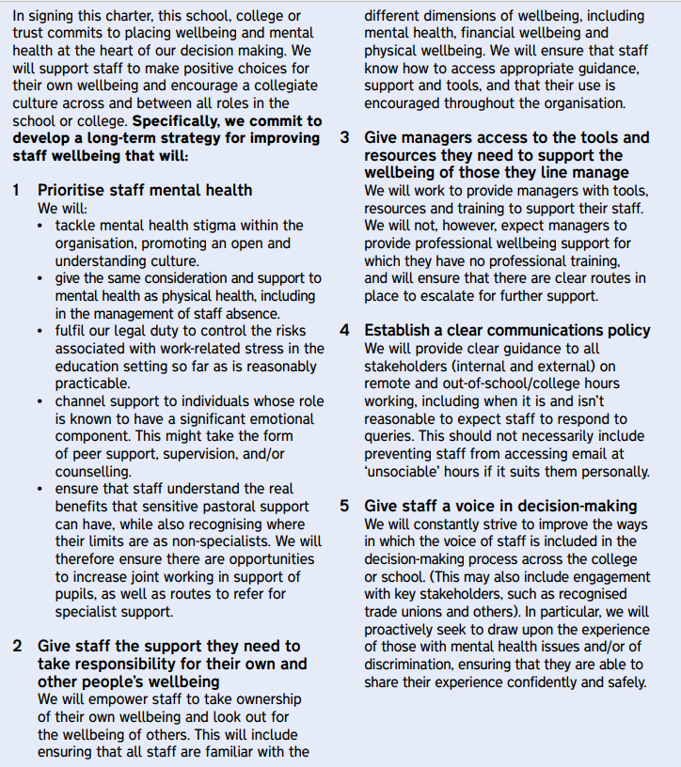
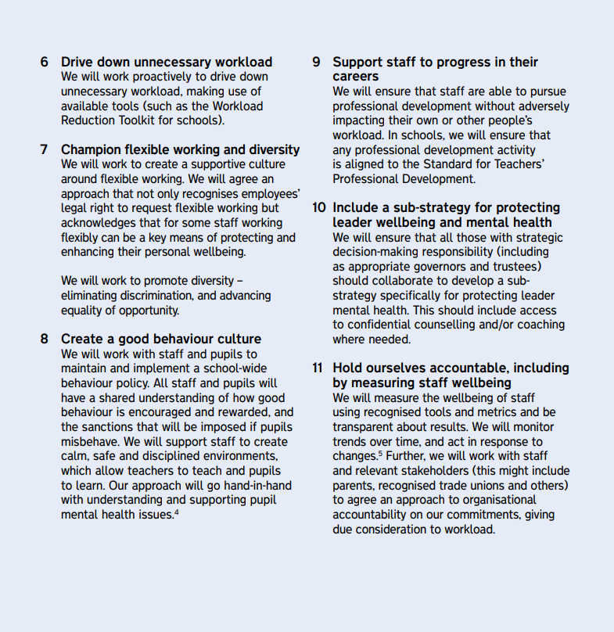

Slide 8
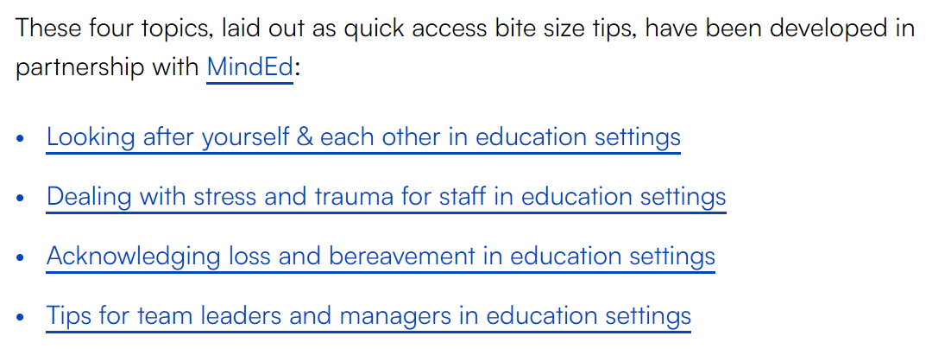
Measuring wellbeing
The staff well-being charter encourages the measuring of staff wellbeing so you can monitor and respond to any changes. Some resources to help this include:
What Works Centre for Wellbeing’s guide on improving staff wellbeing in schools and colleges (see next slide)
Education Support’s staff wellbeing audit tool
Department for Work and Pensions’ workplace wellbeing tool that helps employers work out the costs of poor employee health (see slide 10)
the Thriving Places Index which identifies the local conditions for wellbeing and measures whether these are being delivered fairly and sustainably
The Measures of National Well-being Dashboard monitors and reports on wellbeing of the UK.
Supporting staff wellbeing and mental health
Some resources to help support your staff’s mental wellbeing include:
guidance on promoting and supporting mental health and wellbeing in schools and colleges (gov.uk document; includes reference to the 8 key principles of a whole school approach – principle / chapter 5 focuses on staff wellbeing)
Education Support’s resources to help your organisation with mental health and wellbeing including free 24 hour helpline for education staff
Mentally Healthy Schools which is a directory of resources for schools
Anna Freud’s guidance on supporting staff wellbeing in schools (see downloaded copy)
Mental Health at Work resources for schools
mindfulness and meditation sessions through Headspace for Educators
the NEOST staff wellbeing guide for schools and trusts
the local mental health support database from the Hub of Hope
Education Support’s wellbeing tips for teachers

Slide 9
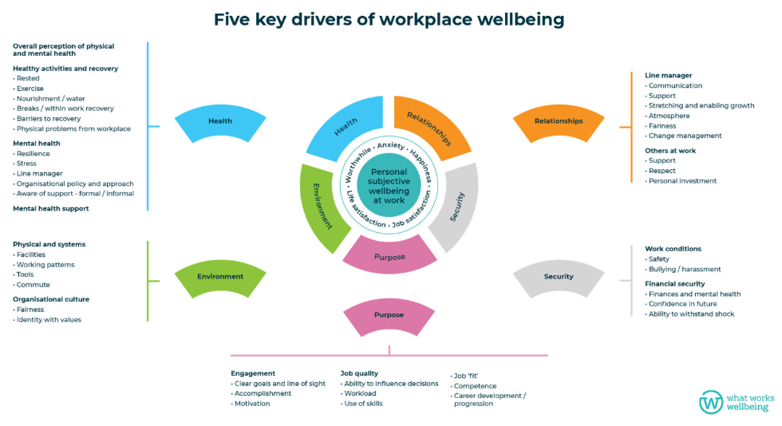

Slide 10
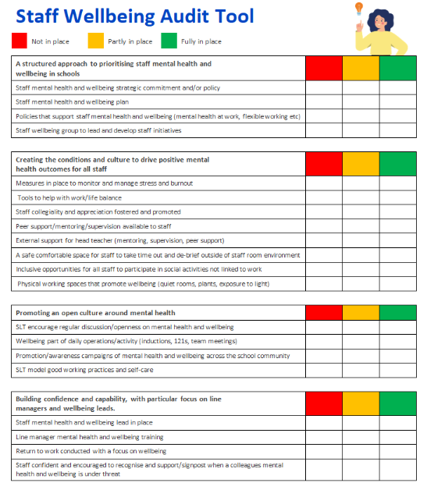
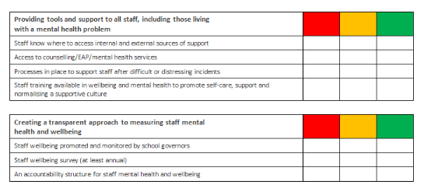
staff-wellbeing-audit.docx (live.com)

Slide 11
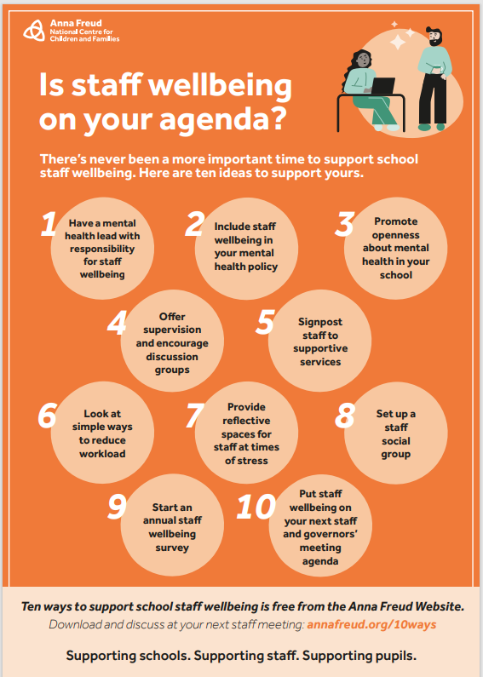
Useful resources
Interactive stress container tool for staff : Mentally Healthy Schools
This interactive online tool will lead staff through steps to help them:
think about their individual capacity for stress
identify sources of stress in their lives
recognise how stress presents to them
helpful and unhelpful coping strategies for stress
Ten ways to support school staff wellbeing | Anna Freud (there is a poster, a booklet and a report to download)
5 Steps to Mental Health and wellbeing - Tips for staff from the Anna Freud website. - A really helpful starting point for considering staff wellbeing within an education setting. It is free to use but you have to register with them to be able to use their action planning tool.

Slide 12
Training and Webinars
Supporting Your Staff Group or Team YouTube Webinar - A 52 minute webinar that addresses challenges that school leaders face, helping them to:
Understand the needs of vulnerable staff,
Develop knowledge about core beliefs/behaviours that build resilient organisations,
Support leaders to consider how they can support the wellbeing of their team, and individuals,
The importance of looking after your own wellbeing.
Supporting Wellbeing Across the School Webinar Part 1
Supporting Wellbeing Across the School Webinar Part 2
These two 31 minute webinars focus on:
Looking after your own wellbeing, the wellbeing of others
Supporting the wellbeing of young people.
For access to lots of free webinars on topics such as stress & anxiety management, mindfulness, relationship break-ups, managing worry, bereavement: Online Workshops and Courses - Wellbeing Suffolk (wellbeingnands.co.uk)

Slide 13
NOVEMBER 2023
SOPHIE BOETTCHER
Education Support:
Mental Health and Wellbeing Support for the entire education workforce

Slide 14
Our mission is to improve the mental health and wellbeing of teachers and education staff. We believe that better mental health leads to better education.

Slide 15
Our Support
We support individuals and help schools, colleges and universities to improve the mental health and wellbeing of their staff – All teachers and education staff!
Helpline – 08000 562 561
Grants
Wellbeing Service (School Leaders Service)
Resources Mental health & wellbeing resources for teachers, education staff & schools (educationsupport.org.uk)
Research
Employee Assistance Programme
Education Support, supporting teachers and education staff (https://www.educationsupport.org.uk/)
Notes:
Free!
Available 24/7 365
Staffed by counsellors
Personal and work related issues
In the moment support
Completely confidential

Slide 16
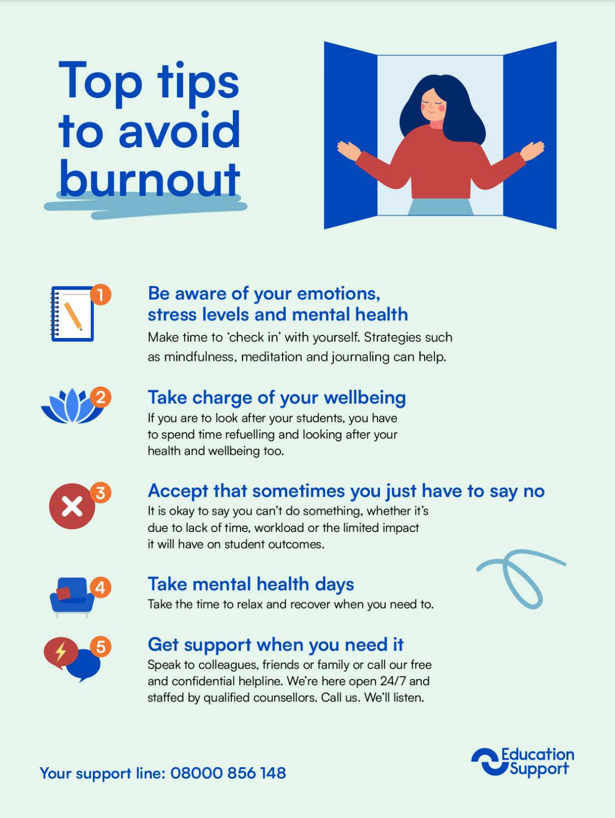
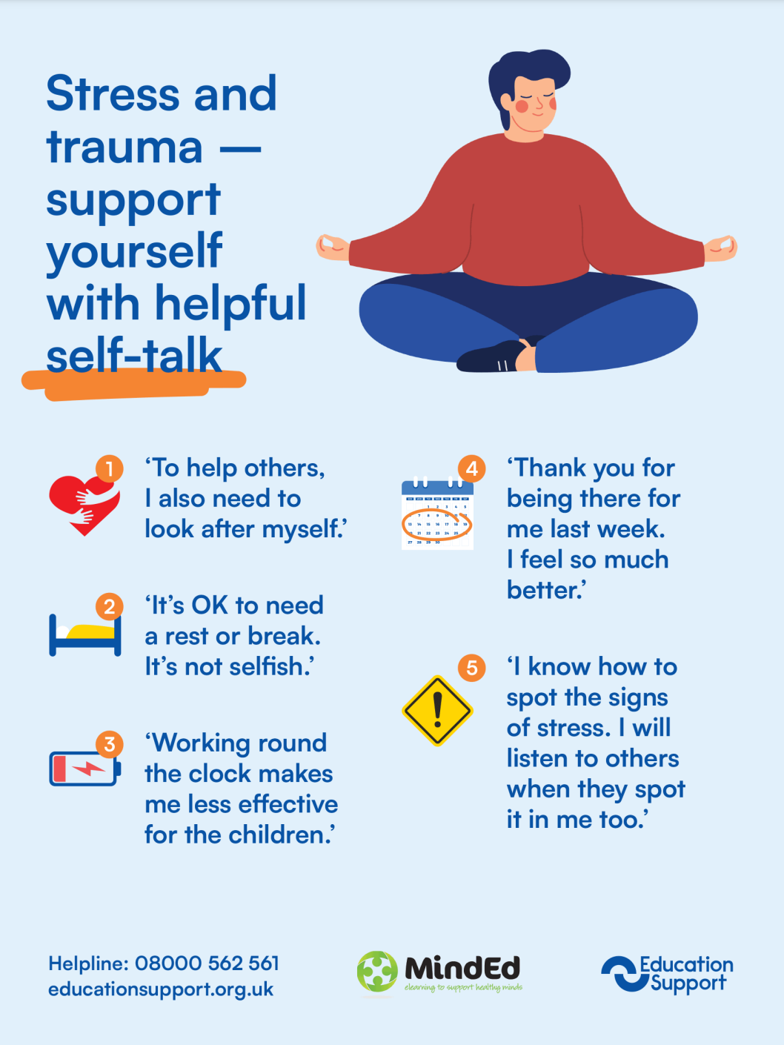

Slide 18
Employee Assistance (EAP)
Impartial and confidential support
24 hour phoneline, 365 days a year
Access to practical resources on a dedicated website
Assistance with personal or work issues
Fast track support by BACP accredited counsellors
Information and guidance for financial and legal queries

