Slide 1
Community Inclusion Forums
A partnership to explore approaches to inclusive practice

Slide 2
The Purpose Of Our Community Inclusion Forums:
To promote the inclusion, and achievement of best possible outcomes, for children and young people with SEND and additional needs
To empower staff across the sector to be able to meet these needs, through the sharing of effective practice and providing peer support, and awareness of emerging research
Through the collaboration of stakeholders, we intend to enable access and knowledge and development of the Local Offer
To understand and meet the needs of the local community in Bury & Central Suffolk
To increase community capacity, facilitate co-creation, and raise parental confidence
To improve our wellbeing and reclaim our professional identity

Slide 3
Agenda
AP update
Feedback from previous meeting
Update on the current Mental Health Offer
Transition charter proposal
Networking & Resource sharing activity
Next meeting – agenda and location

Slide 5
Feedback from last meeting
Mental Health Support
Sign posting information
High needs funding
CPD for specific needs
Training for parents on dealing with anxiety
Early Help Support
Support for low level literacy
Better partnerships with feeder schools
ECHNA related support

Slide 6
Suffolk Children, Families and Young Persons Services: Early Intervention CAMHS
Under 18 Wellbeing Team
Mental Health Support Team
Psychology in Schools Team
Notes:
Explain how U18 and MHST get referrals – MHST via school consultations, U18 via EWH or step downs – core teams.

Slide 7
Under 18 Wellbeing
Primary Mental Health Worker (PMHW)
Psychological Therapist (CBT, IPT-A and EMDR)
Arts Psychotherapist
Children’s Wellbeing Practitioners (CWP)
Systemic Family Therapy pathway
Virtual offer – jointly with PST www.nsft.nhs.uk/parent-workshops​
Parenting groups – Timid to Tiger
Notes:
PMHW – Provide assessment and formulations, consultations to EHT, whole school approach, school nurses, GP’s, social workers, other professionals in Suffolk where parents provide consent. Also will offer some bespoke intervention.
CBT – offer assessment, formulation and intervention including EMDR, IPT-A Trauma focussed CBT
Arts Psychotherapist – offers assessments, formulations and creative space for people who may find engaging in a more formal ‘talking’ based therapy harder.
CWP – offer assessment, formulations and guided self-help directly with children over the age of (approx.) 11 and with parents under the age of 11.
Systemic FT – This is new and will be coming on board in the next couple of month where we can offer family therapy within an early intervention pathway, in the same way out colleagues have been offering this within secondary services.
Virtual offer – this is a great offer across Suffolk and beyond for parents and professionals where you can sign up and watch live or see the YouTube videos pre-recorded, link in slide. Explain some of the workshops – EMSA, ED, low mood, ND, anxiety, sleep, phobias, OCD, selective mutism, self-harm, Tics/Tourette’s.
Parenting groups – for parents of primary school age children, low level intervention,

Slide 8
Mental Health Support Team
The Mental Health Support Team (MHST) is an early-intervention service that supports children and young people, their families and school/college communities with mild to moderate mental health difficulties. Each MHST are allocated to specific secondary schools/colleges and their feeder primary schools in Suffolk. We work directly in schools, on site, and in the wider school/college community, both in and out of term time.
MHSTs are a national program and are underpinned by the 2017 Green Paper; Transforming children and young people's mental health provision.
There are three main functions to the MHSTs:
Deliver evidence-based interventions for mild to moderate mental health issues.
Support the Senior Mental Health Lead in each education setting to introduce or develop their Whole School/College Approach (WSCA).
Giving timely advice to school and college staff, and liaise with external specialist services, to help children and young people to access the appropriate support in a timely manner.
Notes:
MHSTs are a national program and are underpinned by the 2017 Green Paper; Transforming children and young people's mental health provision. This was a cross-departmental document in collaboration with the Department for Education and the Department for Health and Social Care
The three main functions are explained further in the next slide.

Slide 9
Core functions of the Mental Health Support Team
The Education Mental Health Practitioners (EMHPs) are taught manualised approaches to primarily support difficulties with low mood, anxiety, and behaviour. Senior clinicians within the team can support more complex difficulties, including trauma and self-harm. The main therapeutic models used in Suffolk MHST are, Cognitive Behaviour Therapy (CBT), systemic therapy, Acceptance and Commitment Therapy (ACT), Dialectical Behaviour Therapy (DBT), Solution-Focused Approaches and Creative Therapies. Systemic and attachment theory underpin much of the clinical approach, and the team is working towards being trauma-informed. Typically, we work with children, young people, and families for an average of 8 to 10 sessions.
The WSCA considers the ethos and environment of school as well as curriculum, teaching and learning. Additionally, the WSCA offer should consider the whole school voice, including pupils, parents/carers, and staff. This includes the co-development of the WSCA offer. There is emphasis on taking care and prioritising the wellbeing of school staff, as well as supporting their knowledge through teaching and non-teaching methods. Importantly, the WSCA should be individually adapted to each school setting, given each setting is unique, and there is no one-size fits all approach.
Predominantly within the Suffolk MHST, Function 3’s offer has been met through regular consultation sessions with education settings. A consultation is essentially a conversation and Suffolk MHST place great value on the relational aspect of this conversation to ensure the best outcomes are achieved for all parts of the system. Consultation sessions are held within each of the education settings on a regular basis.
Notes:
Deliver evidence-based interventions for mild to moderate mental health issues.
Support the Senior Mental Health Lead in each education setting to introduce or develop their Whole School/College Approach (WSCA).
Giving timely advice to school and college staff, and liaise with external specialist services, to help children and young people to access the appropriate support in a timely manner.
1: The Education Mental Health Practitioners (EMHPs) are taught manualised approaches to primarily support difficulties with low mood, anxiety, and behaviour. After training, EMHPs are supported to develop their therapeutic skills to work with a wider range of presentations. Senior clinicians within the team can support more complex difficulties, including trauma and self-harm. The main therapeutic models used in Suffolk MHST are, Cognitive Behaviour Therapy (CBT), systemic therapy, Acceptance and Commitment Therapy (ACT), Dialectical Behaviour Therapy (DBT), Solution-Focused Approaches and Creative Therapies. Systemic and attachment theory underpin much of the clinical approach, and the team is working towards being trauma-informed. Typically, we work with children, young people, and families for an average of 8 to 10 sessions.
2: The WSCA considers the ethos and environment of school as well as curriculum, teaching and learning. Research indicates for effective implementation of the WSCA, this needs to be championed by leadership, management, and teaching staff (Best Practice Review). Additionally, the WSCA offer should consider the whole school voice, including pupils, parents/carers, and staff. This includes the co-development of the WSCA offer. There is emphasis on taking care and prioritising the wellbeing of school staff, as well as supporting their knowledge through teaching and non-teaching methods. Importantly, the WSCA should be individually adapted to each school setting, given each setting is unique, and there is no one-size fits all approach.
3. Predominantly within the Suffolk MHST, Function 3’s offer has been met through regular consultation sessions with education settings. A consultation is essentially a conversation and Suffolk MHST place great value on the relational aspect of this conversation to ensure the best outcomes are achieved for all parts of the system. Consultation sessions are held within each of the education settings, every two weeks within secondary schools and the college, and once a half term within primary schools.

Slide 10
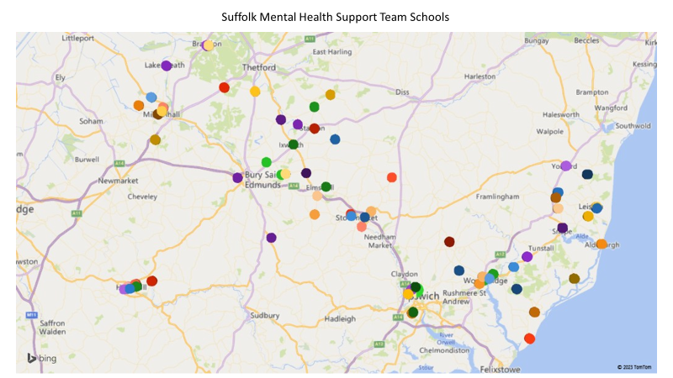
Mental Health Support Team coverage
The MHST has three localities: West, Central and East Suffolk

Slide 11
PMHW/MHST roles
Primary Mental Health Worker​ | Mental Health Support Team​
Primary care​ | Primary care​
Consultation to professionals, with parental consent​ No direct contact with families at this point​ | Consultations with educational settings and other professionals with parental consent​. Anonymised consultations without parental consent. ​
Individual PMHW have allocated School, will offer whole school approach - list available​ | Whole school /college approach based within specific educational settings​
Take referrals from Emotional Wellbeing Hub​ | Referrals through the consultation process with educational settings and other professionals and from the Emotional Wellbeing Hub
Assessment​ and formulation | Assessment​ and formulation
Interventions/Groups​ | Interventions/Groups​
Access to discussions/ stepping up YP to Specialist services ​ | Access to discussions/ stepping up YP to Specialist services​

Slide 12
MHST V U18 Wellbeing offer
Cover different schools/areas
Both teams can offer consultation to the school/professionals and would need consent from parents to offer this.
MHST primarily based within Education settings
Both teams operate a wait list.
Therapeutic relationship is paramount
Notes:
Important to explain we are different teams and whilst we are both under EI CAMHS essentially offering EI, we do differ slightly in how this is offered.
We can provide PMHW areas/MHST schools if this is helpful?
PMHW offer a duty line – not 24 hours of emergency but someone will call you back, it is ‘manned’ 3 days per week.
Waiting lists – expand? *do we need to add this or wait for questions related to it? In the Mental Health Support Team the wait times are different within each team and it would be challenging to provide an overview in a short amount of time.
Therapeutic relationship – explain the importance we place on this, from initial appointments to ensuring the person is seen as a person, not a ‘case’, that we want to make sure we make the best decision regarding their care as first interventions count. Consistency in relationships is important and we ensure the relationship is based on the young person is at the centre of their care and involved in the decision making, as much as their chose to be and they want to be.
**I will add in here the importance of the relationships with the schools – adding that the intervention and support for YP starts within school and that it is everyone reasonability to support / provide guidance where needed.

Slide 13
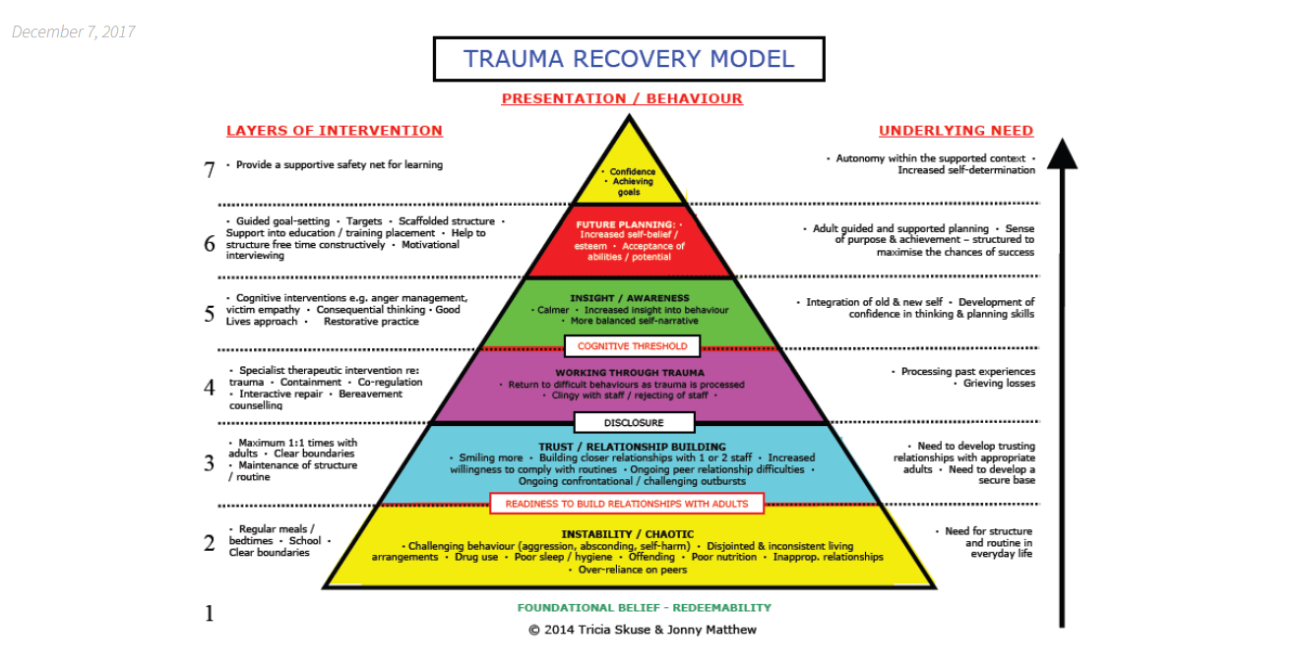
Contact with educational staff:
building up trust and a relationship
with education staff
Targeted support within educational
settings such as ELSA and THRIVE
Therapeutic relationship:
The Early Intervention services provide bespoke mental health support (consultations / WSCA and through forms of therapy).

Slide 14
Crisis helplines
111 option 2​
Shout (All ages): Free 24/7 text service for anyone in crisis. Text: 85258 www.giveusashout.org ​
Papyrus (Under 35 year olds): For people experiencing thoughts of suicide. Tel: 0800 068 4141 Text: 07860 039 967 Email: pat@papyrus-uk.org www.papyrus-uk.org​
Childline (Under 19 year olds): Free, private and confidential service for anyone under 19 where you can talk about anything, including risk and suicide. Tel: 0800 1111 or email/chat via www.childline.org.uk ​
ChatHealth (11-19 year olds): Chat with a local health professional about mental or physical health. Text: 07507 333356​

Slide 15
Crisis helplines
Kooth (11-25 year olds): Free online counselling and more: www.kooth.com​
​There are a number of apps developed for smartphones which young people can find useful for various issues. These include:​
Stay alive – for suicidal ideation​
clear fear – for anxiety​
calm harm – for self-harming behaviours​
headspace – for mindfulness and meditation

Slide 16
Other Local and National Supports
Linden House​
Stand Tall- Abbeycroft Leisure www.acleisure.com/stand-tall
Diadem Girls Group at the Mix- Stowmarket www.themixstowmarket.org/our-services/diadem-girls-group.​
Outreach Youth Ipswich- LBTQ+ www.outreachyouth.org.uk ​
Voice Collective- visions and voices support www.voicecollective.co.uk ​
Young Minds websites​
Psychology Department at West Suffolk Hospital

Slide 17
Useful information and contacts for Bury St Edmunds Area
Emotional Wellbeing Hub 0345 600 2090​
NDD referral process and contact number nddadmin@barnardos.org.uk
www.infolink.suffolk.gov.uk/kb5/suffolk/infolink/advice.page?id=vuyrPmzW-Tw

Slide 19
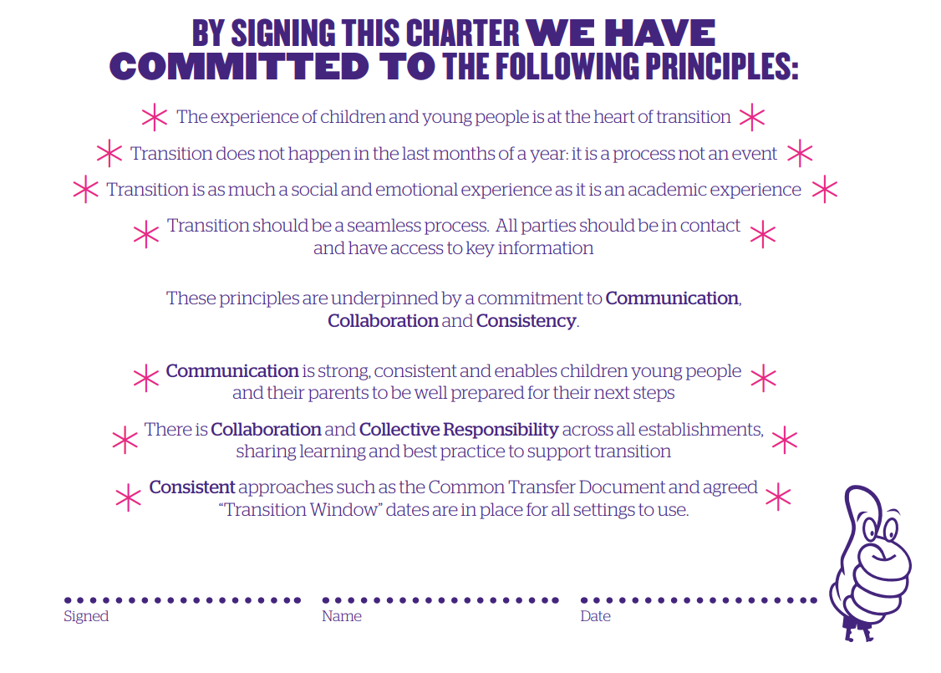

Slide 20
Spring Term 2024
Thursday 21st March venue tbc
Summer Term 2024
Thursday 9th May venue tbc
Thursday 27th June venue tbc

