Slide 1
Ofsted and the Leadership of SEND
Suffolk County Council and partners

Slide 2
Welcome- Agenda (9:00-1:00)
Time | Item | Lead
9:00 | Refreshments and networking
9:15 | Introduction | Ros Somerville
9:20 | Ofsted and the Leadership of SEND, Including SEND in a nutshell | Malcolm Reeve
10:50 | Refreshments
11:15 | SEND Strategy Consultation | Ros Somerville
12:30 | SEP Task Group | Daniel Jones
12:45 | Close | Ros Somerville
Notes:
Ros

Slide 3
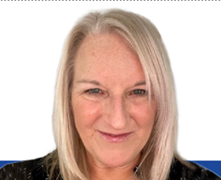
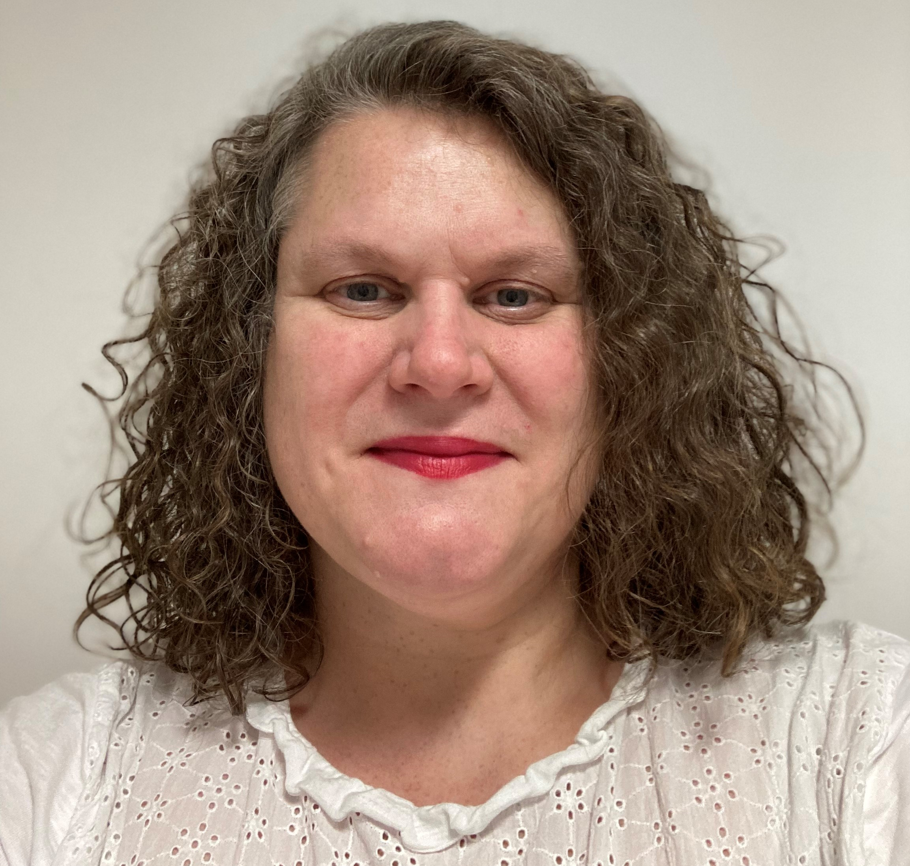
Welcome to Suffolk SEND Conference
SEND is a top priority
Suzy Joyner
Interim Executive Director Children Services
El Mayhew Acting Director of Children & Families
Notes:
Ros /Nicola/Suzy – Child and young person is at the heart of all we do., scale and scope ever increasing. We cannot do this alone and must do it together.

Slide 4
Welcome to Suffolk SEND Conference
It is a challenging time for all
Financial constraints
Increase in need and demand
SEND National context
What is working well:
Positive feedback re SEND Decision making panels
More schools have Quality Inclusion Mark
Schools are accessing more support via the Graduated Response such as VSEND, Inclusion Support Line, Solution Circles and Inclusion Support Meetings – Also all receiving positive feedback and impact
We are on a path to improve
Notes:
Ros /Nicola/Suzy – Child and young person is at the heart of all we do., scale and scope ever increasing. We cannot do this alone and must do it together.

Slide 5
Ofsted and the Leadership of SEND, Including SEND in a nutshell
Malcom Reeve
Ofsted and the Leadership of SEND, Including SEND in a nutshell
Notes:
Now like to introduce to Malcomn Reeve, many of you may know him, Malcomn has worked in the SEND Field for over 30 years.

Slide 6
Break & Networking

Slide 7
SEND Strategy Consultation
Ros Somerville
SEND Strategy Consultation

Slide 8
Suffolk SEND Integrated Strategy
“ Working together, we will support all children and young people with SEND to meet their potential and to live active, healthy and fulfilling lives as part of their community.
Children, young people and their families will be listened to, included and empowered. They will have access to the right support, at the right time, by the right people.”
Notes:
Ros – Talk about Sycol

Slide 9
Suffolk SEND Conference - Consultation
Agree Consultation process
Sign off – LT and SEND Programme board
Start Consultation period 6 weeks
Review Consultation
Draft Strategy
Implement working to draft strategy
Approval at LT and SEND Programme Board
Consultation of draft
EIA Assessment sign off
Cabinet approval
2023 |  |  |  |  |  | 2024
Jul | Aug | Sept | Oct | Nov | Dec | Jan | Feb | Mar | Apr | May | Jun
Recruit Change Team
Draft Programme Reporting and Framework
DRAFT High-level Timescale

Slide 10
Suffolk SEND Strategy 2024-28 Consultation -
Consultation Events Start 6 October 2023 – 1 December 2023
Date | Method | Details | Parent/Carer | Health | LA Colleagues | Schools | CYP
03/10/2023 | F2F (10:30 – 12) | Suffolk Rural |  |  |  | Yes | Yes
10/10/2023 | F2F | Beccles Primary School |  |  |  | Yes | Yes
10/10/2023 | Teams | SEND Group with ICPS |  | Yes
12/10/2023 | F2F | Ofsted & Consultation event, Trinity Park |  |  |  | Yes
13/10/2023 | F2F | West Suffolk College |  |  |  | Yes | Yes
25/10/2023 | F2F | Drop-in session West Suffolk House | Yes | Yes | Yes
31/10/2023 | F2F | Drop-in session Riverside | Yes | Yes | Yes
7/11/2023 | F2F | Drop-in session at Endeavour House (Transport, YJS, Social Care, Early Help, Public Health) | Yes | Yes | Yes
8/11/2023 | F2F | Leadership Group |  | Yes | Yes
14/11/2023 | F2F | Woodbridge Road |  |  |  | Yes | Yes
16/11/2023 | F2F | The Child and Family Psychology Service |  | Yes
24/11/2023 | F2F | Stowmarket Family Hub | Yes |  | Yes |  | Yes
 |  | Meeting TBC –NSFT Team Meeting
 |  | SENCO Forums, ASNF Network, VASP Network,
Notes:
Following request in Headlines schools have been asked if we keep visit to coproduce a childrens outcome framework with children and young people. If you are interested please email Wendy

Slide 11
Suffolk SEND Conference - Consultation
If your school would be interested in the Inclusion change team visiting and working with a group of children or young people (year 5 upwards) please email
wendy.allen@suffolk.gov.uk
DRAFT High-level Timescale

Slide 12
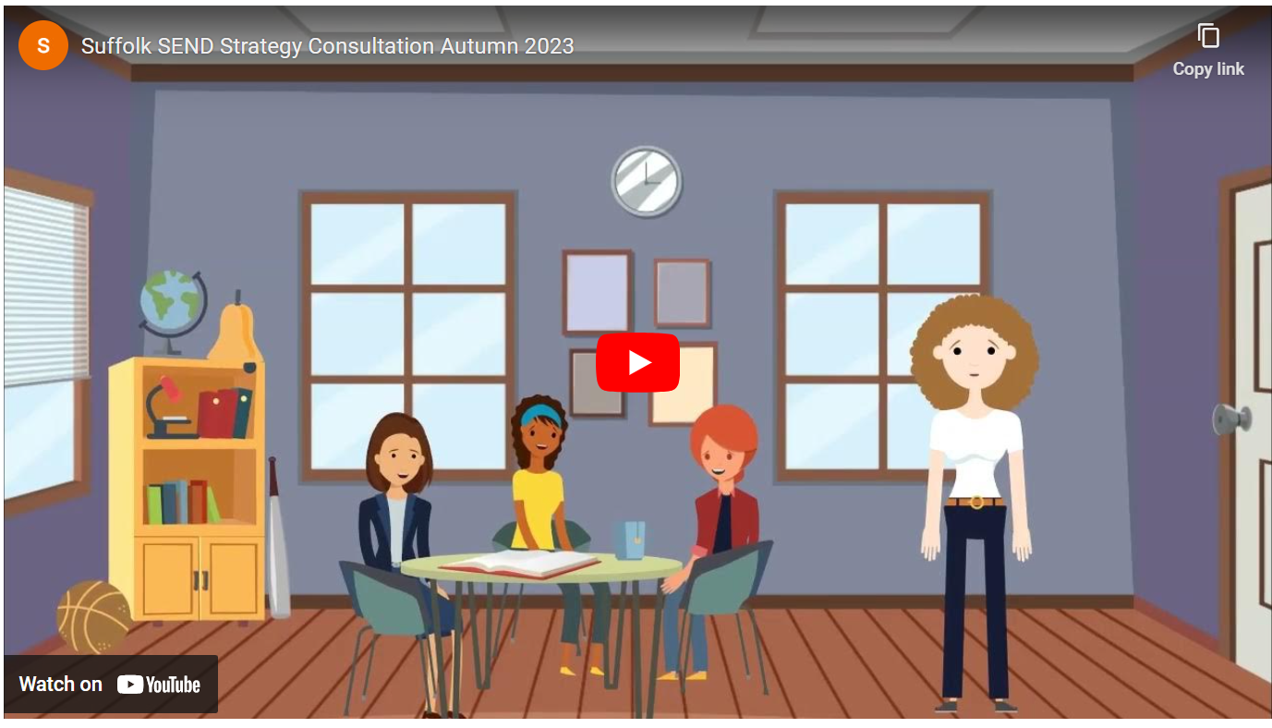
Suffolk SEND Conference - Consultation
Suffolk SEND Strategy | Suffolk Local Offer Click link
Notes:
Ros – Sycol, free and open conversation
Asked Carole for animation script

Slide 13
Suffolk SEND Conference - Consultation
What has worked well in Suffolk from the SEND Strategy (what do you not want to lose)?
What are the top 3 things you would like to be improved for the SEND Strategy 2024-2028?
If it was better, what would it look like?
Please discuss and please record your thoughts
Notes:
Tables record and feedback
Asked Carole for animation script

Slide 14
Suffolk SEND Conference - Consultation
Write what you think the vision for the Suffolk SEND Strategy for 2024-2028 should be……….
Visions should:
be forward thinking
be aspirational
Visions do not state the how
Notes:
Ros – Sycol, free and open conversation – reflect on current vision
Asked Carole for animation script

Slide 15
Suffolk SEND Conference – Delivering Better Value
Key messages for DBV
Want to work with you to make things better
Improve progress for children and young people
Providing evidence-based interventions
Notes:
Asked Carole for animation script

Slide 16
Daniel Jones
Suffolk Education Partnership Task Group

Slide 17
Thank you for coming!
Please complete the SEND Strategy survey
https://www.smartsurvey.co.uk/s/SEND23/
Slides, handouts and links will follow
If you've got any queries, contact us on localoffer@suffolk.gov.uk

