Slide 1
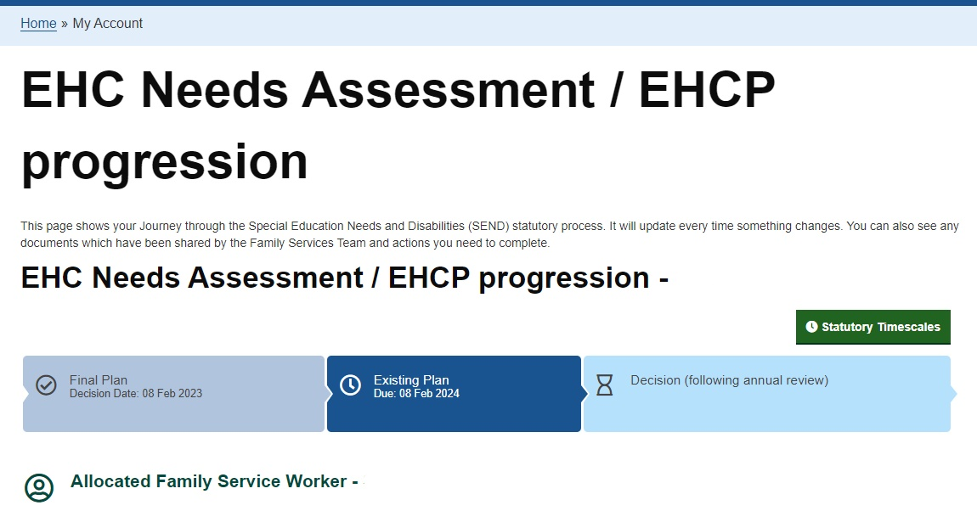
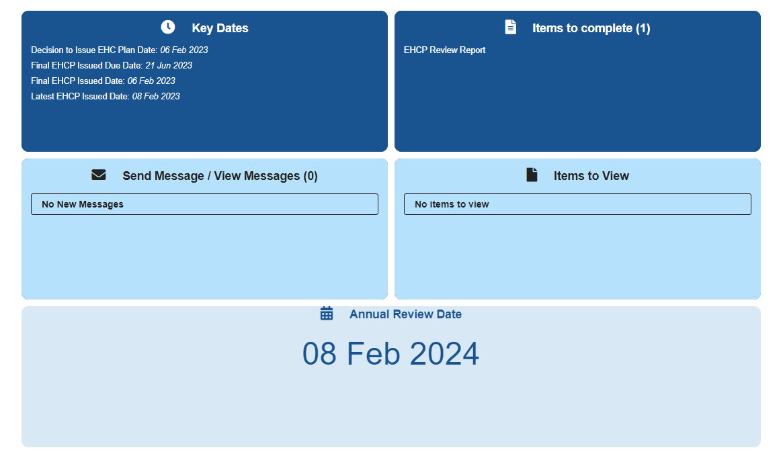
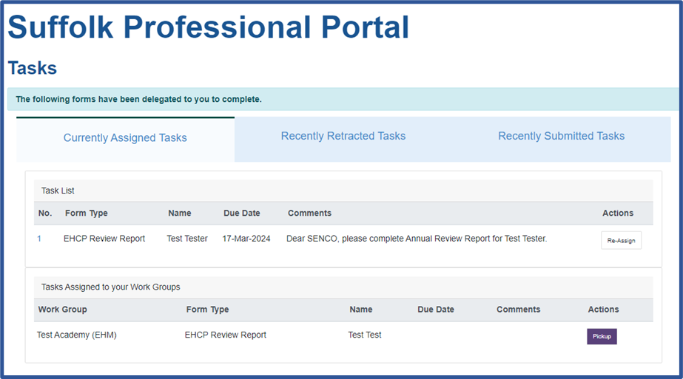
Liquidlogic EHC Portals Implementation
Suffolk County Council have been working to implement new portal functionality to support the Education, Health and Care (EHC) Needs Assessment and Annual Review processes.
Phase 1 (April 2023): Launch of the EHC Portal
New front door for EHCNA Requests submitted by parents, carers, young people and professionals supported by central EHCNA Request team in SEND Family Services. EHCNA Requests submitted via portal land directly in the caseload management system for progression by the service.
Families (parents, carers and young people) can verify their portal accounts to enable access to a dashboard allowing users to monitor their progress through the EHC process. The portal dashboard allows users to see key associated dates with the EHC process, identify their allocated Family Services, message their allocated worker, and receive documents and forms to view and complete.
Phase 2 (from September 2023): Launch of the Professional Portal for Annual Reviews and new reporting
Portal and reporting for use by SENCOs and staff within education settings to support the Education, Health and Care Plan (EHCP) Annual Review process.
Early adopter settings will begin using the functionality to support Annual Reviews they coordinate in Autumn term 2023
Will support settings to have an improved oversight of their children and young people’s Annual Reviews
Use of the portal to return Annual Review documentation will result in information submitted by settings landing directly within the caseload management system alongside existing EHC information to improve consistency and streamline the Annual Review process to support timeliness.
We will actively engage with a variety of stakeholders to ensure that the solution is reflective of requirements including education settings, early years and further education representatives, school transport representatives and SPCF

Slide 2
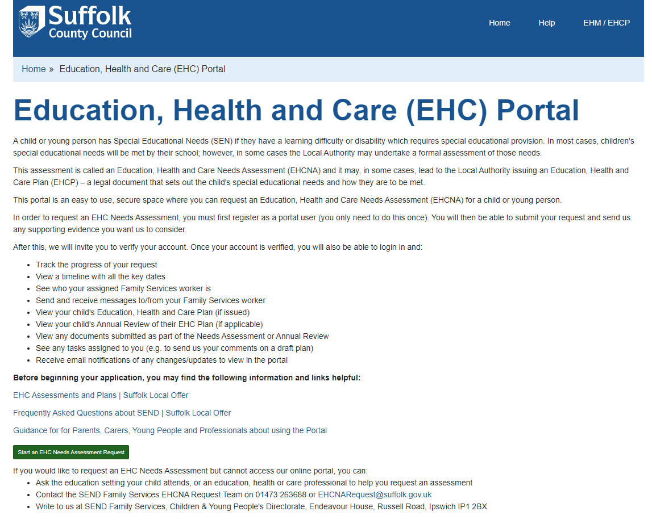
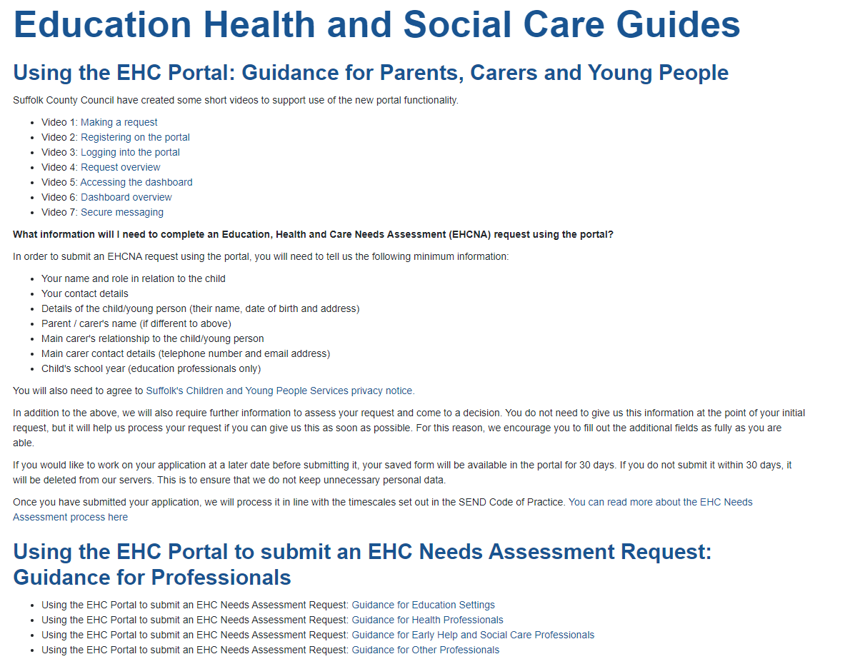
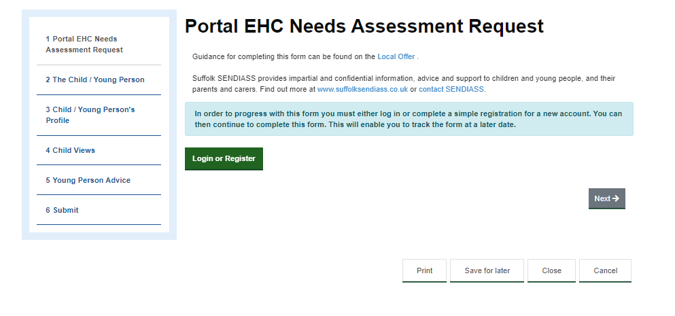
Completing an EHCNA Request using the EHC Portal
April 2023: Launch of the portal to enable EHC needs assessment requests to be completed and submitted by parents, carers, young people and professionals to the Family Services Team.
The portal landing page has been produced to signpost to guidance, SENDIASS and other SCC CYP services. Guidance is available to support use of the portal
The form is dynamic, allowing relevant sections of the EHC needs assessment request form to be displayed
Forms can be initiated and saved for later (for 30 days) or saved as a PDF prior to submission
Professionals can add required attachments

Slide 3
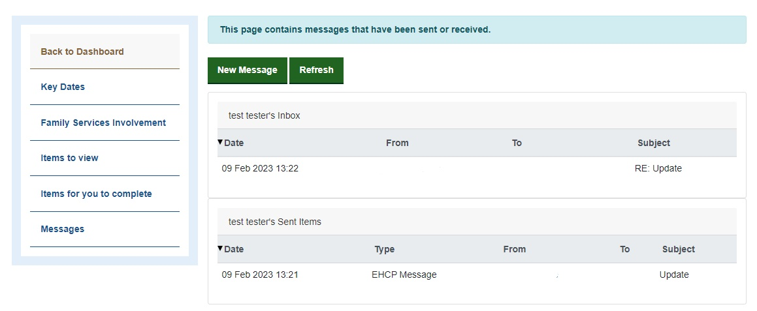
Using the EHCNA / EHCP Dashboard
Parents, carers and young people’s portal accounts can be verified by Family Services, allowing them access to a dashboard to track their progress through the EHC and Annual Review processes.
Verified users can:
See key statutory dates
Identify their allocated Family Services worker
Message their allocated worker
View forms and documents published to the portal
Complete forms as required and send back to the LA

Slide 4
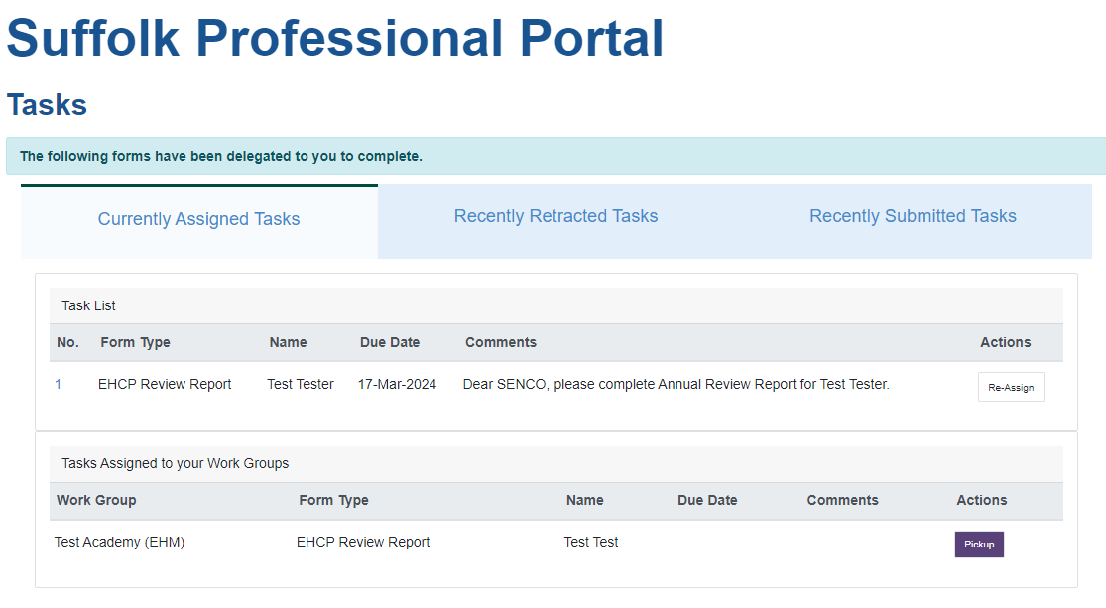
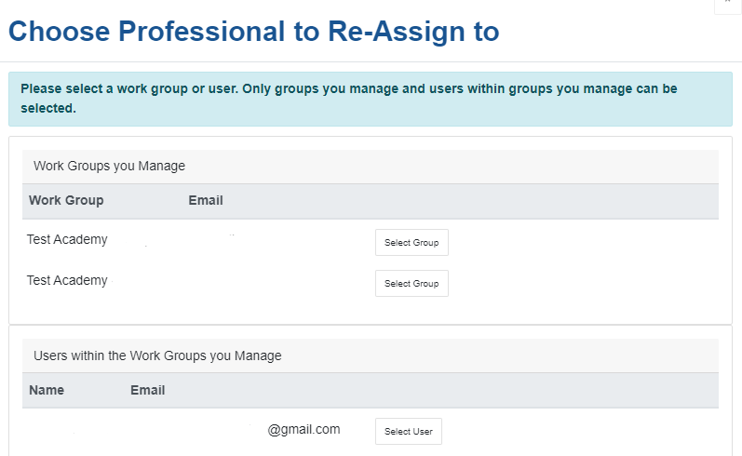
The Professional Portal and Dashboard reporting
The Professional Portal will enable education settings to submit Annual Reviews and associated documentation to the local authority in a digitised format.
Nominated individuals within a setting or trust will have visibility of Annual Review tasks assigned to the setting’s portal work group requiring attention.
Setting work group members will have the ability to pick up tasks (Annual Review Report forms) for completion; once picked up, the form contents can be saved for later, exported as a PDF or submitted once complete. Attachments can also be added.
Staff users can also reassign tasks to other individuals within the setting’s workgroup, or to another workgroup they also manage (eg; another setting within your trust), for required contributions and input into the form before submission to the local authority.
Workgroup managers can also reassign tasks picked up by individuals back to the Workgroup, supporting the effective management of workload associated with ongoing reviews.
Each time a task is sent to the work group for completion, is picked up, or is completed and submitted, an email notification is sent, alerting users to the update.
New dashboard reporting
Power BI dashboard providing oversight of the Annual Review caseload for the setting.
The information within the dashboard will be updated daily and will include line level data on children and young people with an EHC Plan within your setting, with the associated latest Annual Review date and status and associated worker details.

Slide 5
Early Adopter Settings
We are currently engaging with a group of early adopter settings (maintained, academy primary and secondaries, special schools, schools with units) to gain their input on the functionality and Annual Review form
Schools will also be asked to sign a CoCo and Information Sharing Agreement for IG purposes to allow a dashboard to be shared with settings with details of their children with an EHCP; this will be the starting point for the future direction of travel for information sharing with schools.
The functionality will be rolled out to early adopter settings in Autumn term 2023
School | Phase | Type | Academy? | Academy Trust
Whitehouse Community Primary School | Primary | Academy Converter | Academy | The Children's Endeavour Trust
Dale Hall Community Primary School | Primary | Community School | Maintained
Rushmere Hall Primary School | Primary | Academy Converter | Academy | Eko Trust
Chantry Academy | Secondary | Academy Sponsor Led | Academy | The Active Learning Trust Limited
Thurston Community College | Secondary | Community School | Maintained
Priory School | SEN | Academy Special Converter | Academy | SENDAT
Stone Lodge Academy | SEN | Academy Special Sponsor Led | Academy | SENDAT
Castle East School | SEN | Free Schools Special | Academy | East Anglian Schools Trust Ltd
Sir Peter Hall School | SEN | Free Schools Special | Academy | Unity Schools Partnership
Sunrise Academy | SEN | Free Schools Special | Academy | SENDAT

