Slide 1
SENCO Forum Assess Plan Do Review: Your Graduated Approach & Suffolk’s Graduated Response

Slide 2
Agenda
Introduction
Graduated Response
Assess Plan Do Review cycle
Roles & Responsibilities:
“Every teacher is a teacher of SEND”
Share good practice/examples
Local Offer support & resources
Whole School Inclusion team offer

Slide 3
Suffolk County Council Graduated Response
To upskill and enable schools to meet the needs of the CYP in their community. We are the advocates and champions of CYP and their inclusion in their local school and their community
To encourage and support early discussion and early intervention
To support schools to consider underlying reasons why CYP may not be making expected progress
To support and encourage the accurate identification and assessment of need, working with pastoral teams and SEND teams
To assist schools to apply strategies across a whole group/class/school rather than just the individual referral
Crucially, it communicates our expectation that schools demonstrate clear APDR before seeking additional help

Slide 4
The value of a Graduated Approach
Suffolk Graduated Response works best when it is supporting a School’s Graduated Approach to SEND:
Early identification and early intervention is key to preventing some pupils from developing a special educational need.
This ensures that the CYP receives the Right Support in the Right place at the Right time (SEND review – Green Paper)
A school's Graduated Approach enhances & helps to share best practice within school
Delivers the best outcome for pupils.
Ensures all pupils are monitored closely and no pupils fall through the net.
Clarity of school support for parents

Slide 5
Suffolk County Council Graduated Response Stage 1

Slide 6
Activity: Assess Plan Do Review cycle
In groups how would your school respond to the following scenarios?
A CYP that is emotionally dysregulating resulting in self exiting.
A CYP that is not making expected progress.
A CYP with lowering attendance and in danger of becoming a school refuser.

Slide 7
APDR - reflection
How is the cycle monitored/measured for impact?
Who is responsible for the APDR cycle?
How long is the cycle of support?
Are all stakeholders aware of the systems of support throughout the school?
How are staff supported through the process?
How effective is Parent/Pupil involvement?

Slide 8
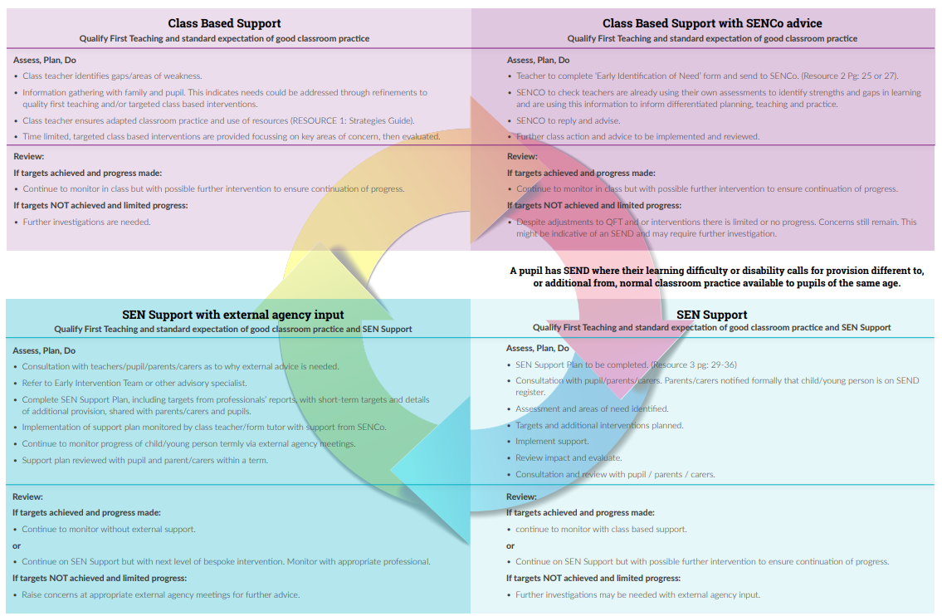

Slide 9
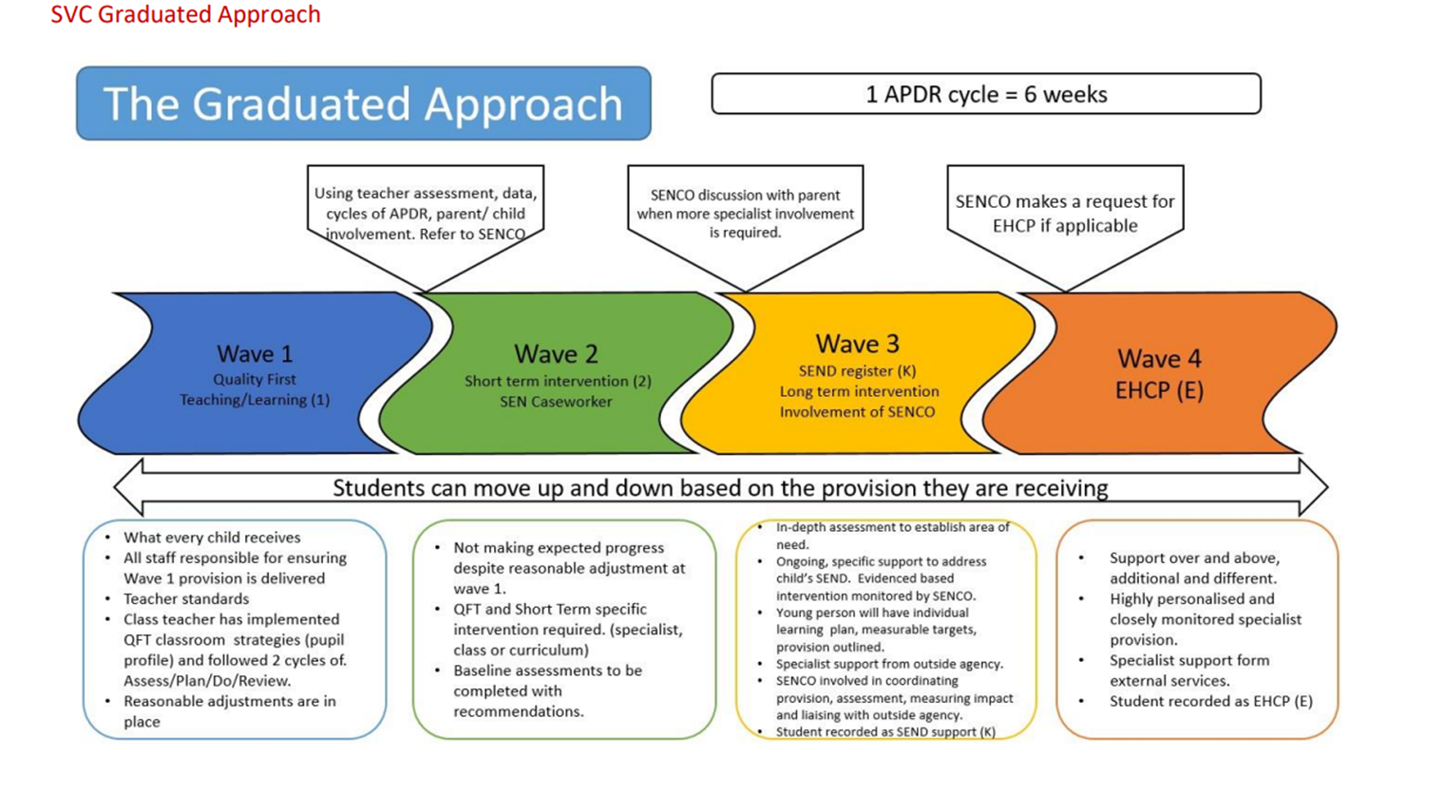
Developing Your Universal Offer
Enabling your staff to be leaders and teachers of SEND.

Slide 10
What’s your role as a SENCO?

Slide 11
Does your school reflect? All teachers are teachers of SEND? All leaders are leaders of SEND?
How do you audit/respond to staff skillset?
How do you know your teachers understand their responsibilities under the code of practice?
How do you monitor CYP provision within the classroom?
What is SLT involvement in SEND monitoring?

Slide 12
Code of Practice APDR
The Code of Practice (6.45) lists a range of sources of information that teachers should use, these include:
Teacher assessment and knowledge of the CYP;
Data on the pupil’s progress, attainment and behaviour;
The individual’s development in comparison with their peers;
The views and experience of parents;
The CYP’s own views;
Advice from external support services.

Slide 16
Suffolk County Council Graduated Response Stage 1

Slide 17
Stage One Support in Suffolk
Stage 1 Support in Suffolk
VSEND
SENCO support line
01473 296631
Mon –Fri 3:30 – 4:30
Inclusion Support Meeting
Whole School Inclusion Team
Suffolk Headlines
Subscribe by email to suffolkheadlines@suffolk.gov.uk
SENCO Forum
Contact SENCOsupport@suffolk.gov.uk for more information or to book onto any events
Inclusion Support line
01473 265502
Mon- Fri 9-5
SENCO Central
SENCO bulletin
Subscribe by email to SENDNews@suffolk.gov.uk

Slide 18
Whole School Inclusion Team
Advice and guidance around whole school inclusion and SEND practice.
Support with reviewing policies, practices and protocols when supporting children with SEND or other needs.
Advice around developing, maintaining and embedding inclusive practice.
Support for new SENDCos and ECTs
Inclusion Quality Mark – funding still available. Contact Jamie Hudson.
Specialist Teachers:
Jo.bustos@suffolk.gov.uk
Laura.chevous2@suffolk.gov.uk
Jamie.Hudson@suffolk.gov.uk
Laura.Humphrey@suffolk.gov.uk
Team Leader: Maria.hough@suffok.gov.uk

Slide 20
Suffolk County Council Graduated Response Stage 2

Slide 21
Stage 2 Support in Suffolk
Specialist Education or Psychology and Therapeutic Services Core Offer around individual CYP
SEND Support Consultation.
To book email sencosupport@suffolk.gov.uk
Refer to external agencies (e.g. Health, Mental Health, Early Help, Social Care)
High Needs Funding
IYFAP
The APDR cycle then starts again with the updated information
SEND Toolkit
A strengths based framework for learners with SEND

Slide 22
Suffolk Inclusion Toolkit
LC
Analysis of Additional Needs Tool (AANT) In depth EP analysis and consultation
Essential SENCO Toolkit
SEND assessment. A strengths based framework for learners with SEND
SEND intervention planning provision with purpose
Quality Assurance
VSEND
Whole school setting readiness for all schools – and all teachers (SEND is everyone’s responsibility)
Children’s needs profiles to understand provision & need, show progress & create collaboration

Slide 23
Suffolk County Council Graduated Response Stage 3

Slide 24
Stage 3 Support in Suffolk Where Support at Stages 1& 2 has been exhausted
ATS
LA provided Alternative Provision
EHCNA
Specialist Placement – where a pupil has an EHCP
Inclusion Practitioner Team
Education Access Team
email: EducationAccess@suffolk.gov.uk

Slide 25
Referrals to SES
SES Referral Form
for
Stage 2
SES services
Inclusion Service Referral Form
For
Stage 3
SES services

Slide 26
What Else?
SENCO Central | Community Directory (suffolk.gov.uk)
Specialist Education Services – Suffolk Learning
Psychology and Therapeutic Services | Suffolk County Council
Primary Mental Health Workers for Schools in Suffolk | Community Directory
Children and Young People’s Emotional Wellbeing Hub | Community Directory (suffolk.gov.uk)
School nursing | Suffolk County Council

Slide 27
Questions?

Slide 28
References
www.bexleylocaloffer.uk/Services/5419
https://educationendowmentfoundation.org.uk/news/eef-blog-five-a-day-to-improve-send-outcomes
https://www.swaveseyvc.co.uk/wp-content/uploads/2020/10/SVC-SEND-Information-Report-2020-2021.pdf
https://astreaacademytrust.org/inclusion-home/supporting-pupils-with-send/
https://nasen.org.uk/news/teacher-handbook-launched
https://westsussex-local-offer.s3.amazonaws.com/public/system/attachments/790/original/Graduated_Approach_July_2017.pdf

