Slide 1
Improving the EHC and Annual Review Journey Liquidlogic EHCP functionality implementation
South SENCo Forum 22/11/22

Slide 2
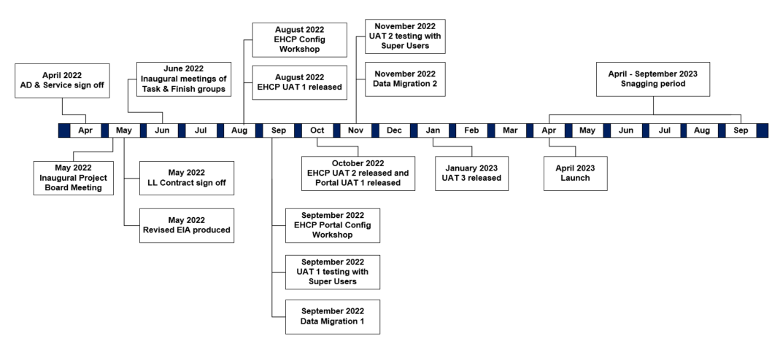
Liquidlogic EHCP functionality implementation
High level summary
This project will manage the move of the Education, Health and Care Plan (EHCP) process and workflow from the caseload management system Capita One Education to Liquidlogic. This piece of work will support the service to move the EHCP process in its entirety from an application to request an assessment through to the issue of the draft and final plan, annual reviews, and tribunal and mediation. The scope of this project will include SharePoint integration and the implementation of portal functionality.
We are looking to launch the new system and portal from April 2023 and are currently testing and developing the functionality.​
Background to the project:
Based on the findings of a Prior Information Notice (PIN) issued to the market in November 2021 and subsequent Soft Market Engagement (SME) with suppliers and other local authorities, CYP LT agreed to the implementation of a solution for Special Educational Needs and Disability (SEND) Family Services.
Following further discussions and demonstrations with Family Services, it was agreed that the EHCP process will move to Liquid logic. The Liquidlogic EHCP workflow sits within the EHM module, which SCC CYP currently use for Early Help and Social Care.
At present, the EHCP workflow sits within the Capita One Education caseload management system. There is a need to consolidate Family Services' processes and the storage of information such as case notes. There is also a high level of scrutiny in Family Services (eg; SEND Lincolnshire review) and work is currently ongoing to deliver improvements to the system to best support the service. The implementation of this solution is therefore integral to the delivery of outcomes set out in the 2021 SEND review action plan and the achievement of CYP priorities.

Slide 3
Key benefits associated with this programme of works:
Aligned with the green paper and the recognised need to digitise the EHCP process.
This programme of works is key to the delivery of outcomes set out in the 2021 August SEND review; many improvements hinge on better data recording and reporting which cannot be achieved with our current EHCP CMS.
New portal functionality will streamline the push and pull of stakeholder/ partner contributions eg; health/ psychology services to act as a central source of information of an EHC plan. This will enable relevant stakeholders to access draft plans and outcomes with sufficient notice and to receive reminders for their required contribution.
New portal functionality facilitates more effective coproduction (eg; prevention of families having to repeat information to multiple professionals) and allows families to track their progress throughout the EHCP journey, empowering them to feel more involved in the process.
Key benefits to the implementation of Liquidlogic EHCP functionality
Opportunity to better achieve greater visibility across services and better align Family Services data with Early Help and Social care.
Plans will be created in the system and linked to SharePoint, allowing for the storage of information within a consistent and singular location, quick amendments to plans to be made, and version control held within the system.
New portal functionality allows for a more enriched insight into the views of the child or young person for advice givers, placing their wishes and preferences at the centre of the process
Provides an opportunity to inform the configuration of the online forms with insight from key stakeholders such as the Parent-Carer Forum, SENDIASS and the SEND Young Persons Network.

Slide 4
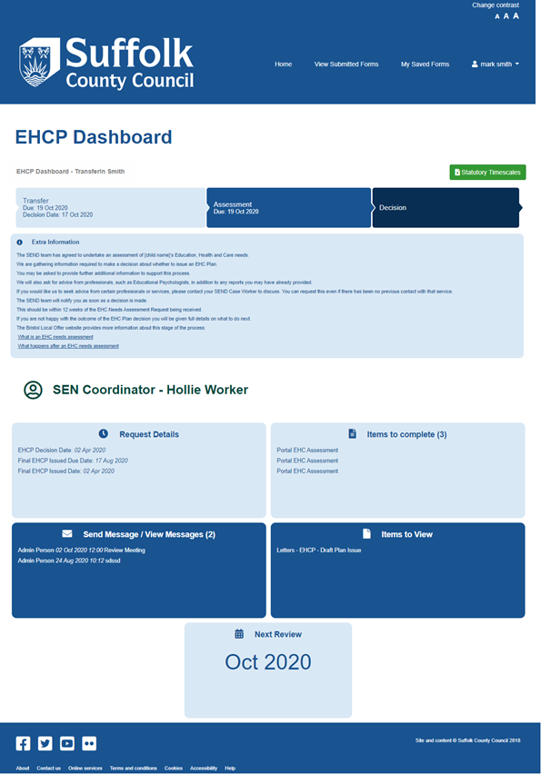
Upcoming testing and configuration of new functionality
EHCP Module
UAT1 released on the 19th August. Testing with Family Services took place on the 21st and 27th September. Social care representation was present at this testing.
Required changes are to be incorporated into UAT2 released on the 28th October. The service super users tested this release in a second round of UAT testing on the 4th and 7th November
Education Psychologists will also test the new functionality on the 25th November
EHCP/ Parents Portal
Portal UAT was released on the 28th October alongside module UAT 2 for testing
Family Services Super Users also tested the portal in November
Members of the SPCF and SENDIASS have been invited to review the portal functionality in November
We have also secured access to an Apple iPhone, iPad and Samsung phone for parents to test the new EHCP parents' portal on multiple devices.
Delegation/ Professional Portal
We have begun engagement with various education and health stakeholders and have requested their involvement in testing of professional (delegation) portal functionality used for form delegation.
This testing is due to take place with professionals in January 2023. This will include
Key schools and SENDAT
SENCos involved in the HNF moderation
Health (Nic Smith Howell and DCOs to nominate individuals from across health)
To conduct this testing will be using a combination of face to face testing using SCC laptops or providing an SCC device for allocated professionals to utilise.
New ECHNA Requests will be submitted through the portal from April 2023. We would also like to work with Schools from April 2023 in regard to Annual Reviews.

Slide 5
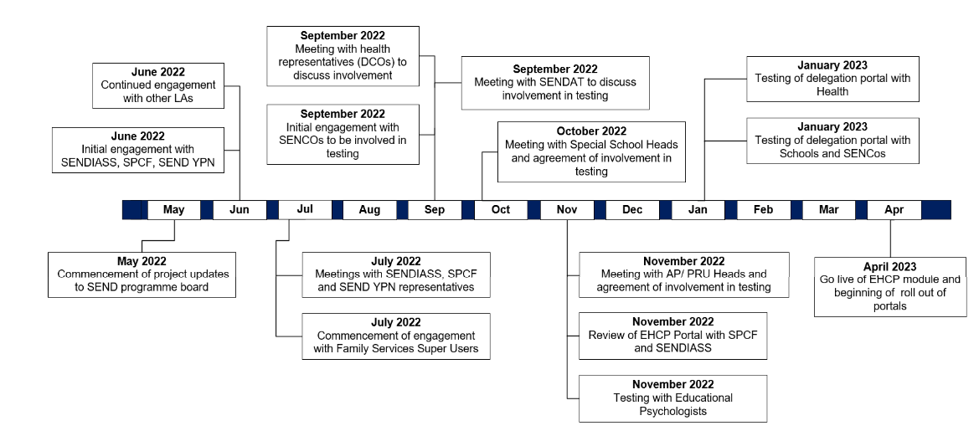
Stakeholder engagement
Next steps and our ask of SENCos
HNF Moderators to be involved in testing the functionality in January/ February 2023
Half day session to review the use of the delegation portal to be scheduled

