Slide 1
Suffolk Governors’ Conference: 3 May 2023
Growing your board successfully: succession planning and diversity
Emma Knights, Chief Executive, National Governance Association
with
Katherine Soanes, Regional Lead for the East of England, NGA

Slide 2



















Our offer and services
Independent and confidential advice
Sector-leading
induction guides
NEW: virtual Welcome to Governance LIVE sessions
Membership magazine
The essential
information hub
Keeping you informed
Making your voice heard
Access to independent
and timely advice for GOLD members – governing boards, governance professionals, headteachers and executive leaders.
Supporting new and experienced governors, trustees and chairs:
Welcome to Governance,
The Chair’s Handbook,
Welcome to a Multi
Academy Trust.
Make an impact in the first six months as a governor/trustee, via sessions that complement local school, trust or LA induction programmes.
Thought-provoking articles on aspects of all education and governance, published five times a year.
Access members-only guidance, research, practical resources and much more.
A weekly e-newsletter during term-time featuring the latest education news, policy updates, guidance and much more.
We raise the profile of governance through our engagement with policy makers and through our campaigns.
High-profile events
NEW: Governance Leadership forums
Webinars and podcasts
E-learning anytime, anywhere
Tailored to your board’s
circumstances
Development programmes
National Leaders
of Governance
Hear from high-profile speakers and share best practice. Events include: NGA Summer and Annual Conferences, Governance Professionals’, SEND and MAT Governance Networks.
Networking events for those governing and leading schools to share experiences, debate future plans and discuss key issues they face.
Supporting governing boards through NGA’s series of webinars and podcasts.
Develop governance skills
and knowledge with over 50 high-quality e-learning modules, and bitesize modules.
Includes external reviews of governance, online appraisals and virtual face-to-face training workshops delivered by our team of expert consultants.
For chairs and governance professionals to lead and support your governing board to have real impact on your school or trust’s improvement.
DfE-designated experts delivering school and trust governance support where it can make
a difference.
0121 237 3780
www.nga.org.uk

Slide 3
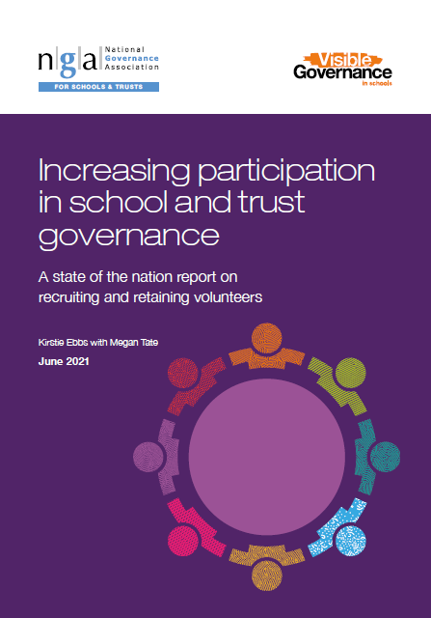
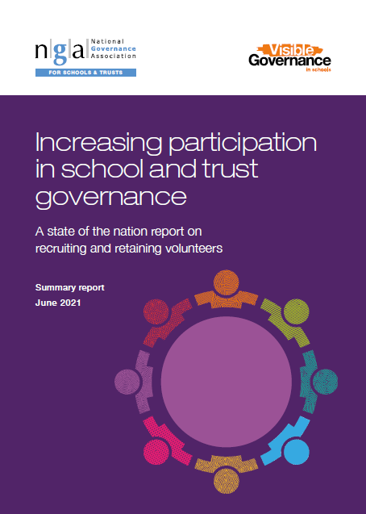
www.nga.org.uk/increasing-participation
Notes:
About our research – stemmed form an advisory group meeting with governors and trustees, governance professionals and executive leaders on governance and race in August 2020
Asked us to carry out research to understand the barriers to participation
Conducted focus groups with 34 governors and trustees – 14 from white British backgrounds aged under 40, 2 from ethnic minority backgrounds aged under 40 and 18 from ethnic minority backgrounds aged over 40.
Formed the reports by taking the themes and comments that focus group participants raised and supplementing with NGA survey data and reviewing research from other sectors

Slide 4
Making the case for diverse boards
Having the right people around the table is essential to good governance
Diverse boards make better decisions by avoiding group think and considering issues from different perspectives
Volunteers should share a common vision for the school/trust but bring different skills, knowledge, experience, perspectives and approaches
The literature shows that celebrating difference & diversity and being inclusive enables organisations to better serve the people they want to make a positive difference to
Reflecting the community and equipping pupils for the wider world
Setting a healthy culture is a crucial role of the governing board: by committing to diversifying itself and changing its behaviours, the board will set an example and be a catalyst for achieving diversity and equality at all levels of the organisation, including school leadership
There are two crucial elements to increasing participation and perspectives in school and trust governance: recruitment and retention of volunteers
Notes:
We know this!

Slide 5
The Department for Education’s Governance Handbook says:
“More than ever we also need diverse boards, and the Handbook has been updated to emphasise the expectation that recruitment processes should encourage volunteers from a wide range of backgrounds, cultures and perspectives, that better reflect the communities they serve.”
Just this term, the DfE has updated its guidance on publishing governing board diversity data:
Diversity is important and we want governing boards to be increasingly reflective of the communities they serve.
We encourage schools to collect and publish governing board members’ diversity data.
Information should be widely accessible to members of the school community and the public.
Board members can opt out of sharing their information, including protected characteristics, at any given time including after publication.
Schools must ensure that individuals cannot be identified through the publication of data

Slide 6
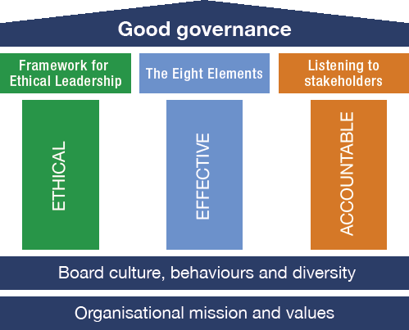
www.nga.org.uk/Knowledge-Centre/Good-governance
Notes:
Why this topic now? It’s fundamental but also wherever we go people say they need more ideas

Slide 7

www.nga.org.uk/governance2022
Notes:
Why this topic now?

Slide 8
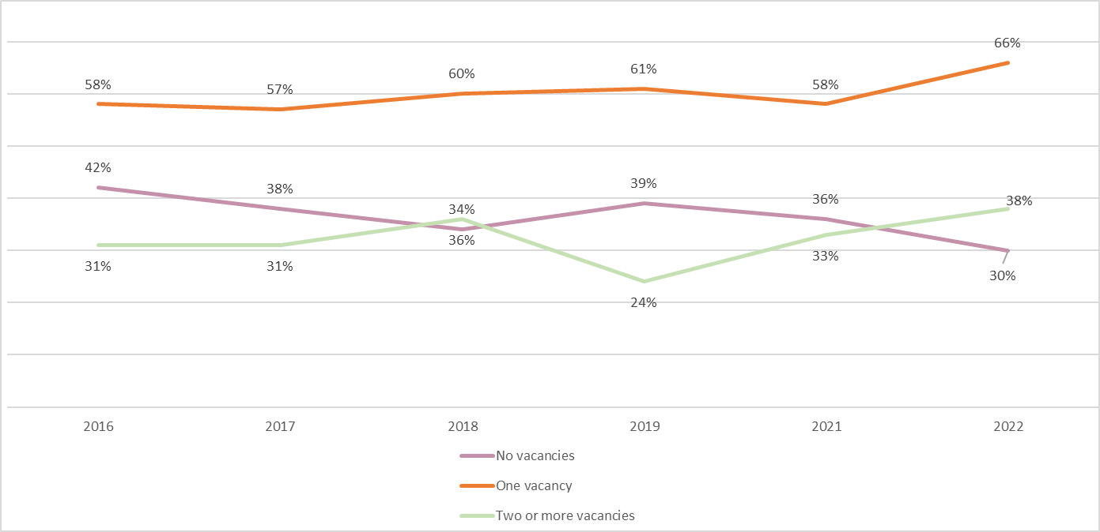
Vacancies: 2022 data
The number of vacancies on governing boards are at their highest since NGA started recording them in this way in 2016
The number of governing boards with more than two vacancies has risen by five percentage points from 2021 and seven percentage points from 2016
There are now more governing boards with two or more vacancies than no vacancies at all
There are regional differences
Notes:
Why we use 2 vacancies
Reflect on regions: The recruitment challenge varies a little across the regions with two or more vacancies most likely to be reported in the South West, followed by the East Midlands and the East of England. It is unsurprising that London is the region with the lowest proportion of boards affected as the capital has the highest number of volunteers registered with the recruitment agencies. There is a slight corelation which shows that regions with two or more vacancies on their governing board are also more likely to report that recruiting to the board is a challenge.

Slide 9
Recruitment of volunteers in 2022
Despite board sizes reducing over the past decade, recruiting to governing boards is a challenge for most: 63% of respondents reporting that it is difficult and 29% saying that it is not
37% of governors and trustees said difficulties recruiting to the governing board had been exacerbated by the pandemic and 30% had not seen the pandemic as having an impact on recruitment (33% did not have a view)
Recruiting to the board remains a difficulty for most boards of all type; but LA federation governing boards and academy committees are most likely to say that recruiting to the board is a challenge, while SAT (single academy trustes) boards were slightly less likely to have challenges
 | 2015 | 2016 | 2017 | 2018 | 2019 | 2020 | 2021 | 2022
It is difficult to recruit to the governing board | 50% | 53% | 56% | 58% | 55% | 63% | 64% | 63%
No view | 10% | 13% | 13% | 12% | 10% | 9% | 7% | 7%
It is not difficult to recruit to the governing board | 40% | 34% | 31% | 30% | 35% | 28% | 29% | 29%

Slide 10
Diversity of boards in 2022
A higher percentage of governors and trustees are female (59%) than male.
The percentage of governors and trustees below the age of 40 is the lowest on record. The percentage of respondents under 40 years old has halved over the past five years to 6%, and those under the age of 30 remains at 1%.
For the first time, more than half of volunteers (51%) are 60 years or over.
Long service is increasing: over half of respondents (52%) have been governing for more than 8 years, the equivalent of two terms of office
A healthy board needs both experienced members and new members with new ideas
Notes:
Nina
59% female, 39% male, rather not say 2% - consistent with previous years
58% of chairs/ co- chairs were female
40% of chairs/ co-chairs were male
Males likely to govern in secondarys, all through and special schools
This year’s findings show that there is a higher proportion of males aged under 40 (57%) compared to the number of females under the age of 40 (43%).
Historically, women have governed at slightly lower rates in secondaries than in primaries and nurseries, and this year’s findings continue to reinforce this with 20% of those governing in secondaries and 4% in special schools being women, compared with 63% in primaries.

Slide 11
Ethnic diversity in 2022
Only 6% of governors and trustees surveyed reported they were from an ethnic minority background – this is not a significant increase from previous years
There is a big disconnect between the demographic of the people governing our schools and the pupil population they are serving
New volunteers are more likely to be representative of the adult population: 83% identify as white, 4% from mixed/multiple groups, 7% as Asian and 4% as Black, up from 2020
What does this mean for communities which are not as ethnically diverse
 | 2021 census/ ONS | Pupils in England | Teachers in England | Heads in England | Governance volunteers surveyed | Chairs surveyed
White | 84% | 71% | 90% | 92% | 94% | 96%
Black, African, Caribbean or Black British | 4% | 6% | 2% | 8% | 1% | 1%
Asian | 8% | 12% | 5% |  | 3% | 2%
Mixed/multiple | 2% | 7% | 2% |  | 1% | 1%
Other | 1% | 2% | 1% |  | 0% | 0%

Slide 12
Reflecting the community: what we found from the 2021 survey
A third (33%) of respondents perceived that their board ‘very much’ reflects the community it serves while around half (48%) said it ‘moderately’ did so.
Black (33%) and Asian volunteers (38%) were equally or more likely to think that their board very much reflects the community; only volunteers from mixed/multiple ethnic groups were less likely to feel that at 19%
Young people were less likely to say their board ‘very much’ reflected the community (21%)
A word on other protected characteristics….

Slide 13
Focus group voices… A lack of open and transparent recruitment is a significant barrier to entry for underrepresented groups getting involved
“The opportunities tend to be passed through word of mouth or through networks, and if you've got a white network that's how opportunities of learning about governorship spreads. But it ends up building these bubbles that don't really spread out, and so it means that you can be cut out of opportunities as an ethnic minority.”
Participant in focus group – volunteers from an ethnic minority background, aged under 40
“How do you become a co-opted governor if you've never seen an advert and nobody knows this post exists? I think it's always put on ‘all these ethnic people don't apply’. The barrier is the actual institution themselves, because they are not putting the roles out there for anyone to know they exist. What are they applying for if they don't know it exists? What are we, mind readers?”
Participant in focus group – volunteers from an ethnic minority background, aged over 40

Slide 14
Recruitment: what will make the difference
Positive action - When boards actively seek volunteers from underrepresented groups, they are more likely than not to be successful.
Transforming recruitment practices - using a wide range of routes to reduce the number of potential volunteers excluded from finding out about the role and so that everyone with the potential to fulfil the role has an equal opportunity to apply.
Use free independent recruitment services - volunteers that sign up with Governors for schools & Inspiring Governance and are appointed are generally more representative of wider society.
Increasing visibility #VisibleGovernance
A national recruitment campaign – NGA is calling for a large-scale national recruitment campaign, funded and delivered by the DfE, to give a tremendous boost to awareness and applications.
  We need a quarter of a million volunteers at any point in state school governance in England: this is an on-going situation
Notes:
Wide routes needed for for parent and staff roles as well as co-opted and other roles
Given the significance and responsibility attached to the role, there is a duty to match the investment provided by volunteers with investment to persuade a wide range of talented, skilled individuals to join school and trust boards.

Slide 15

Watch it at nga.org.uk/role-of-governors-and-trustees
Highlighting the role of governors and trustees
NGA is proud to present a short, animated film designed to highlight school and trust governance.
The film can help you to share your board’s work and support your recruitment and succession planning.

Slide 16

Addressing volunteer recruitment
Advertise widely (including LinkedIN) and explain the role
Use targeted networks for specific skills or backgrounds
  eg your alumni; professional networks; Reach
Have someone candidates can speak to further
Interview by a panel in person or virtually
Due diligence – request references & scan social media
Don’t forget to offer expenses
Your governance professional is there to support
The Right People Around The Table www.nga.org.uk/RPATT
Includes a role description; advice on elections & what to put in adverts, questions for an interview, and more

Slide 17



Recruiting governors and trustees
You can sign up to recruitment services which help schools and trusts to find volunteers:
Inspiring Governance – is the DfE commissioned free online recruitment service, connecting schools and trusts in England with skilled local volunteers interested in becoming governors and trustees.
Governors for Schools is a charity that finds, places, and supports skilled volunteers as governors and trustees on school and academy boards.

Slide 18

Everyone-on-Board-increasing-diversity-in-school-governance
Notes:
And in 2020 after disappointing annual survey numbers, we convened the equality & diversity advisory group

Slide 19

The Recruitment Cycle
NGA’s skills audit
updated & improved
Evaluate
Advertise
Interview & appoint
Welcome & induct
Develop
Notes:
This is not about out with the old and in with the new
250 million volunteers

Slide 20
Inclusion: what we found from the 2021 survey
Overall, the picture of inclusion on boards seems fairly positive
However, governors and trustees from all ethnic minority backgrounds were slightly less likely to feel that:
  they belong on their board
  their opinion is valued by their board (71% of white volunteers strongly agreed that their opinion is valued by their board compared with 50% Black, 55% Asian, and 58% mixed /multiple volunteers)
  they are invited equally to contribute to the board’s discussions (70% white volunteers; 69% Asian, 58% mixed /multiple group and 55% Black volunteers)
Similarly young governors and trustees were less likely to feel their opinion is valued (53% compared to 71% of over 40s) and to feel invited to participate in board discussions equally to others (57% compared to 71% of over 40s)
Notes:
board must also be ready to accept people with backgrounds and experience different to their own, so that they can retain and make the most of what volunteers have to offer
Focus group participants shared how feeling excluded by their board or in other arenas such as governance training can manifest. Volunteers can be excluded by being made to feel unwelcome or like they don’t ‘fit in’ to the environment; meeting practices such as having limited opportunities to speak or not being able to add topics to the agenda; a lack of access to impartial and free information to help them learn more about the topics they are discussing; and poor board dynamics including boards with long serving governors/trustees becoming stale or meetings being dominated by executive leaders.

Slide 21
Inclusion: what the literature and focus groups told us
Things that make volunteers feel excluded include meeting practices, lack of access to impartial and free information and poor board dynamics.
A better experience with a board encourages governors and trustees to remain.
“If it’s collaborative and engaging and you feel like you're making a difference and you're being involved, you're more likely to want to stay and support.”
Participant in focus group – volunteers from an ethnic minority background, aged under 40
“If people don't feel they are listened to they won’t stay on the board.”
Participant in focus group – volunteers from an ethnic minority background, aged over 40

Slide 22
Focus group voices…
“One of the things I find hardest about governing is not being able to get any [free] independent advice […] so I feel much happier now that I have a group of friends who are governors. When I was a young governor, this was a challenge and I was very isolated.”
Participant in focus group – volunteers from a white British background, aged under 40
“At the board table, I don't feel like I'm a token person there. There are other people [from ethnic minority backgrounds] and we’re listened to equally, we equally support and challenge and we're equally supported and challenged in the views that we express. I feel that it's a really productive place.”
Participant in focus group – volunteers from an ethnic minority background, aged over 40

Slide 23
Focus group voices.…
“Superb board, excellent chair, excellent clerk. Between them they ensure that everybody is contributing and it doesn't feel like you're picking people out to contribute. It feels very natural and I can only put that down to a very good team and it's a diverse and inclusive group.”
Participant in focus group – volunteers from an ethnic minority background, aged under 40
“The head and the chair both draw challenge from the right people at the right time and that does add to your confidence because you're being invited to contribute.”
Participant in focus group – volunteers from a white British background, aged under 40
Notes:
Pay credit to these boards

Slide 24
Inclusion: what will make the difference
Creating a welcoming and listening culture – so that all volunteers can participate and contribute to decision-making and so that they feel their contribution is valued, listened to and makes a difference.
Important role of leaders – volunteers being invited to participate in discussions, being encouraged to speak up and having their contributions acknowledged helped focus group participants feel valued and confident.
High quality induction including buddying – for all governors and trustees is crucial in raising the effectiveness of governance and giving volunteers a confident start to their role. Experience was very patchy.
Consider timings of meetings & digital inclusion

Slide 25
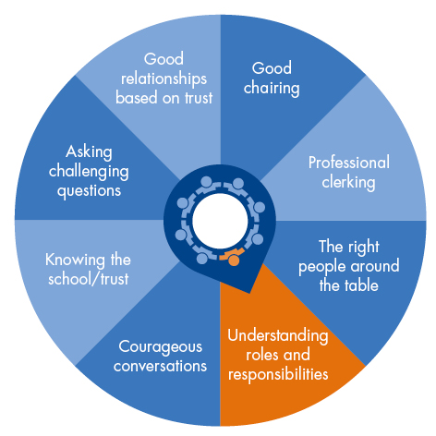
Welcome & induction
Arrange an introductory visit and meeting: often this will include the head
Introduce other contacts:
  Clerk/governance professional
  Buddy/mentor
Provide an information pack:
  understanding the role
  knowing the school/trust
Signpost to an induction training course
Offer support prior to the first meeting

Slide 26

Welcome to a Multi Academy Trust and Welcome to Governance
A guide for newly appointed trustees
A guide for newly appointed governors
Members: £8 Non-members: £16
www.nga.org.uk/wmat
www.nga.org.uk/publications

Slide 27
Bespoke free session for NGA GOLD members during a new volunteer’s first session, separately for:
For new trustees of a SAT board
For new governors on a local academy committee within a MAT
For new trustees of a MAT board
For new governors in maintained schools

Slide 28
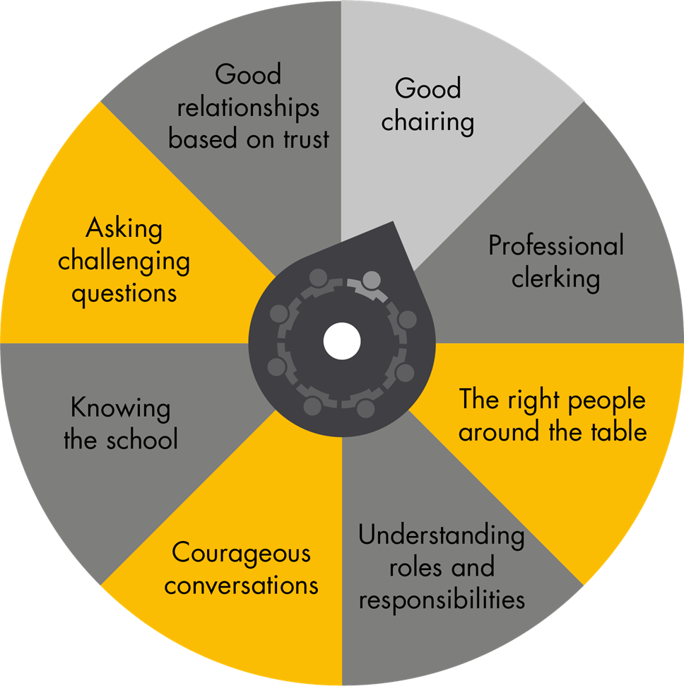
Back to evaluation
What to evaluate?
  Board composition & dynamics
  Governor skills & experience
  Board effectiveness
How in addition to skills audit?
  Annual conversations
  Use your governance professional for advice
  Self-evaluation eg using NGA 20 & 21 questions
  360º review of chair performance
  Board-to-board peer review
  External Review of Governance
  Exit interviews

Slide 29
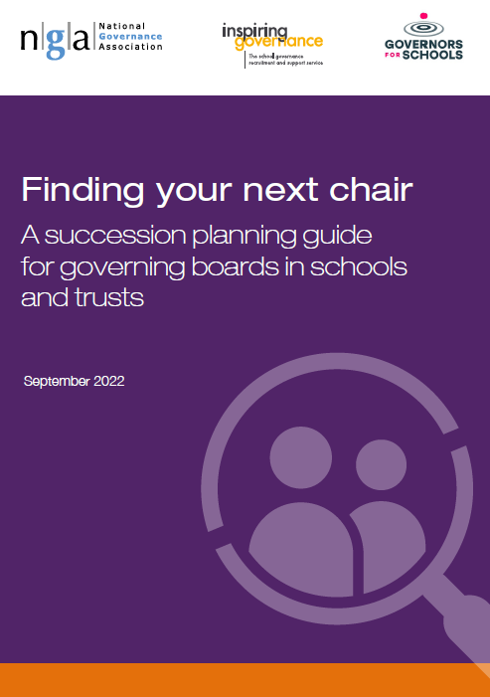
Succession planning guidance
About the role of chair
Electing or appointing a chair
Using the succession cycle
Succession planning activities that work
Sharing leadership to support succession
Accessing support
www.nga.org.uk/succession-planning

Slide 30

Equality, Diversity and Inclusion (EDI): Beyond Compliance
NGA has partnered with ASCL to develop a series of e-learning modules that focus on creating an inclusive culture and ensure governing boards and leaders have the tool they need to promote EDI
The first 2 modules look at why EDI is important and how different types of bias manifest in day to day life. The third module builds upon this by exploring what it means to fulfil the duties of a governor or trustee while putting EDI principles into practice. It provides actionable advice for governing boards to ensure they are effectively promoting the principles and creating a welcoming environment.
These modules are available to all Learning Link subscribers now but also
freely available to those who sign up for a free trial of Learning Link

Slide 31
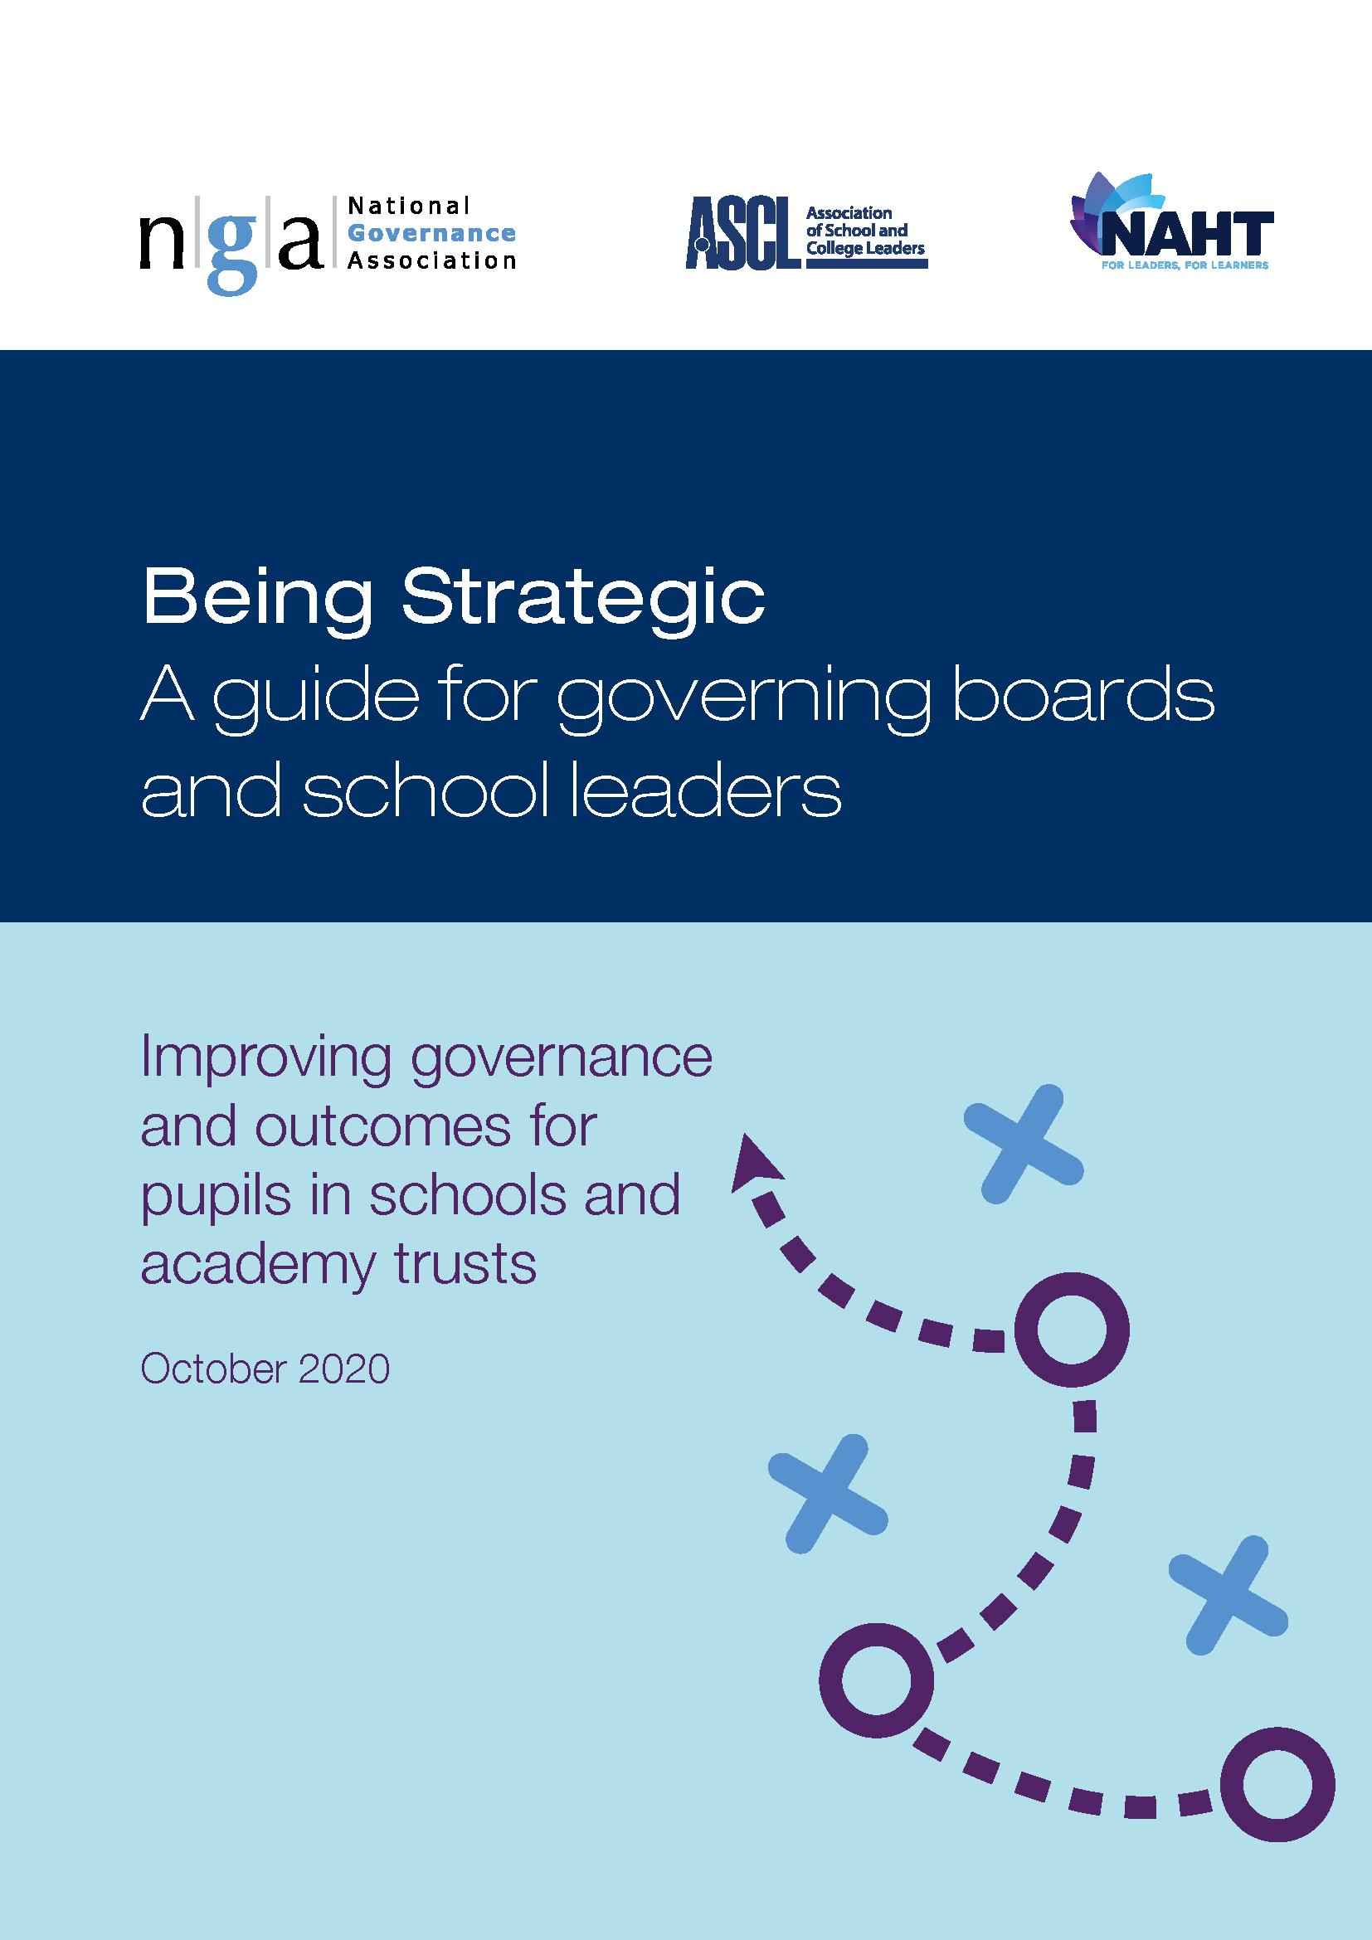
Co-creating creating a strategy to turn vision into reality
Core function of the Governing Board:
Setting vision, values, ethos and strategic direction, and ensuring a culture which will deliver that strategy
What is the vision?
How do we get there?
How do we know if we are getting there?
Do we measure what we value?
For MATs: what is set at board of trustees level and what delegated to academy committees?

Slide 32
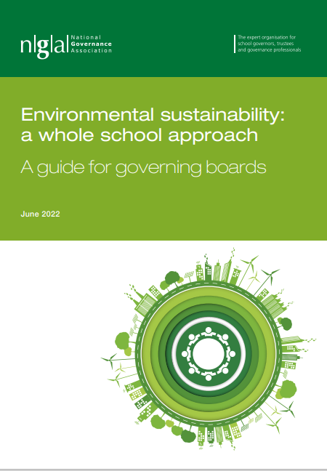
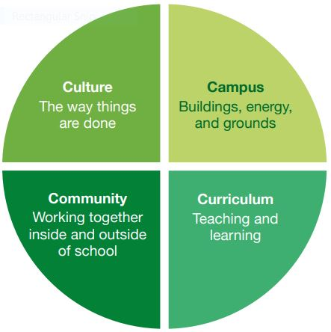
Put Environmental Sustainability & the 4C’s on your agenda:
www.nga.org.uk/GreenerGovernance
NGA webinars - National Governance Association

Slide 33

NGA’s project for 2023: Volunteer workload
What can be done differently?
More distribution across the all the volunteers & the governance professional
What is increasing to unsustainable levels:
  Complaints; panels especially exclusion panels
  Is there more work supporting leaders & reworking budgets?
We will find out more from our exit interview research & our 2023 survey
Is there anything which needs to be removed as a responsibility?

Slide 34


