Slide 1


FASD
Foetal Alcohol Spectrum Disorder
Dr Jane Leighton, Educational Psychologist (Adoption Specialism)
Acknowledgement: Dr Cassie Jackson

Slide 2
Vulnerable children and education
The UK’s All Party Parliamentary Group report into the education of Looked After Children (2012) gave 10 recommendations for improved practice, including that:
“teachers should receive greater training to improve their understanding of and ability to manage issues such as trauma, attachment and Foetal Alcohol Spectrum Disorders (FASD)”

Slide 3
Session aims
What is FASD
Intervention strategies

Slide 4
What is FASD?
Foetal Alcohol Spectrum Disorder is a neurodevelopmental condition with lifelong cognitive, emotional and behavioural challenges.
Cause: exposure to alcohol whilst in utero

Slide 5
Impact on foetus

Slide 6
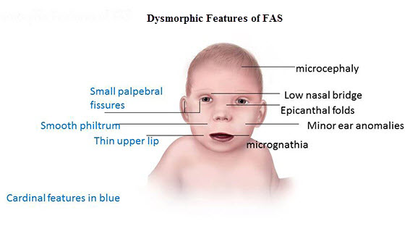
Diagnostic terms
FASD- with sentinel facial features (Formerly FAS- Foetal Alcohol Syndrome)
This is on the most severe end of the FASD spectrum. It describes people with the greatest alcohol effects, causing signs and symptoms so distinct that the diagnosis is based on special measurements and findings in each of the 3 following areas:
Three specific facial abnormalities: smooth philtrum (the area between nose and upper lip), thin upper lip, small palpebral fissures (the horizontal eye openings)
Growth deficit (lower than average height, weight or both)
Central nervous system (CNS) abnormalities (structural, neurologic, functional, or a combination of these)
Ref: healthy

Slide 7
Diagnosis
FASD: pFAS- Partial Foetal Alcohol Syndrome
When a person does not meet the full diagnostic criteria for FAS but has a history of prenatal alcohol exposure and some of the facial abnormalities, as well as a growth problem or CNS abnormalities that person is considered to have partial FAS (pFAS).

Slide 8
Diagnosis
FASD: ARND- Alcohol Related Neuro
People with ARND do not have abnormal facial features or growth problems, but do have problems with how their brain and nervous system were formed as well as how they function. These individuals may have:
developmental disabilities
Behaviour or learning problems
Nerve or brain abnormalities
In particular, a 2011 US convened committee that reviewed the science noted that these children are most likely to have problems with neurocognitive development, adaptive functioning, and or behaviour regulation.

Slide 9
Diagnosis
FASD: Alcohol-Related Birth Defects (ARBD)
People with ARBD have problems with how some of their organs were formed and or how they function, including:
Heart
Kidney
Bones (possibly the spine)
Hearing
Vision
These individuals also may have one of the other FASDs.

Slide 10
Current diagnostic terminology
Foetal Alcohol Spectrum Disorder with sentinel facial features (formerly Foetal Alcohol Syndrome)
Foetal Alcohol Spectrum Disorder without sentinel facial features-formerly Partial Foetal Alcohol Syndrome (pFAS), Alcohol-Related neurological Disorder (ARND), Alcohol-Related Birth Defects (ARBD), or Neurobehavioral Disorder-Prenatal Alcohol Exposure (NDPAE).

Slide 11
Prevalence
Recent research by the University of Bristol indicated that 6% of the research cohort, potentially equivalent to up to 4 million British people, may have FASD. While the UK’s first small-scale active-case ascertainment study is underway and the results not yet published, an active-case ascertainment study in the USA showed rates between 1-5%. In other words, FASD affects more people than autism and is sadly most often undiagnosed or misdiagnosed.
FASD is often called a ‘hidden disability.’

Slide 12
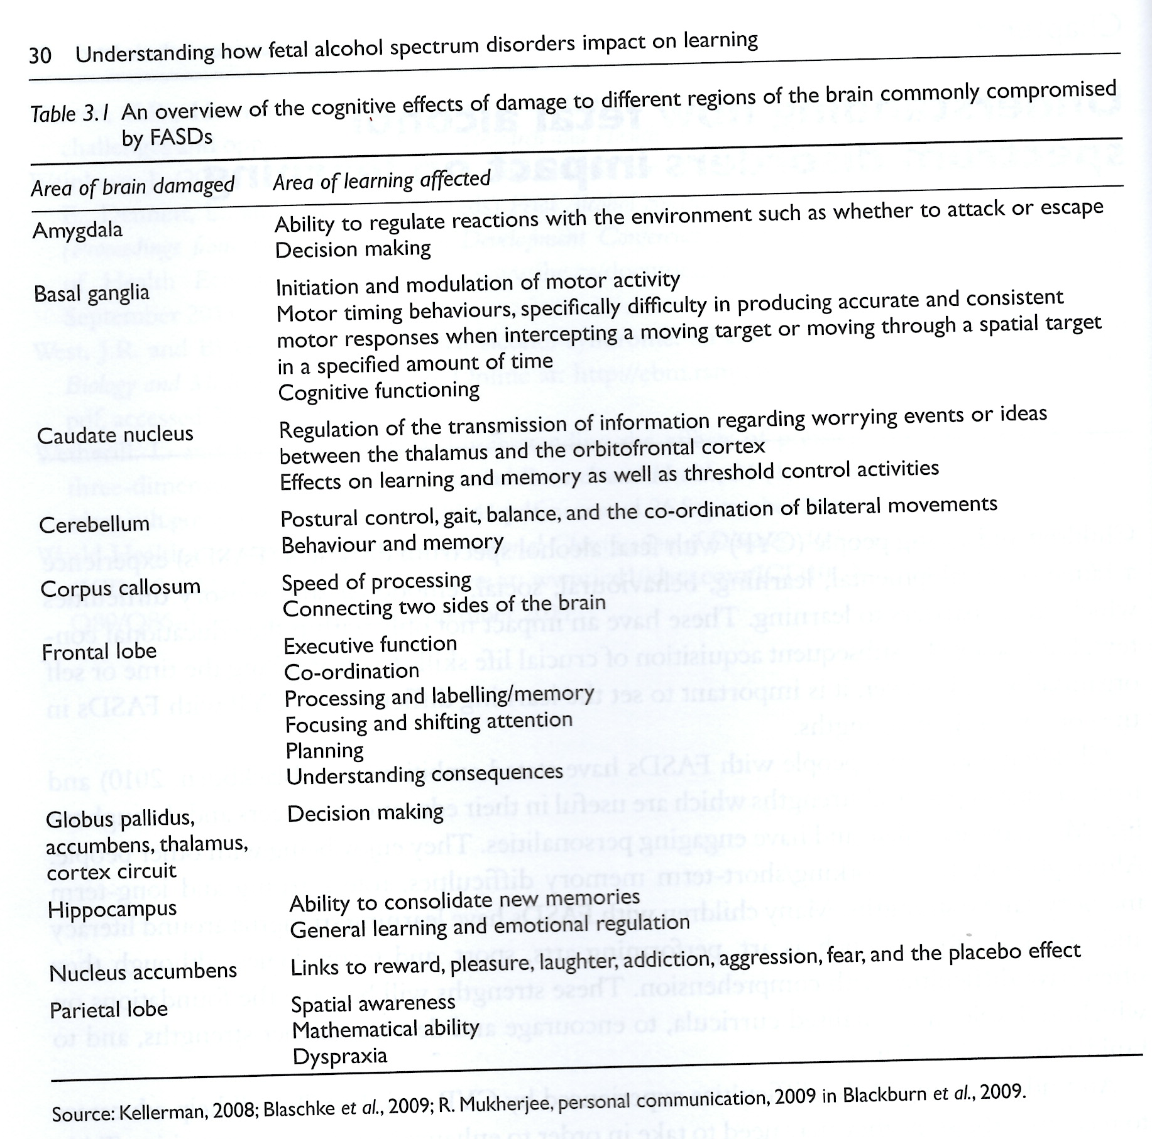
Impact on learning

Slide 13
The Importance of Neuropsychological Assessment
Used in conjunction with medical assessment for diagnosis
The neuro-cognitive impairment in FASD is one of the most significant aspects of the diagnosis
Neuropsychological assessment provides prognostic indicators when considered alongside knowledge general adaptive functioning
Vital for planning future needs/support

Slide 14
‘Textbook’ Neurocognitive Profile in FASD
Verbal IQ is frequently lower than nonverbal IQ
Inference, abstract reasoning, receptive comprehension
IQ, while variable, most typically:
FASD without = 80s
FASD with facial features = 70s
Essentially borderline, and therefore falling between gaps in educational provision
Working memory weakness or impairment
Episodic memory often more spared
Significant executive Functioning Impairment demonstrated in:
Neuropsychological assessment
Reports by parents and teachers
Difficulties with peer relationships
General adaptive functioning for chronological age
NB: Many children with FASD have also been exposed to other substances in the womb, which cause additional problems

Slide 15

The managing director of the brain
Hot Executive Functioning Problems
´Social immaturity
´Poor peer relations
´Naivety/vulnerability
´Hyperactivity
´Poor impulse control
´Poor emotion regulation
´Lack of insight into effect of behaviour
´Poor learning from past mistakes
Cold Executive Functioning Problems
´Poor working memory
´Poor understanding of abstract concepts
´Poor planning and organisation
´Difficulty sequencing
´Perseveration
´Poor sustained attention/concentration
´Inability to work independently

Slide 16
Even with a reasonably normal IQ, children with FASD often lack the core skills required to learn and succeed:
Sitting still
Listening without distraction
Sustaining attention
Understanding cause and effect
Following complex verbal instructions
Planning
Organising their time/belongings/school projects
Regulating responses to frustration
Managing peer relationships

Slide 17
Problems associated with EF Impairment often begin in school from year one onwards:
Easily influenced by others
Difficulty understanding cause and effect and predicting consequences
Difficulty learning from past mistakes
Appearing capable but with less actual ability behind this (confuses and frustrates teachers)
Inconsistent learning profile and poor working memory –‘forgetting’ learning and requiring continual repetition
Difficulty separating fact from fiction
Temper tantrums, stealing, lying, disobedience, defiance of authority
Poor understanding of social rules

Slide 18
FASD person at 18 years

Slide 19
FASD: how does it present?
https://nationalfasd.org.uk/about-fasd/how-it-presents/

Slide 20
If Executive Functioning Impairment associated with FASD is not understood and recognised (particularly in school):
A child can be incorrectly labelled as:
Lazy
Unmotivated
Disorganised
Oppositional
Wilful
Non-compliant
Poorly parented
Generally naughty

Slide 21
‘If s/he would just try harder and listen more, s/he could do it..’

Performance always fluctuates from day to day
Many children with FASD are trying to the point of exhaustion
Constant hyper arousal… meltdowns… more negative labels… further knock-on effect on self esteem.. Vicious cycle

Slide 22
Stop focusing on IQ!
A (near) normal IQ does not mean a child with FASD can function normally.
Executive functioning (and adaptive functioning) is more predictive academic success (social vulnerability) in children with FASD.
An educational psychologist assessment without executive functioning included, does not move anything forward.
The interpretation of neurocognitive results within the context of adaptive functioning is vital.

Slide 23
FASD and the Classroom: Strategies
Sensory overload
Poor attention, concentration and hyperactivity (ADHD)
Poor working memory
Poor peer relationships and poor social skills
Social vulnerability
Meltdowns

Slide 24
Reducing sensory overload
Prevention is the most effective approach to FASD related meltdowns
Difficulty filtering and screening out background interference:
Avoid busy and loud areas where possible/small group working
Teach self-soothing techniques
Build in movement breaks at school and home
Breaks in the classroom –can be masked by ‘doing a job for the teacher’
When giving choices, make these closed and visual where possible –less pressure on working memory and abstract reasoning
Manage transitions carefully – visual timetables, visual timers
Give time to process verbal instruction or explanation (at least 30 seconds)

Slide 25
ADHD Symptoms within the Context of FASD
Remember ADHD is just a symptom of FASD, it is not the whole picture
https://www.youtube.com/watch?v=zj4F6qIsedo
Minimise distraction
Movement breaks
Single step instructions, key information where possible
Task breakdown
Visual prompts
TA support to remain on task and reiterate teacher instructions for poor working memory
Over-learning and repetition

Slide 26
Meltdowns
Largely occur because of:
Sensory overload
Anxiety
Impaired hot executive functioning
Prevention is key (but won’t always work)
In school -frequently hyper-aroused over-whelmed by their environment
Often it is environmental and external factors in the world that trigger meltdowns
Pre-planning and analysis of triggers –hard work but effective
Keeping sensory overload and anxiety to a minimum
Strategies for poor working memory and ADHD
Preparation and transitions
Consistency and routine
Reassurance and repetition ++

Slide 27
General teaching strategies
Multi-sensory learning –visual, kinaesthetic, auditory
Demonstrate as well as describe new techniques, and be prepared to repeat this daily
Small group work and one-to-one work where possible
TA support to help child remain on task (cold EF)
Construct a personalised learning plan based on child’s strengths and interests
Use consistent language and approaches across home and school (working relationship with parents)
Allow time to process verbal information. Ask the child to repeat the instruction back to you (however remember they still might not fully understand…)

Slide 28
Ten fundamental FASD teaching responses
A calm learning environment, free from clutter
Focused tasks presented in small steps
Personal space for student with plenty of support and praise
Visual structuring
Scripted/ role play
Short, information carrying instructions
Visual clarity and graphic simplicity
Frequent, short exercise programmes throughout the day
A break down of tasks with visual and tactile cues
Multi-sensory learning pathways

Slide 29
Strengths to build on:
Practical strengths that are useful in CYP’s educational careers and throughout life
Many affected children are articulate and have engaging personalities. They enjoy being with other people
Many have learning strengths around creative subjects, such as art, drama, sport, and technologies, although they often have difﬁculties with comprehension and sequencing tasks.
While there are working/short-term memory difﬁculties, rote learning and long-term memory can be relative strengths.

Slide 30
Social vulnerability with Peers
Secondary school in particular
Rule of thumb: halve a child’s age for their social/emotional functioning age –keep your expectations of them at this level
Easily led = Supervision +++
Nurture groups (teaching social skills, feelings), role play, social stories
Ownership and stealing
Blurred reality and fantasy: ‘lying’ and confabulation

Slide 31
Tendency to repeat past mistakes
Children with FASD struggle to learn from past mistakes and to imagine the consequences of their actions.
This makes discipline difficult and largely futile
Prevention is everything (and even then not always realistic)
Teaching self-regulation skills is key –this will not happen overnight and will likely never reach same level as unaffected young people

Slide 32
The problem with traditional behaviour management strategies
For a child to change their behaviour in response to either threatened punishment (detention, extra work) or future reward (positive referrals, treats, extra play time) they must:
Understand the concept of ‘future earning’ / deferred gratification
Have the impulse control to control reactions
Understand cause and effect
Have some understanding of impact on others
Be able to regulate emotional response
Children with FASD generally do not have these skills

Slide 33
Teachers of children/ YP with FASD will need to:
Provide the scaffolding around the child’s executive functioning impairment.
Remember they will not fully understand the link between behaviour and consequences, even if they tell you they do.
Repeat. A lot.
Remember the child will struggle to transfer learning a skill from one environment to another… hence the repetition.
Supervise, supervise, supervise..
Accept that there are some skills they may never fully master and will always need support with.
Manage your own expectations –this is organic brain damage, not a ‘behaviour problem’.
Think ‘can’t’ not ‘won’t’ – don’t assume intentionality.

Slide 34
For teachers of CYP with FASD
https://www.youtube.com/watch?v=fSsCXnsYKRI

Slide 35

Resources
https://nationalfasd.org.uk/
https://fasd.me/
Strategies NOT solutions https://edmontonfetalalcoholnetwork.org/resources/strategies-not-solutions/
https://tinyurl.com/GuernseyOTSensoryStrategies

Slide 36
Myth busting
https://nationalfasd.org.uk/about-fasd/mythbuster/

