Slide 1
Introduction to the
IQM Awards

Slide 2



Inclusion Quality Mark

Slide 3
Inclusion Quality Mark

Slide 4
Current Position
IQM is currently working with more than 5,500 schools which is increasing on a daily basis.
Working in support of a number of local authorities and academy chains

Slide 5
What is Inclusion?
Raising achievement for all.
Creating the environment which provides the opportunity for all to succeed.
Promoting access and diversity to their fullest extent.

Slide 6
How does IQM contribute to the whole school improvement/effectiveness programme?
Self evaluation.
School/Organisation improvement planning.
Training & advisory input including bespoke CPD programmes.

Slide 7
The Three Core Groups
The Individual Pupil
The Family and Community
The Staff

Slide 8
The Self-Evaluation Report (SER)
The Inclusion Values of the School/Organisation.
Leadership, Management and Accountability.
Curriculum (Structure, Pupil Engagement and Adaptation).
Teaching and Learning- Learning Environment, Planning Resources and Pedagogy.
Assessment.
Behaviour, Attitudes to Learning and Personal Development
Parents, Carers and Guardians.
Links with Local, Wider and Global Community

Slide 9
Inclusion Cluster Groups

Slide 10
Why?
Celebration
Collaboration
Capacity

Slide 11

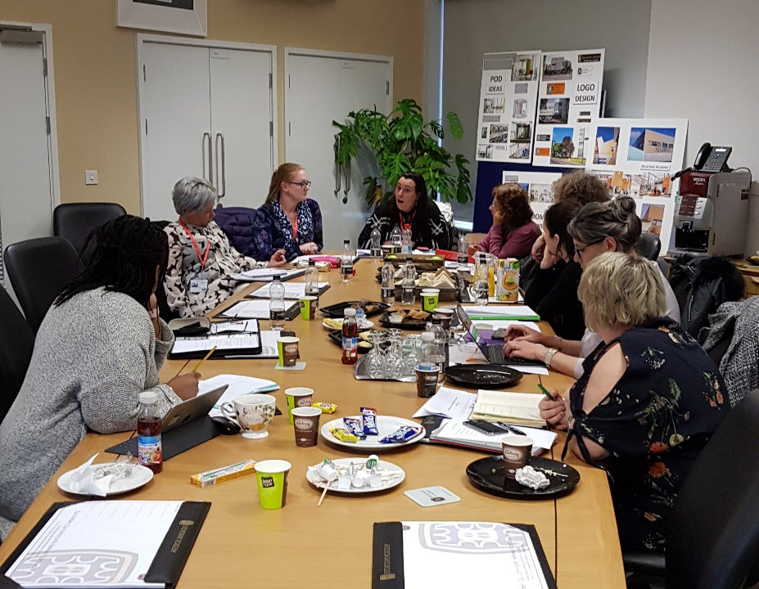
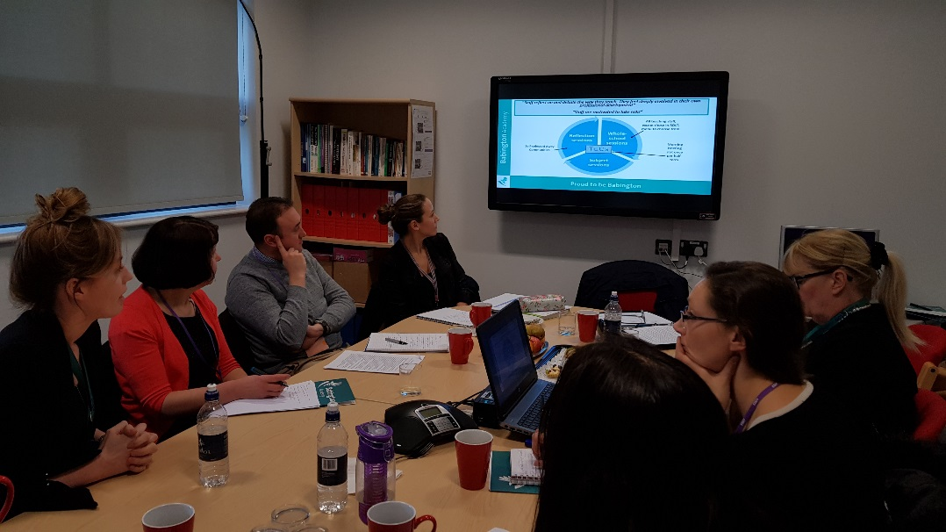
Why?
Creating safe, happy and exceptional students through the ongoing development of curriculum and assessment.
Drama and Self-Esteem
Inclusion in Practice
Transition
Leadership for Inclusive Practices
From Good to Outstanding
iPeace and Restorative Practices
Maximizing the impact of TAs
Teaching & Learning

Slide 12
Why?
Managing the Needs of Learners who are New to the UK
Intervention and Monitoring of Disadvantaged Pupils
Pupil Nurture and Well-Being
Behaviour and Mental Health
Student Ethos and Culture
The Use of Computing and Mobile Technology to Enhance Learning for All Learners
Inclusion for All (LGBT+)
A Research Informed Approach to Inclusive Practice
Inclusive Community Working for the Benefit of Our Stakeholders
Outdoor Learning - Forest School
Attachment Theories, Issues and Practice

Slide 13
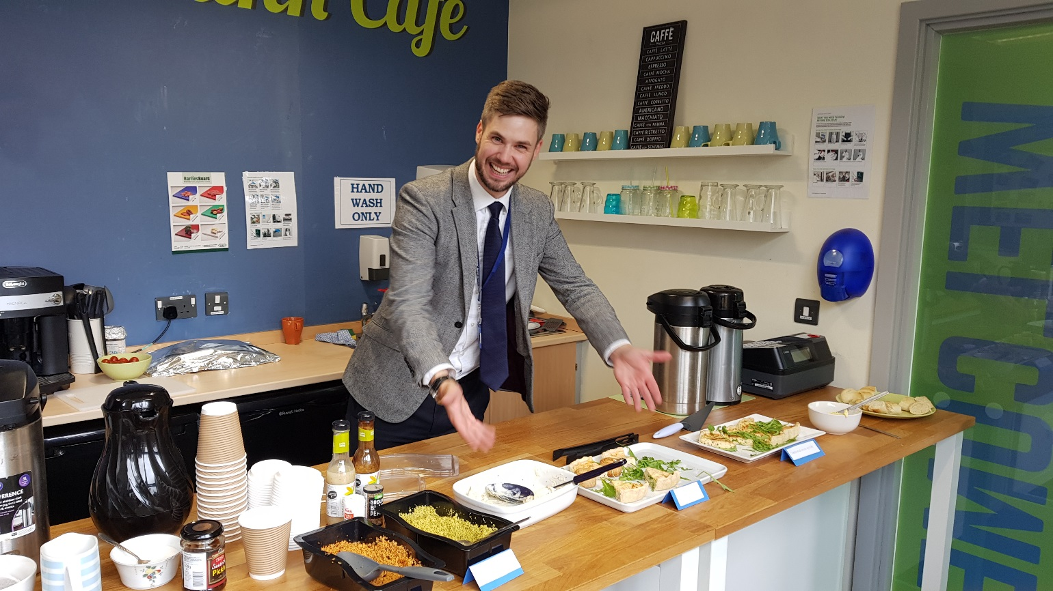
Inclusion Quality Mark

Slide 14
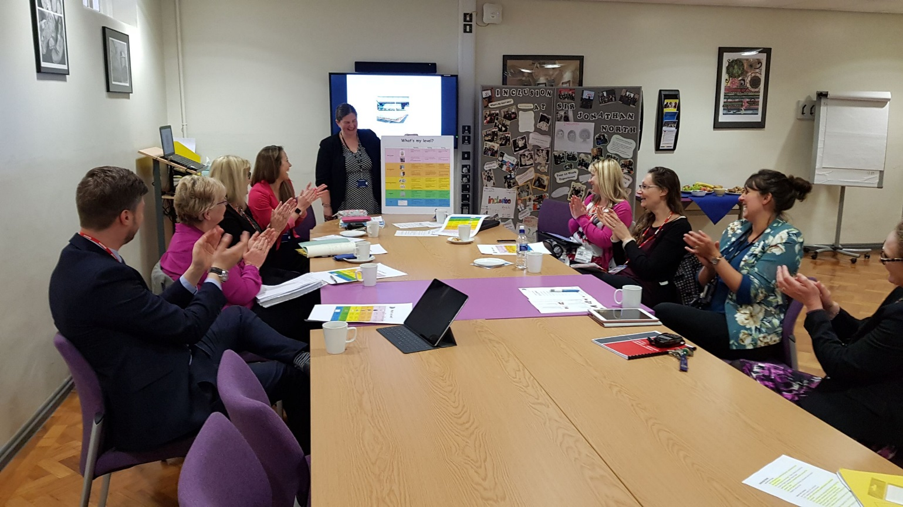
IQM Cluster Groups

Slide 15
For Additional Information
Email: info@iqmaward.com
Website: www.iqmaward.com
Tel: 02871 277857

