Slide 1
EPAC: Education Plan for Adopted Children Dr Jane Leighton: jane.Leighton@suffolk.gov.uk
Aims:
Post LAC context/ support
Post-LAC school obligations
The EPAC
Sign posting/ Resources
Notes:
Whilst you are watching, please note anything that comes to mind, ideas/ thoughts/ comments which could be helpful in moving this task forward.

Slide 2
Needs of Post-lac CYP: The multiple impact of early adversity upon mental, physical and social health (Golding, Dent, Nissim and Stott, 2006)
Early abuse and neglectful experiences
Abnormal brain development
Difficulty/ inability to recognise and regulate emotions
Difficulties in:
Mental Health
Physical health
Social Health

Slide 3
Manifesting difficulties
Attachment relationships with adults
Managing peer relationships
Managing their feelings and behaviour
Coping with transitions
Developing their executive functioning skills
Bullying
School absence
ALSO..
May have a formal diagnosis. FASD is now prominently implicated.

Slide 4
History: Post LAC needs
Rushton (2003/4) review: 3 “hardest to handle” difficulties for adopted children and families
Behavioural and emotional difficulties
Relationship difficulties
Education problems
Selwyn, Meakings and Wijedasa. (2014). “Beyond the adoption order”.
1/3 families reported facing “major difficulties”/ placement disruption
1/3 families experiences “highs and lows but mainly highs” (82% clinical diff’s on the SDQ in placements rated “challenging but continuing).)
3. 1/3 reported things were going well. (25% clinical diff’s on SDQ)
Notes:
Increasing rise of children in care..Since 200o government review of adoption as a pathway for CIC
Scoping and scanning
Behav diffs : non compliance, over activity stealing, anxiety, fearfulness
Difficulty showing warmth and expressing feelings, regulating emotions and close relationships
Delayed school attainment, communication and concentration problems, behavioural difficulties, poor relationships with peers and teachers.
Beyond the adoption order research into why adoptions disrupt.

Slide 5
Research from Adoption UK
“80 % of adopters said their child needs more support than their peers and nearly 2/3rd’s of parents (59%) said their child is always trying to catch up in school and make up for their early life experiences”

Slide 6
Support:
Post adoption support statutory service since 2002 (The Adoption and Children’s Act, 2002).
Adopted children given highest priority to school admissions (2014).
Pupil premium plus for post LAC (2013/14).
Adoption Support Fund (ASF, 1st may 2015).
Extension of the DT role (2017/18).
Trial of pupil premium plus for post 16, post C LA 2021/22
Notes:
ASF funds treatment packages capped at £5000

Slide 7
Adopted children/ SGO and in school support: Statutory duty and guidance
Schools and education settings have a statutory duty to support previously looked after children. The statutory duty applies to children from aged two in a funded education place up to post 16 who are educated in a maintained school or academy.
Local authorities have a statutory duty to provide information and advice about previously looked after children from aged two in a funded education place to the end of Year 11 who are educated in a maintained school or academy.
Maintained schools and academies must have a designated teacher responsible for previously looked after children.

Slide 8
Adopted children/ SGO and in school support: Statutory duty and guidance
Pupil Premium Plus for looked after and previously looked after children.
Pupil Premium Plus is available to pupils from reception age to Year 11 in state-funded education in England who:
Are in local authority care in England.
Have been adopted from care in England or Wales.
Left care under a Special Guardianship Order (SGO).
Left care under a Child Arrangements Order (formerly known as a Residence Order)
The DfE has said that it intends the funding to be spent on: ‘...helping adopted children emotionally, socially and educationally by providing specific support to raise their attainment and address their wider needs.’
Notes:
In 2013 the DfE introduced Pupil Premium Plus for looked after and previously looked after children. In doing this, the DfE acknowledged the enduring impact of trauma and loss in children's lives and the key role of schools in supporting children who have had a difficult start in life. Pupil premium plus is currently £2,300 per child per year.
How is funding accessed? In order for schools to access the funding, parents and guardians must declare their child's adoptive, SGO or CAO status directly to the school before the school completes the January census. Parents and guardians must provide evidence, for example, a copy of the legal order order, or a confirmation letter from the local authority which placed their child. Parents should not need to declare their child’s status again until the child changes school.
The DfE has said that it intends the funding to be spent on: ‘...helping adopted children emotionally, socially and educationally by providing specific support to raise their attainment and address their wider needs.’ The focus on children’s social and emotional and wider needs is in contrast to the Pupil Premium for children eligible for free school meals, which is focused on closing the attainment gap.

Slide 9
What is the EPAC
A resource for schools and families
The start of a conversation
Research:

Slide 10
EPAC in Suffolk
Aspiration
Work to date
Notes:
Experience of working with parents
Discussion with VS, adoptive parents, working group.. Current trials, contact with Devon

Slide 11
EPAC

Slide 12
Case studies
Case study 1
Case study 2

Slide 13
Further help: Suffolk Permanence Team: Post adoption (SGO) support
Assessment of need
Organise/ deliver therapeutic support:
Theraplay
VIG
Life story work
Dyadic Developmental Psychotherapy
SENSi/ Jumpstart: sensory attachment focused sensory integration therapy/ and assessment
Specialist EP: training, parent/ carer helpline, service development
Complication with SGO’s support and ASF
Use PAC UK
Centre for FASD: Dr Cassie Jackson
Parents and carers can self-refer on the duty line 01473 265700
Notes:
40 kids adopted in Suffolk
Impact of developmental trauma and attachment on learning
Adoption triangle support and schedule 2’s (birth records for an adult…) Birth records inquiry… when adopted adult wants to trace a parents/ siblings. Adoptions pre 75 and after 75…

Slide 14
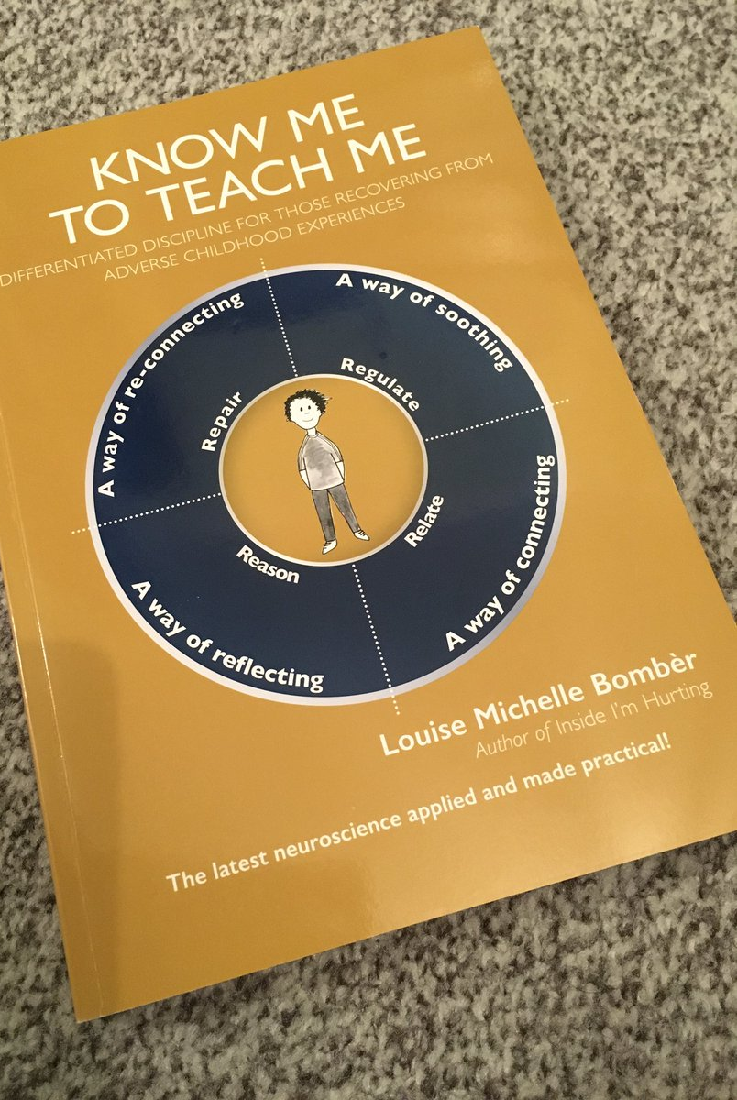
Useful resources

Slide 15
Resources
PAC-UK: From Protection to Inclusion: A Handbook for teachers on children in alternative
care and adopted children.
Meeting the needs of adopted and permanently placed children - A guide for
school staff
https://www.pac-uk.org/our-services/education/education-resources/
Adoption-UK:
Family Futures: e.g., https://www.familyfutures.co.uk/services-for-schools/#:~:text=Anti-Bullying%20Resource%C2%A0for%20Schools
FASD:https://nationalfasd.org.uk/
https://fasd.me/
Strategies NOT solutions https://edmontonfetalalcoholnetwork.org/resources/strategies-not-solutions/

