Slide 1
Adapting phonics using visual methods

Slide 2
The communication chain

Slide 3
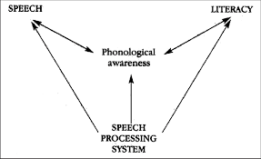
A common root – Stackhouse and Wells

Slide 4
Phonological awareness
Phonological awareness precedes phonic skills. It involves the knowledge that sounds are the building blocks of words.
It depends on being able to hear and manipulate the sounds in spoken language, such as words, syllables and rhyme before progressing to the individual sounds in words.
For pupils with SLCN these skills may not develop on their own, and they will need visual strategies and direct teaching to help raise awareness of the sounds and patterns in spoken language.
A1%20SLCN%20Specialist%20Teacher%20Sept%202020/SLCN%20resources/The%20Ultimate%20Guide%20to%20Phonological%20Awareness.pdf

Slide 6
Phonics or phonemic awareness
Some pupils with SLCN may not have an ‘inner voice’ or an auditory memory of words they hear.
The usual pattern of development may be different, and visual routes to support phonemic awareness will be more important.
More practice will be needed in a variety of ways and with more attention given to visual presentation (pictures, written pattern or visual cuing system)
Phonological awareness (pre-phonic skills) will need to be worked on alongside phonics teaching.

Slide 7
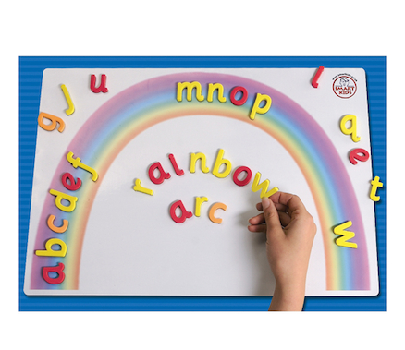
Multisensory approach
Integrate the use of visuals as part of a multi-sensory approach (look listen say do write to remember) – a vital strategy for teaching and practicing phonics for pupils with SEND or EAL.
Opportunities to practice phonics through play/ games/ sensory experiences can still be motivating for older children.

Slide 8
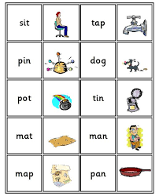
Understanding the language
With icons you can find in Word, Google images and symbol support software such as Communicate in Print or Widgit on line, a visual illustration for most words cab be easily and quickly produced.
For example, most of the Letters and Sounds phase 2 words can be illustrated with a picture, and of the more than one meaning of the same word (tap, bark etc)

Slide 9
Using visual cueing systems
There are different visual systems which can be used to support children who have difficulty accessing phonics through listening alone
As a sound is said, a particular hand shape or movement accompanies the sound.
Using a visual method to enhance the memory of what can be heard gives the pupil a way of remembering.
They are linking something that they know and find easy with something they find difficult.
Discrete actions or hand movements provide kinaesthetic support for learning letter-sound correspondence.

Slide 10
Examples of visual systems
Jolly Phonics
Visual Phonics
Cued Articulation

