Slide 1
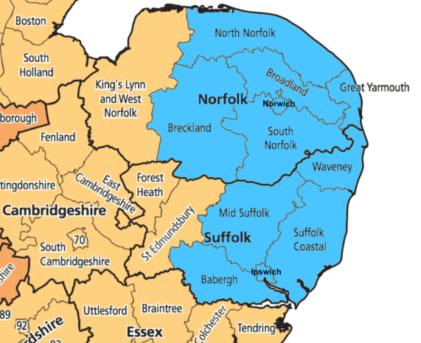
Welcome to Angles Maths Hub
Working together to create an indispensable community for Maths staff, through collaboration and high-quality training.
All Hub training is offered to state schools free of charge and some programmes are funded.

Slide 2
Primary School Projects 2021/22
Create transformative leadership and culture that promotes a mastery approach to primary mathematics teaching and learning
Working together to create an indispensable community for maths staff through collaboration and high-quality training.
Deepen the subject knowledge in the teaching and learning of mathematics for:
EYFS Teachers
KS1/2 Teachers
TAs
Early Career Teachers
Embed a Teaching for Mastery approach across the school
Subject Knowledge Enhancement
Mastery Readiness
Mastery Development
Embedding Mastery
Sustaining Mastery
Year 5 to 8 Continuity
Develop a consistent approach for Key Stage 2 and 3 teaching and learning
Mastering Number
EYFS and KS1
Supporting mathematics development in EYFS and KS1
Develop teachers' mathematical and pedagogical knowledge of a mastery approach in the primary classroom
Secure a whole school approach to sustained change in mathematics
All Work Groups are free to attend, with Development and Embedding
offering additional funding for schools
W: anglesmathshub.org | E: admin@anglesmathshub.org | T: 01603 280940 | Express your interest here

Slide 4
Contact Us
Express your interest: https://forms.gle/GxuApCdxpez2MYcL8
Hub Lead: nicolacoe@anglesmathshub.org
Primary Lead: charlottemartin@anglesmathshub.org
Secondary Lead: samphillips@anglesmathshub.org
Richard Harding: admin@anglesmathshub.org
Notes:
https://forms.gle/GxuApCdxpez2MYcL8

