Slide 1

Working with Parents
Welcome
Sian Monteith
Training & Development Officer

Slide 2
The Children and Families Act 2014
Duty to have regard to:
the views, wishes and feelings of child, young person and parents
the importance of child and parent participation
giving clear information and advice
outcomes and impact
Children and Families Act 2014, Section 19

Slide 3
The SEND Code of Practice says:
‘parents know their children best and it is important that all professionals listen and understand when parents express concerns about their child’s development. They should also listen to and address any concerns raised by children and young people themselves’.
SEND Code of Practice Section 6.20
Notes:
.

Slide 4
In this session we will explore:
Key ingredients of a positive meeting or conversation
Underlying causes for a parent’s stress, distress or anger
Practical approaches for positive communication with parents in meetings, conversations and emails and to support them to participate.
Focus on preparation today.
We’ll email you the slides & helpful links.

Slide 5
Jamboard
Think of a positive meeting or conversation that you have had recently.
What do you think made it go well?
What helped you feel comfortable regarding the exchange of information, the environment and timings?
What helped you feel calm and in control?
Notes:
Brainstorm

Slide 6
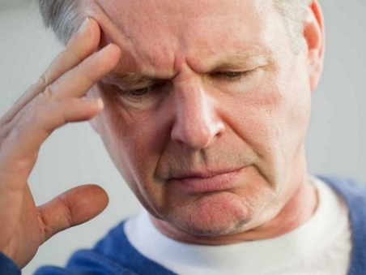
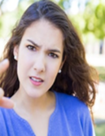
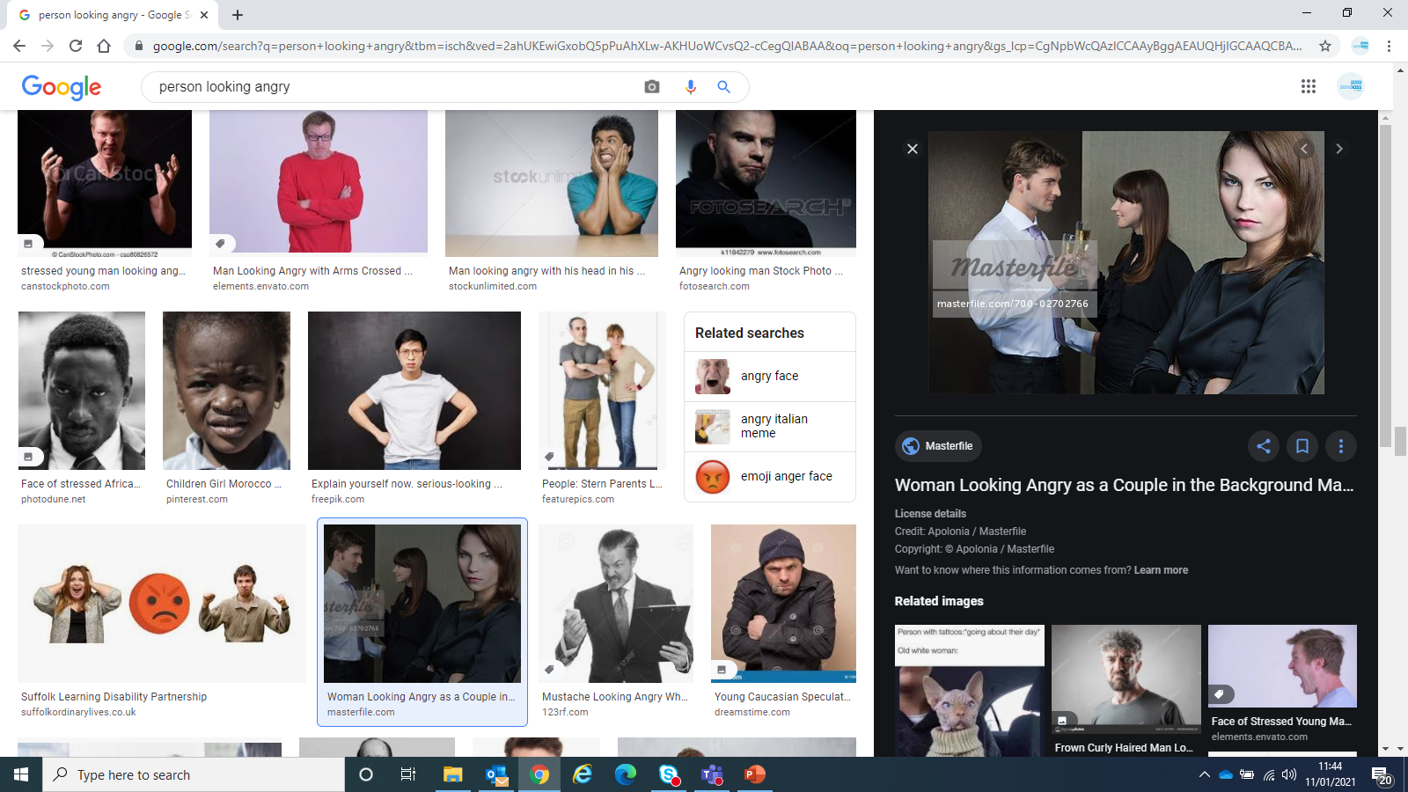
Why might a parent arrive at a meeting or face you in a conversation looking stressed or angry?
STRESS

Slide 7
Being prepared
Being prepared for a conversation or meeting can make a huge difference to our ability to feel comfortable and in control

Slide 8
Quick chat at drop-off or pick. Consider:
Are they expecting this? Could they feel ‘ambushed’?
Will others be able to overhear your conversation?
Consider sending a quick email or text beforehand:
Hello …
It would be good to have a quick chat with you.
Have you time for a short phone call after school
today?
If not, please suggest a time which would work well for
you.
Looking forward to speaking to you soon.

Slide 9
What happens to our bodies when we feel stressed/threatened/upset?
Do unmute and jump in or post or use ‘chat’.

Slide 10
Emotional Flooding
thinking space
thinking space
feelings
feelings
‘An angry person is a stupid person because their higher brain function has been inhibited from working by our primitive centre of emotion.’
Psychologist Joe Griffin

Slide 11
Planned meeting or discussion
What might ‘throw’ a parent when a planned meeting or conversation is about to start?

Slide 12
Planned meeting or discussion : consider
Is the parent aware of:
The purpose/agenda? How do you know if they
have the same perception?
What information will be discussed? (Will there be
any new information shared?)
The duration of meeting or conversation?
Who will be attending?
Do they have any learning or mental health issues which might impact on their ability to take part?

Slide 13
Pre – meeting email template
Dear ….
We’re looking forward to meeting with you on.. (day, date,
time, where or how to join online)
We just want to confirm what we are expecting to make it
easier for us all to prepare and take part.
We aim to (explore/discuss/agree..)
We expect we will need (eg an hour)
Joining me will be …
(For a SEN meeting) Do encourage your child to share their
thoughts and join us. Are there adjustments we can make
for you and your child to make it easier to take part?
You are welcome to text or email us your key questions.

Slide 14
Before a planned discussion/meeting
Agree the reason for the meeting or conversation
Establish time boundaries and date/time
For a SEN meeting, encourage the parent to gain the child’s view
Is there information which is helpful to share in advance? Is it clear how parents can participate?
Tell parents who will be attending from school.
Consider the additional needs of the parent
Consider how to follow up unresolved issues

Slide 15
Meeting planner
See SENDIASS Leaflets and Resources
What is the important issue? | Suggested/agreed action | Who will action and when?
1.
2.
3.
4.

Slide 16







Person – Centred Tools
Important people
How others describe me
My Journey So Far
The best ways to help me
The best way to communicate with me
All About Me
What is important to me
Things I like doing
My dreams

Slide 17
What would you do…
A parent catches you as they drop their child off.
The parent is quite worked up and starts to share details of the matter which is worrying them straight away.
It’s not a crisis situation and you can’t stop and talk right now.
How will you respond?
Do unmute and jump in
Notes:
Real response when you’re tired, busy, stressed?

Slide 18
Your Positive Offer
It is helpful to consider in advance what your availability will be this week so that you can be prepared with a ‘positive offer’.

Slide 19
Before your meeting or conversation starts
‘Reframe’
Expect that this meeting or conversation will go well and that things are going to change for the better.

Slide 20
Betari Box
How I think and feel
Affects
Affects
How you behave
How I behave
Affects
Affects
How you think and feel

Slide 21
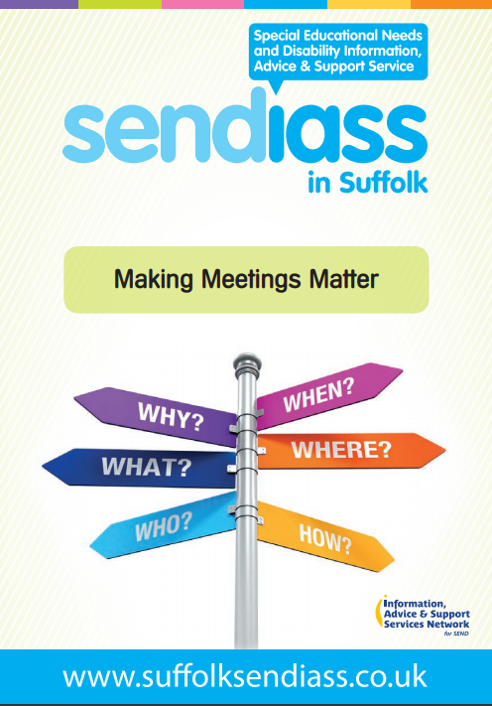
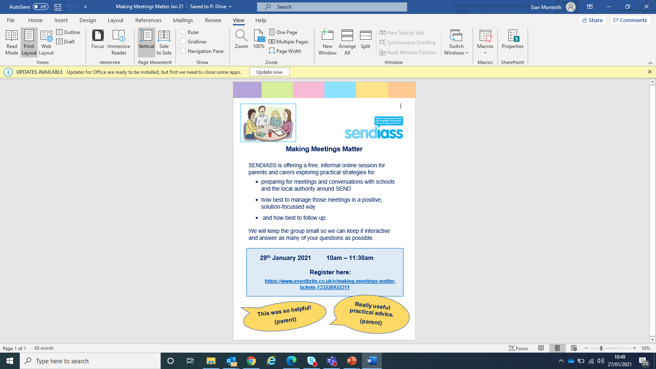
Leaflet for Parents and Making Meetings Matter Workshop

Slide 22

How we can help you
Help parents understand what they can reasonably expect in terms of SEN support
Help foster positive partnership working between parents, pupils and schools. We don’t collude or judge. We take a solution-focussed approach.
Offer training for staff and governors
Offer training and information sessions for parents and carers

Slide 23
Contact details and comments
www.suffolksendiass.co.uk
enquiries@suffolksendiass.co.uk
Helpline: 01473 265210
Comments from Service Users:
Fantastic service!
Very useful suggestions – directly relevant to my work.
Every question or query (no matter how small) is always responded to.

Slide 24

Thank you for taking part today.
We really value your feedback ☺

